Slide 1
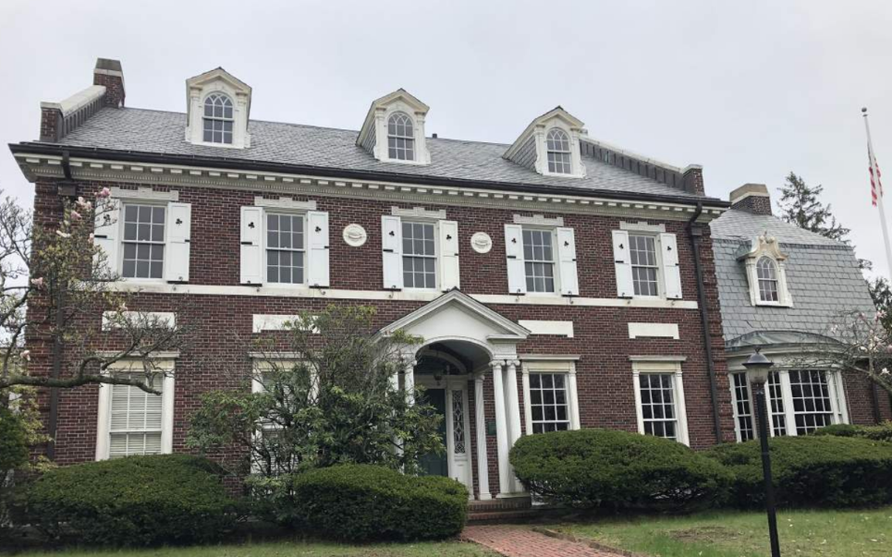
Curley House
350 Jamaicaway

Slide 2
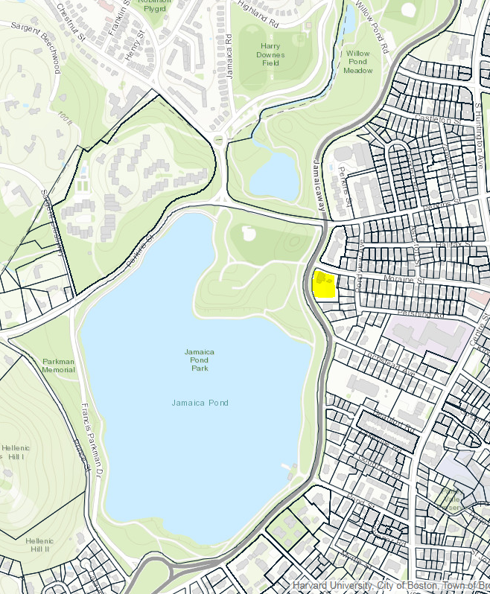
Location

Slide 3
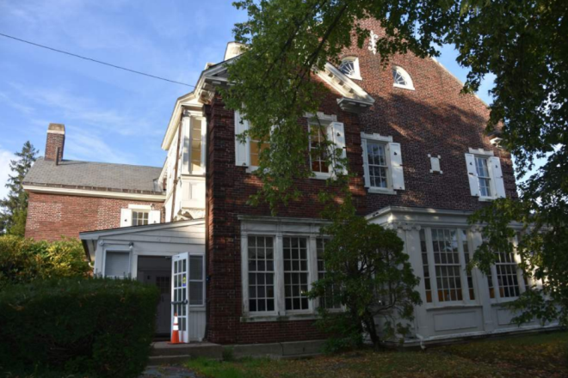
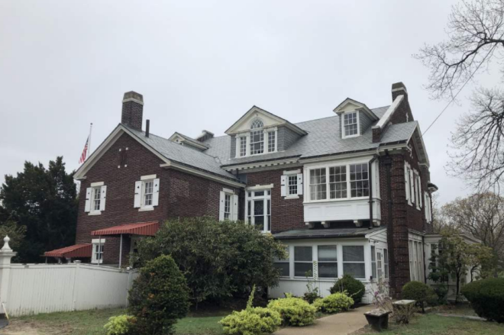
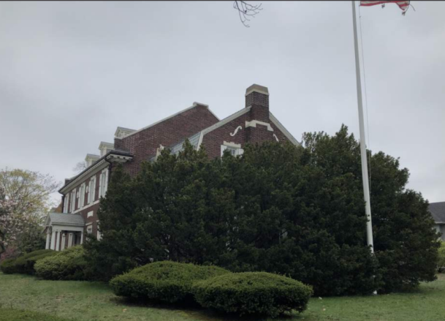
Landmarks Designation
Exterior designated
Some interior areas designated
North East (rear) Elevation South

Slide 4
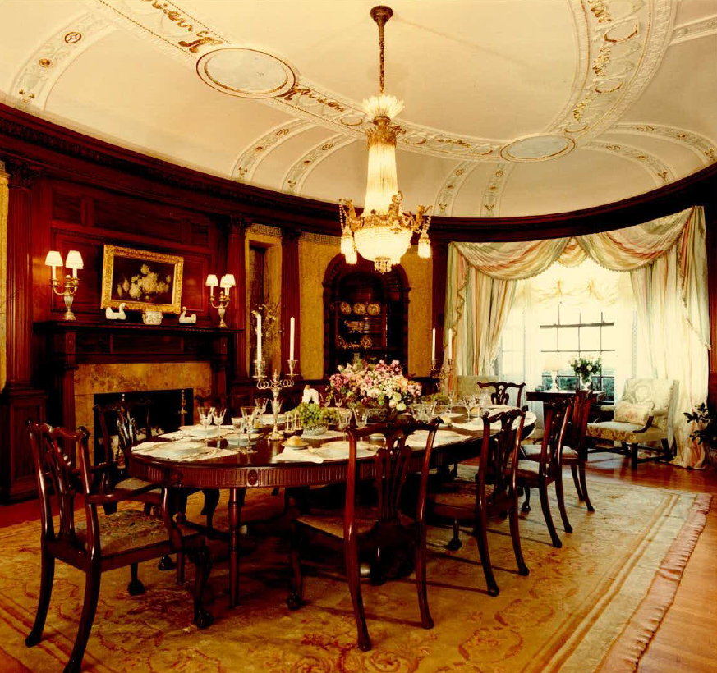
Interior Designation - Dining Room

Slide 5
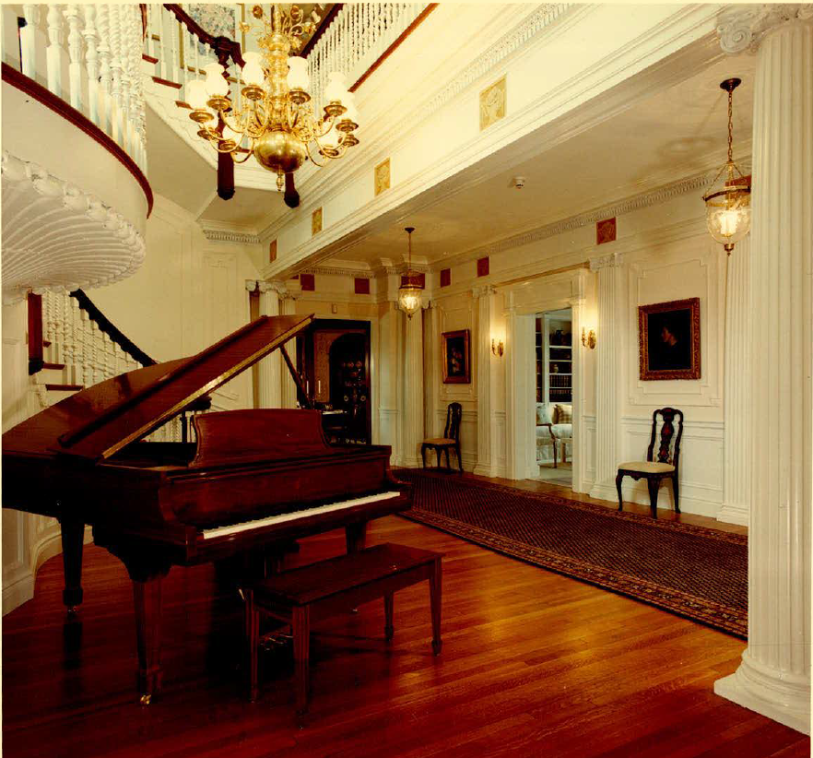
Interior Designation – Entry Hall and Stair

Slide 6
History
Private House constructed in 1915 for James Michael Curley - Architect Joseph P. McGinnis, builder Thomas O’Connor
Certain features of the interior were acquired from the estate of Henry H. Rogers of Fairhaven when the Roger heirs put his 1895 house and contents up for auction
Purchased by Oblate Fathers of Mary Immaculate for Missions among the Poor in 1956
Acquired by Fund in 1988
Museum envisioned but never was fully utilized
Junior League Show House in 1995
RFP advertised 2016 for use of house
ENC responded – office and interpretive space use

Slide 7
Change in Use
New use required zoning variance
Variance approved
Also requires a new certificate of occupancy
  Building
  Plumbing
  Electrical
  Fire

Slide 8
Current requirements
Some additional lighting and emergency signage required because of office use.
Exit signs and emergency lighting within the landmarked areas of the interior
Emergency lighting at the exterior

Slide 9
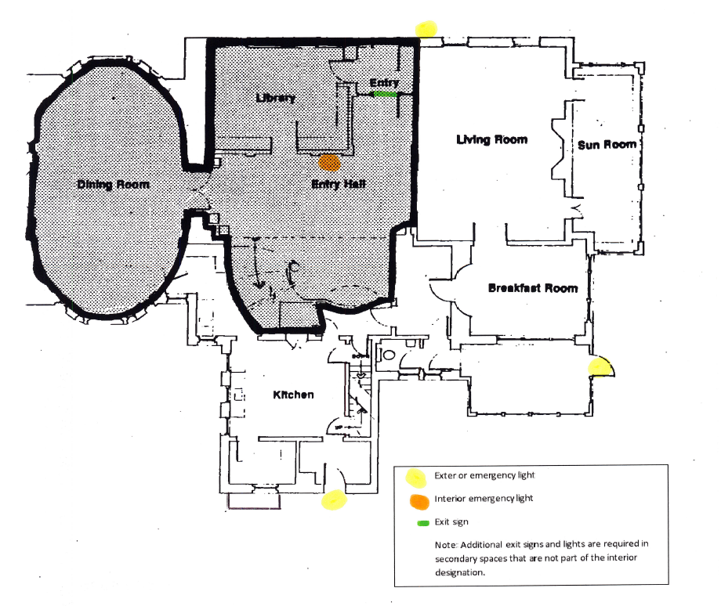
Landmark areas

Slide 10
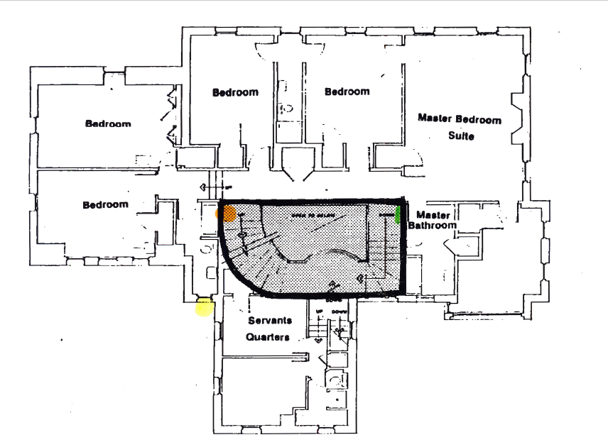

Slide 11
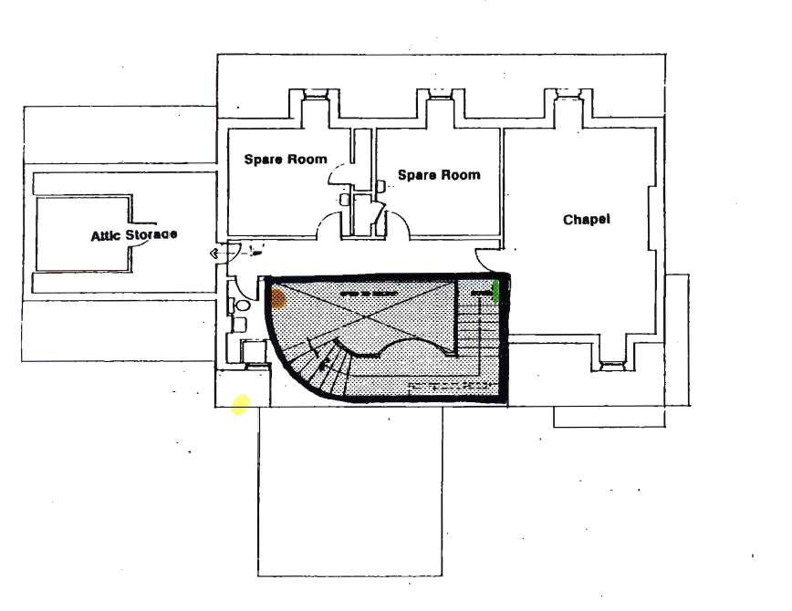

Slide 12
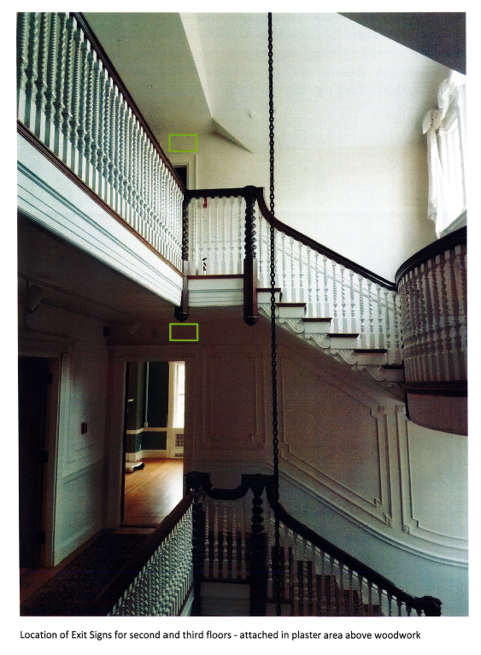
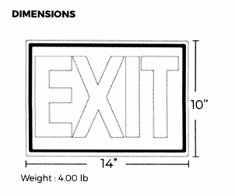

Slide 13
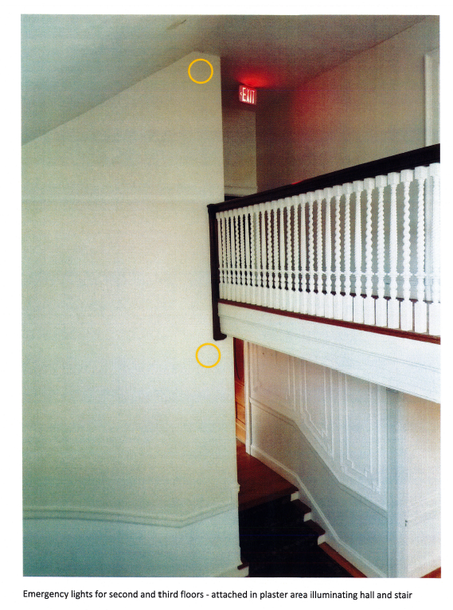
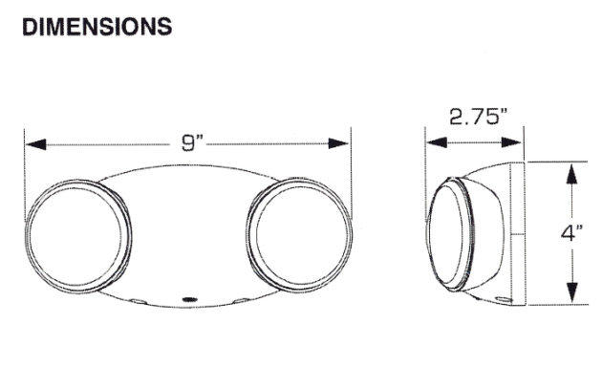

Slide 14
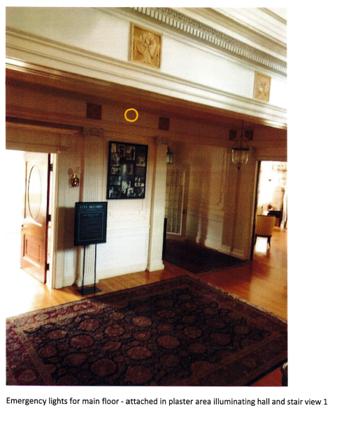
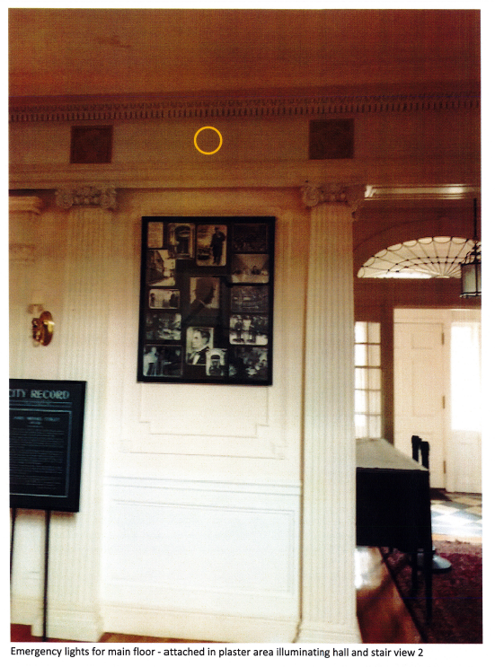

Slide 15
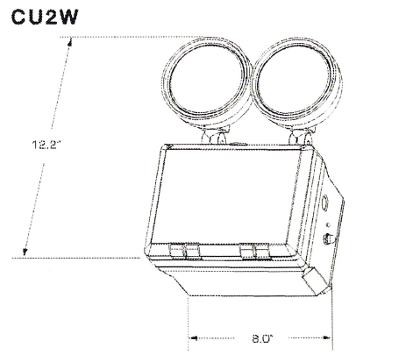
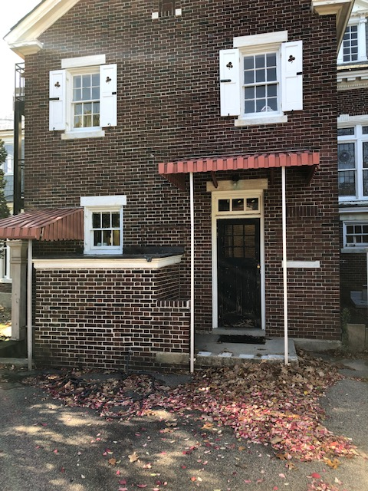

Slide 16
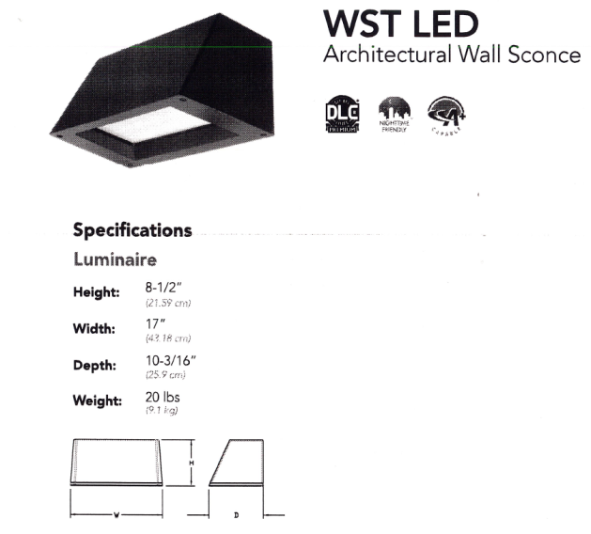
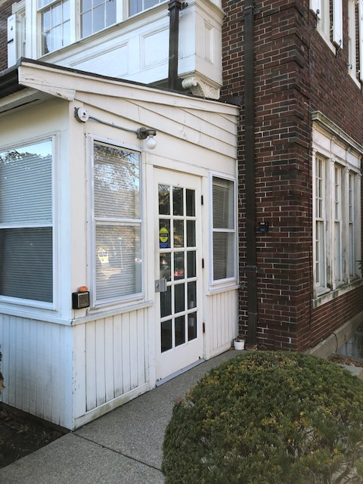

Slide 17
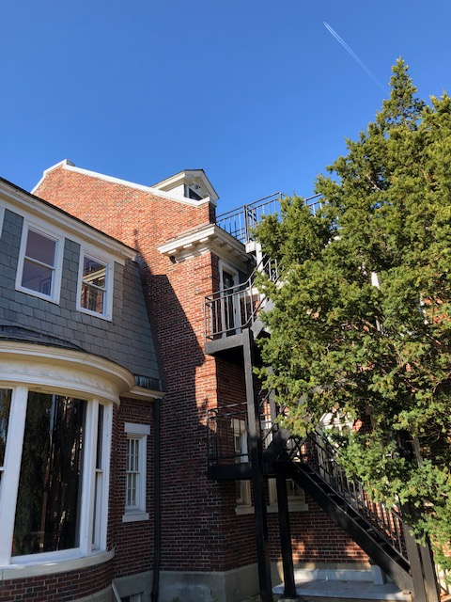

Slide 18
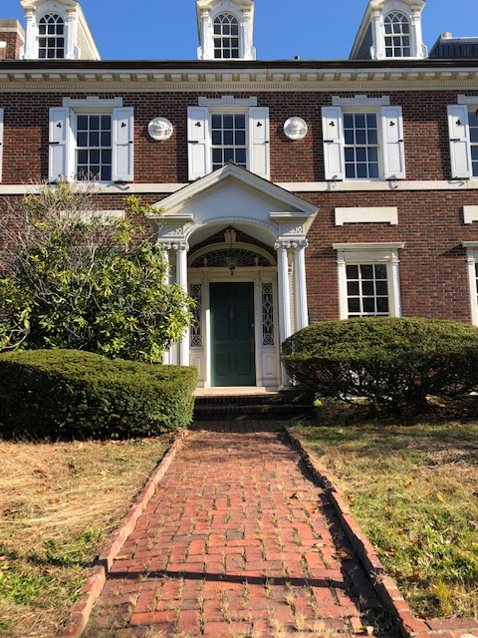

Slide 19
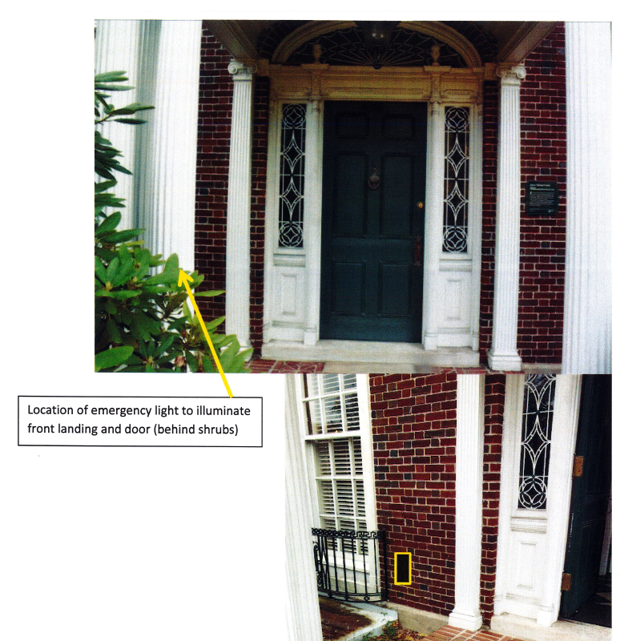

Slide 20
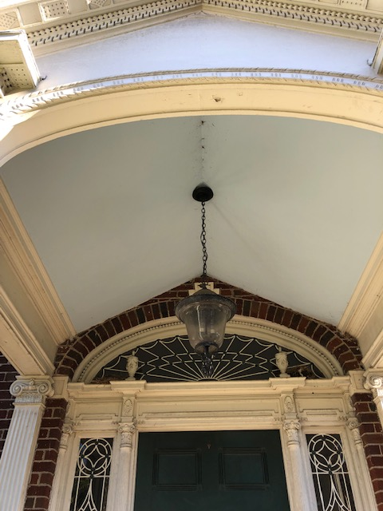
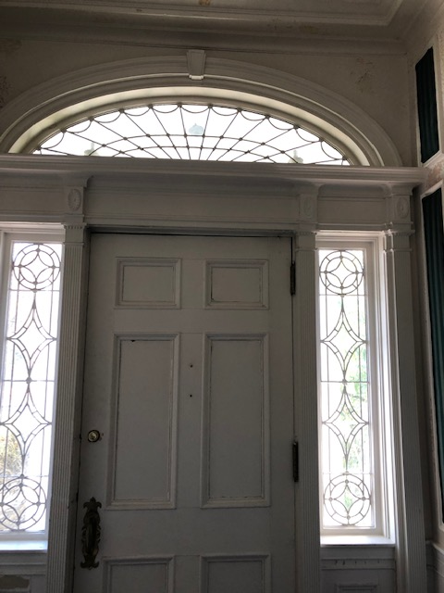

Slide 21
