Slide 1
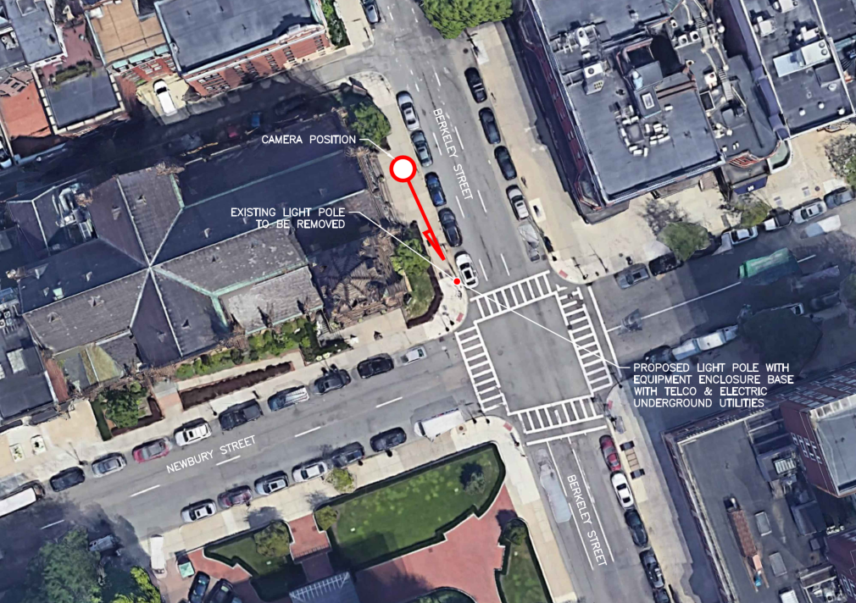
20.227 BB 67 Newbury Street
BBCOP
015

Slide 2
20.227 BB 67 Newbury Street
Replace existing concrete lamp post with six-sided metal pole, painted the color of concrete.
An antenna will be located within a concealment shroud on top of the pole, and the remaining antennas will be mounted on the side of the pole above the level of the light fixture.
Top of existing post is 24’ above grade level.
Top of proposed post is 31.2’ above grade level, including antenna.
Decorative base, antennas, and lamp post all to be painted the color of concrete

Slide 3
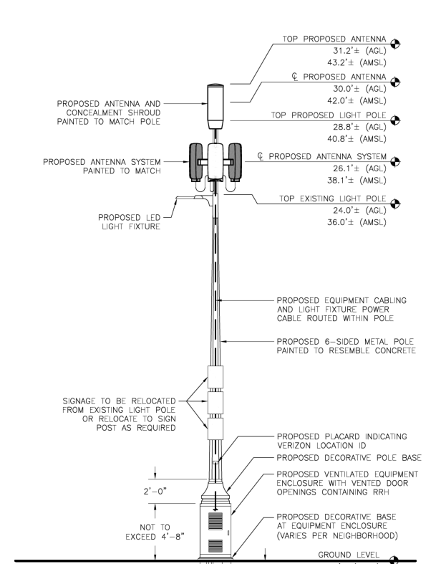

Slide 4
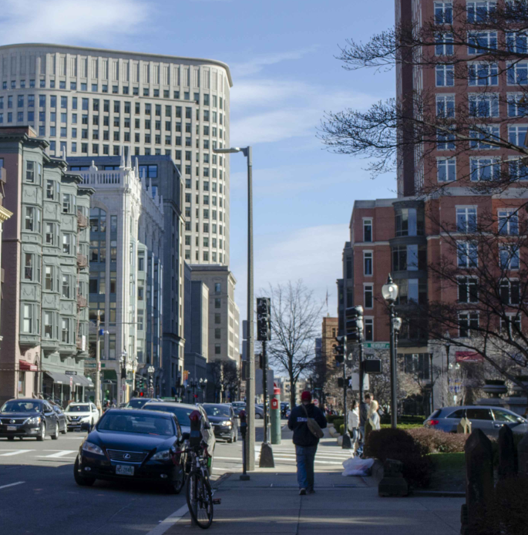
Existing

Slide 5
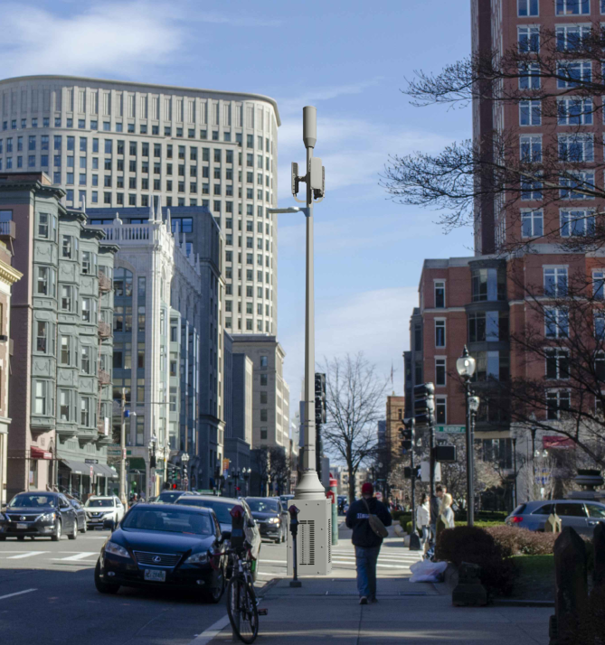
Proposed

Slide 6
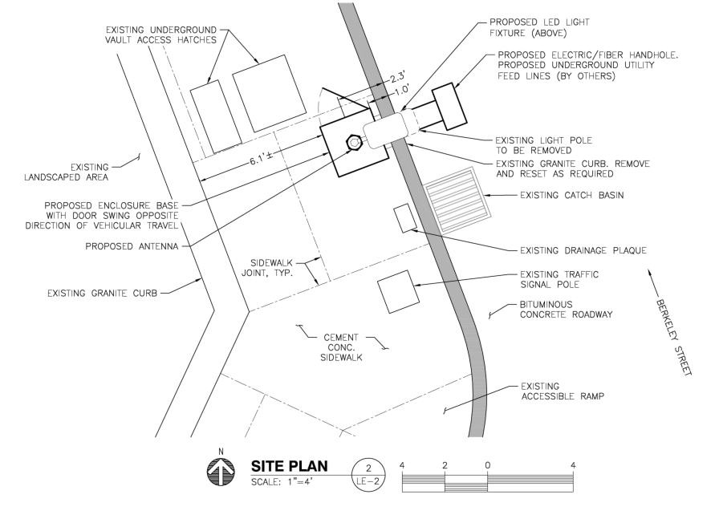

Slide 7
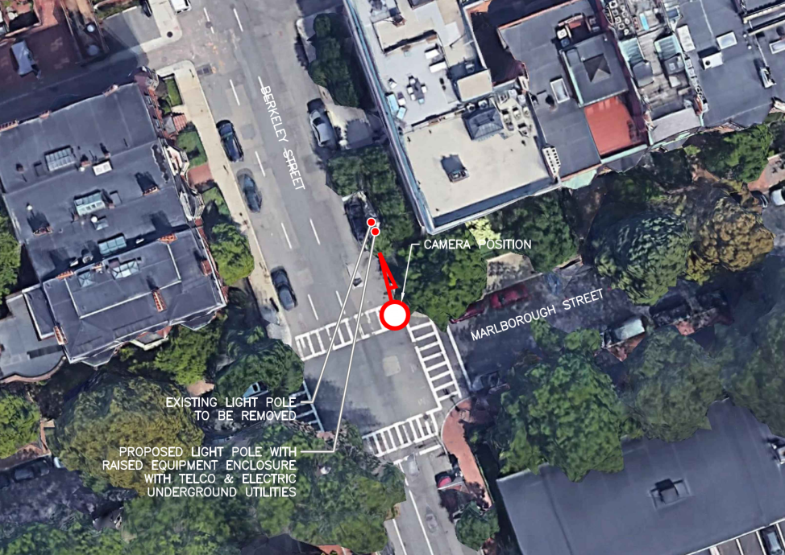
20.226 BB 301 Berkeley Street
BBCOP
016

Slide 8
20.226 BB 301 Berkeley Street(at Marlborough Street)
Replace existing concrete lamp post with six-sided metal pole, painted the color of concrete.
An antenna will be located within a concealment shroud on top of the pole, and the remaining antennas will be mounted on the side of the pole above the level of the light fixture.
Top of existing post is 24’ above grade level.
Top of proposed post is 31.2’ above grade level, including antenna.
Equipment cabinet, antennas, and lamp post all to be painted the color of concrete

Slide 9
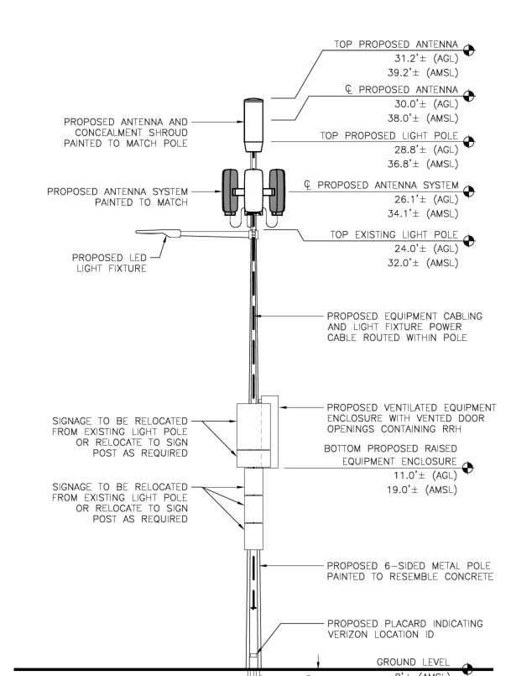

Slide 10
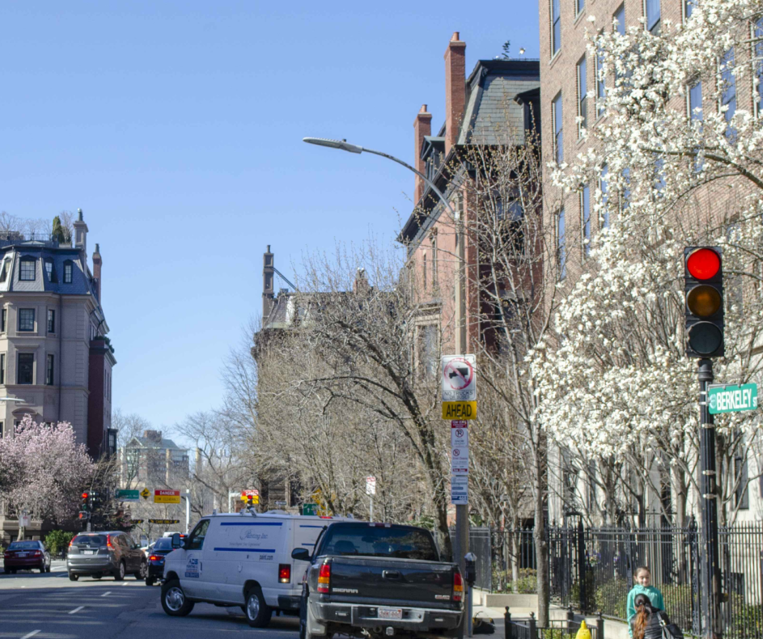
Existing

Slide 11
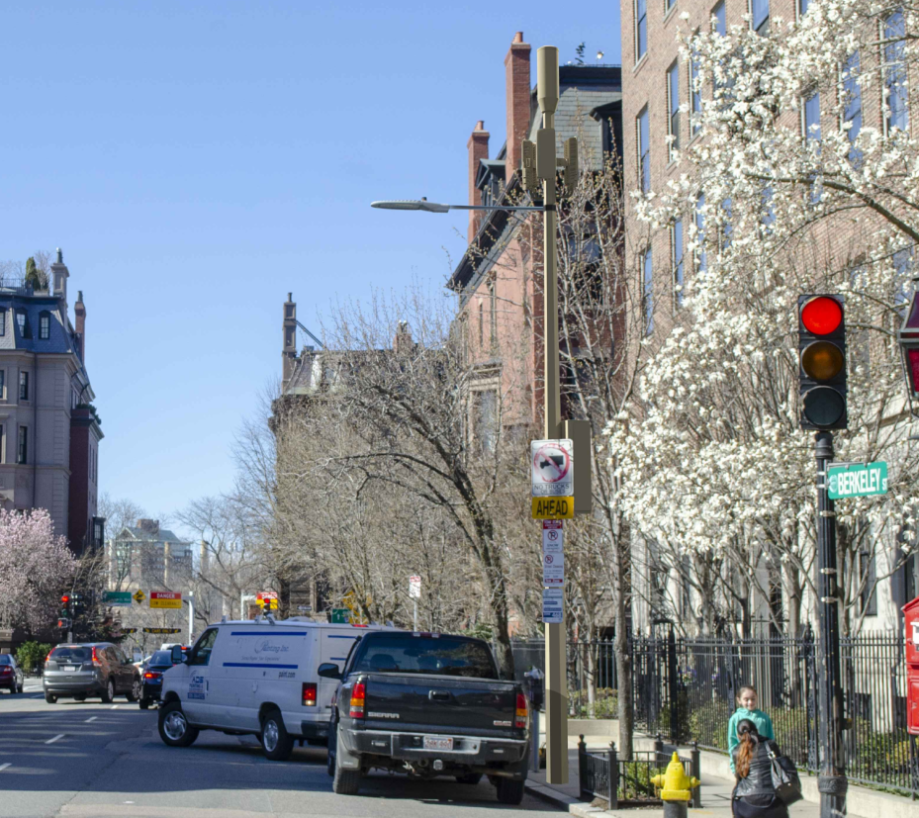
Proposed

Slide 12
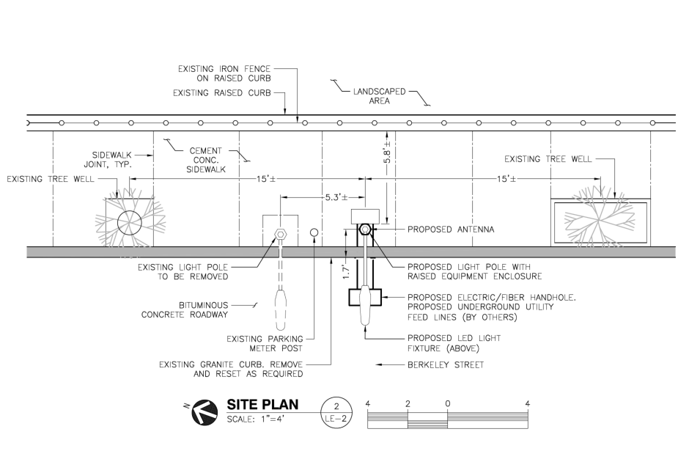

Slide 13
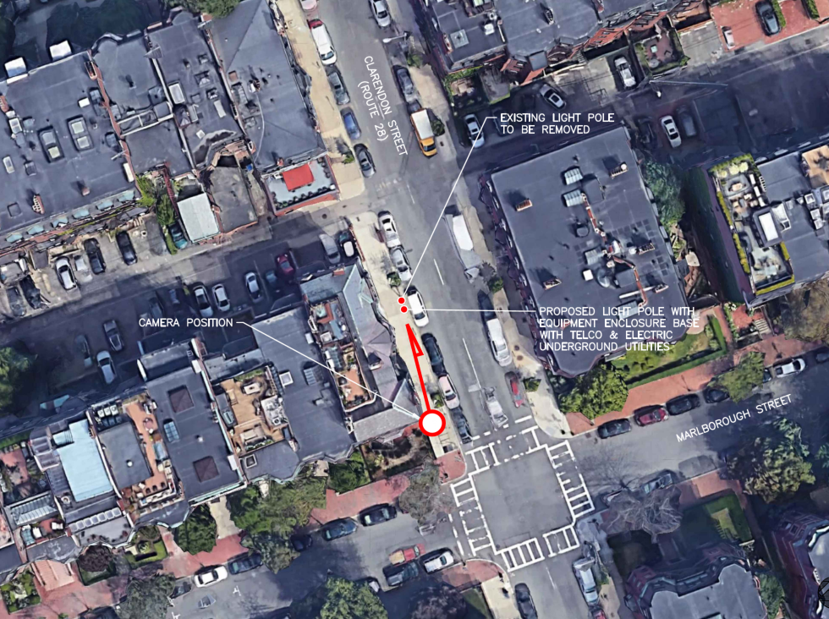
20.232 BB 274 Clarendon Street
BBCOP
017

Slide 14
20.232 BB 274 Clarendon Street
Replace existing concrete lamp post with six-sided metal pole, painted the color of concrete.
An antenna will be located within a concealment shroud on top of the pole, and the remaining antennas will be mounted on the side of the pole above the level of the light fixture.
Top of existing post is 24’ above grade level.
Top of proposed post is 31.2’ above grade level, including antenna.
Decorative base, antennas, and lamp post all to be painted the color of concrete

Slide 15
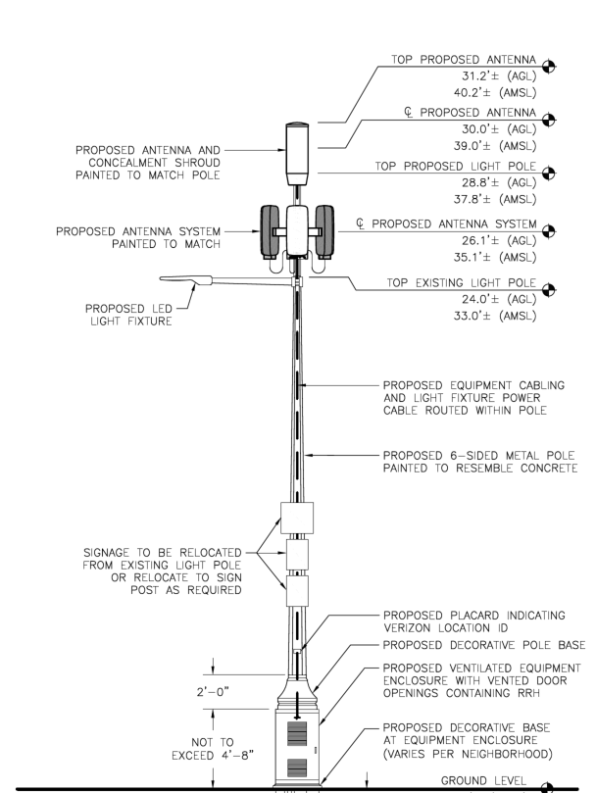

Slide 16
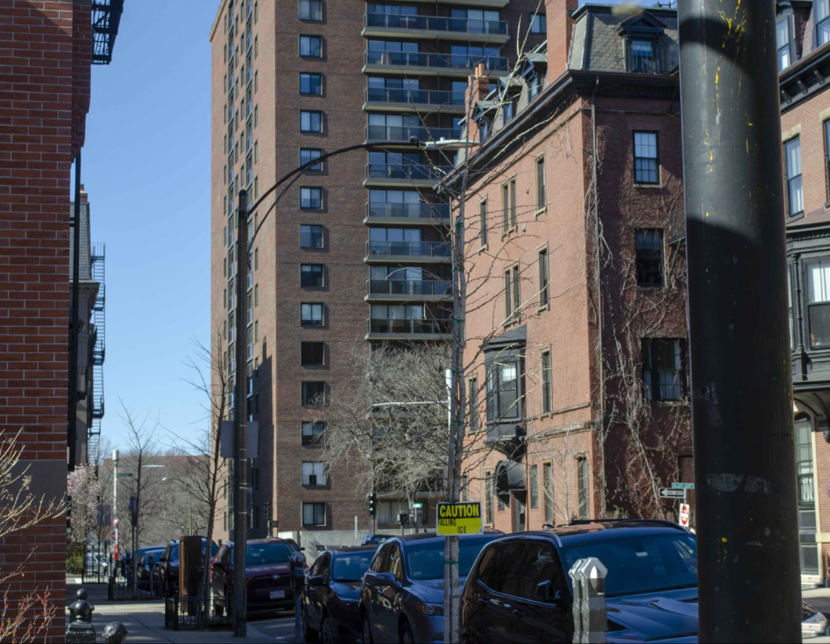
Existing

Slide 17
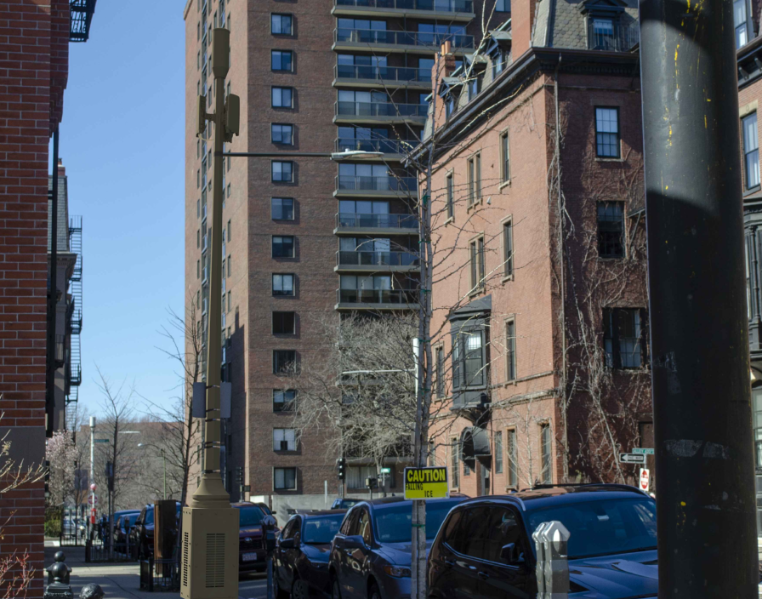
Proposed

Slide 18
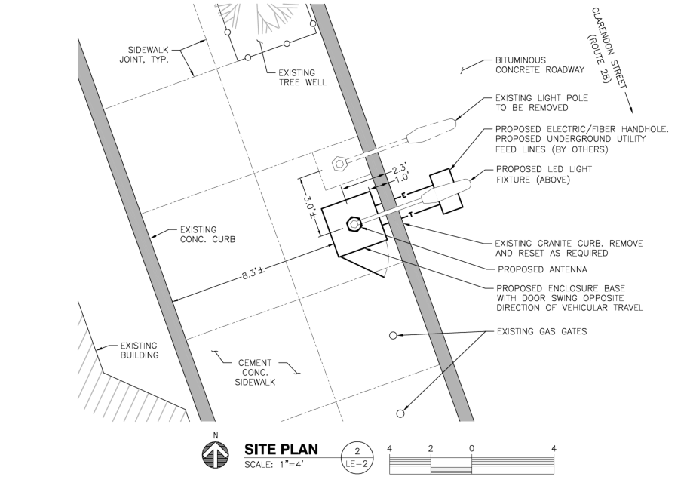

Slide 19
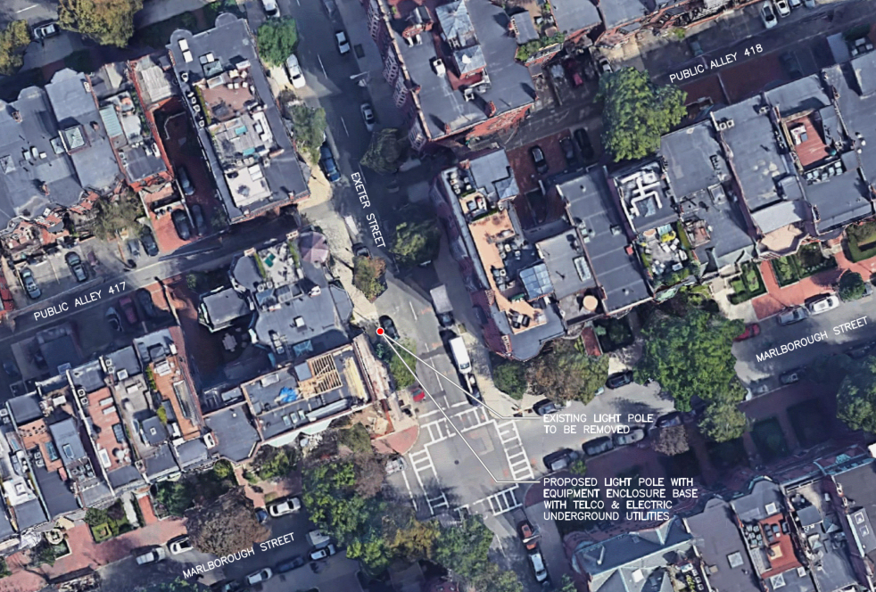
20.228 BB 11 Exeter Street
BBCOP
026

Slide 20
20.228 BB 11 Exeter Street
Replace existing concrete lamp post with six-sided metal pole, painted the color of concrete.
An antenna will be located within a concealment shroud on top of the pole, and the remaining antennas will be mounted on the side of the pole below the level of the light fixture.
Top of existing post is 24’ above grade level.
Top of proposed post is 31.2’ above grade level, including antenna.
Equipment cabinet, antennas, and lamp post all to be painted the color of concrete

Slide 21
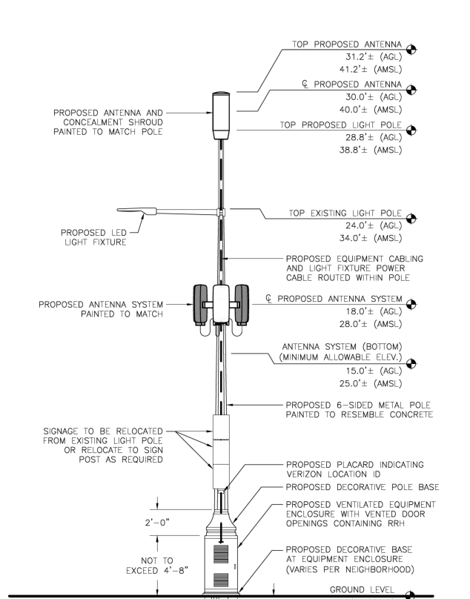

Slide 22
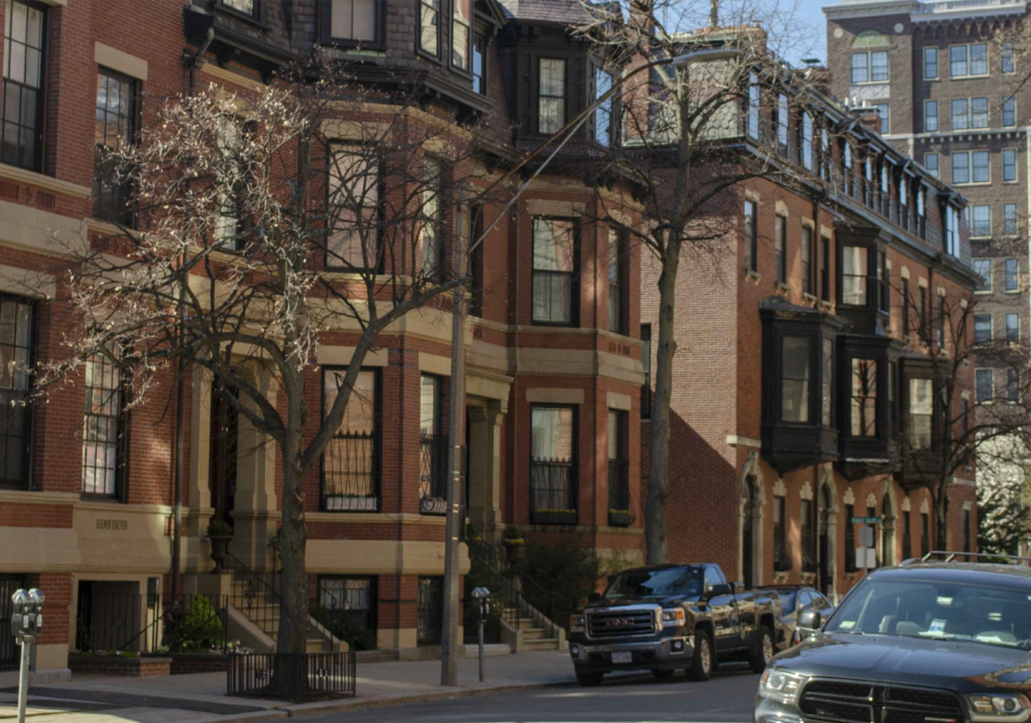
Existing

Slide 23
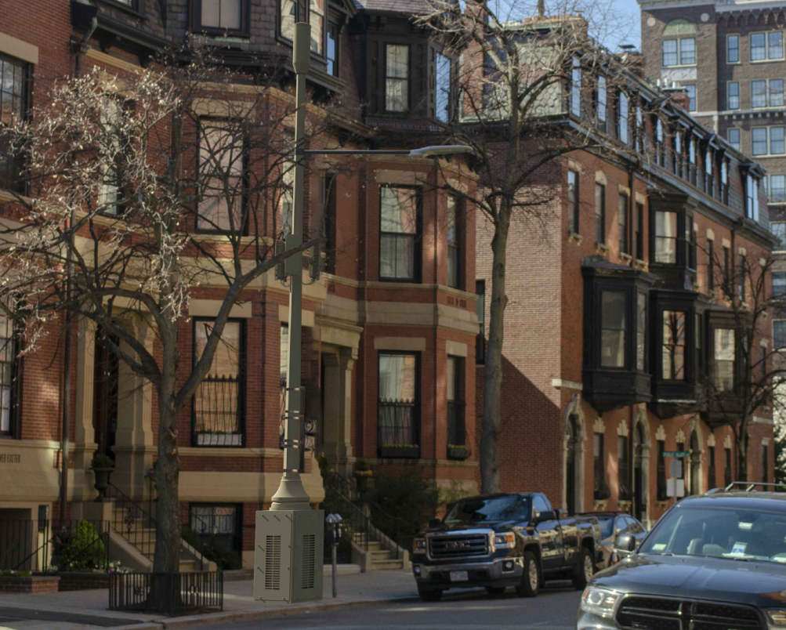
Proposed

Slide 24
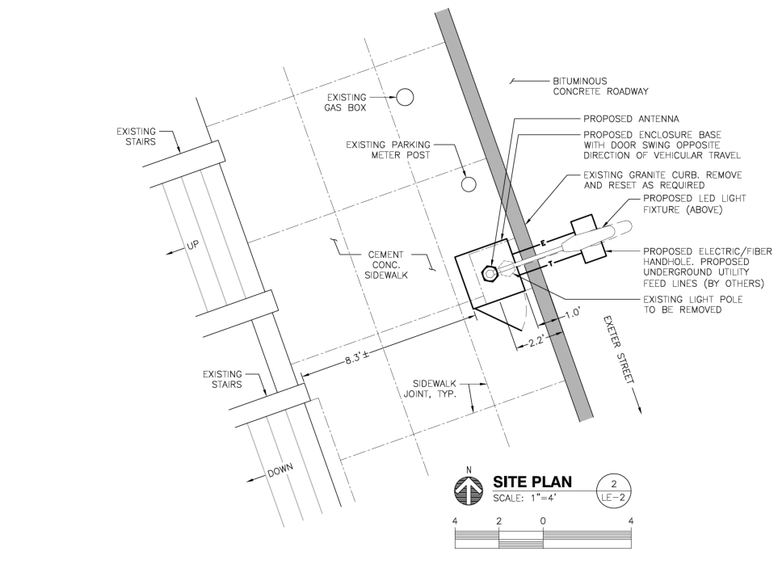

Slide 25
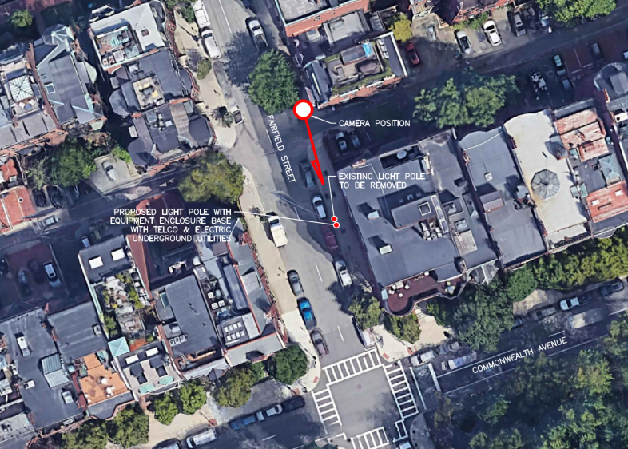
20.229 BB 239 Commonwealth Avenue
BBCOP
033

Slide 26
20.229 BB 239 Commonwealth Avenue
Replace existing concrete lamp post with six-sided metal pole, painted the color of concrete.
An antenna will be located within a concealment shroud on top of the pole, and the remaining antennas will be mounted on the side of the pole below the level of the light fixture.
Top of existing post is 24’ above grade level.
Top of proposed post is 31.2’ above grade level, including antenna.
Decorative base, antennas, and lamp post all to be painted the color of concrete

Slide 27
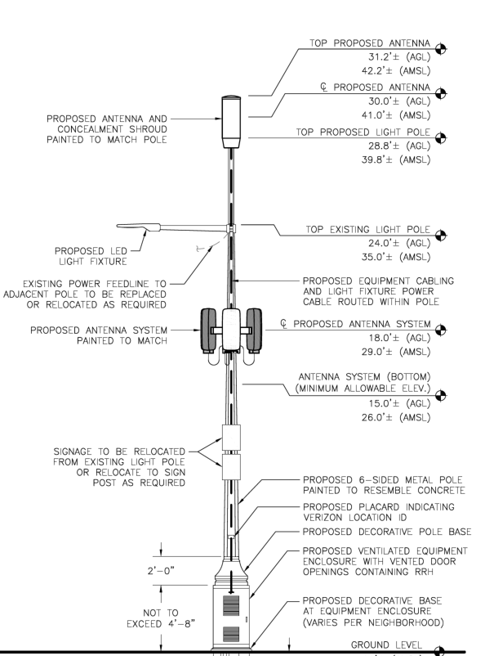

Slide 28
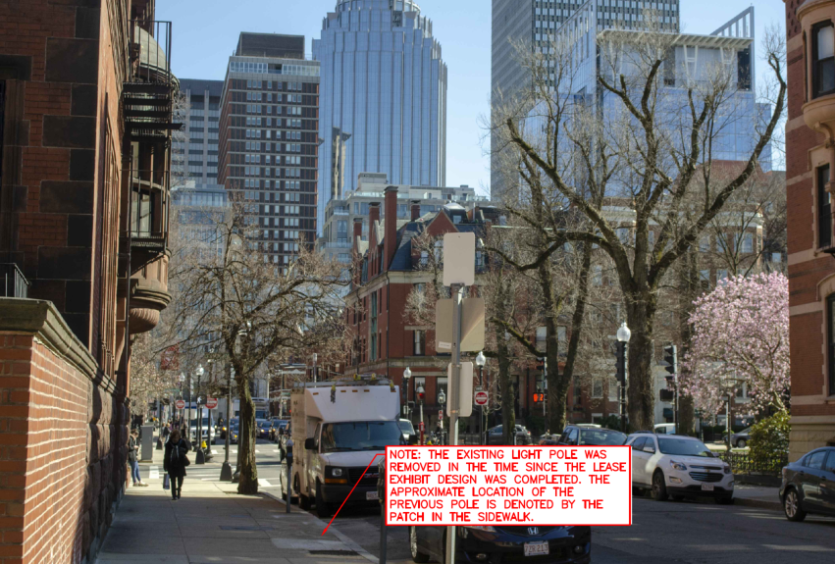
Existing

Slide 29
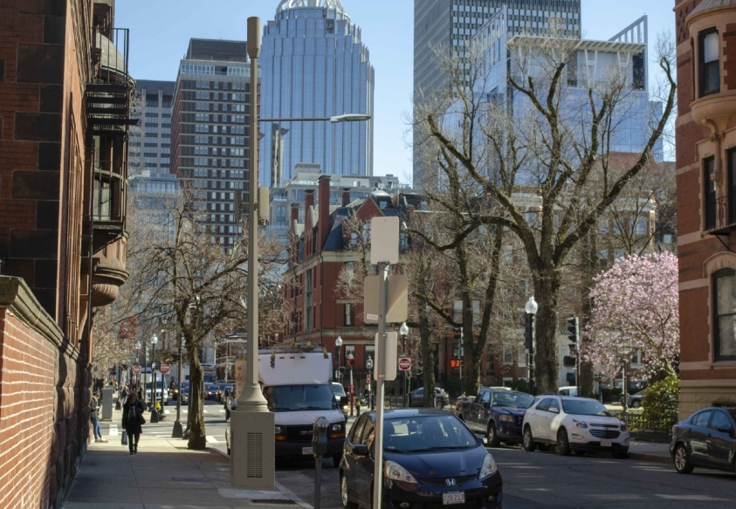
Proposed

Slide 30
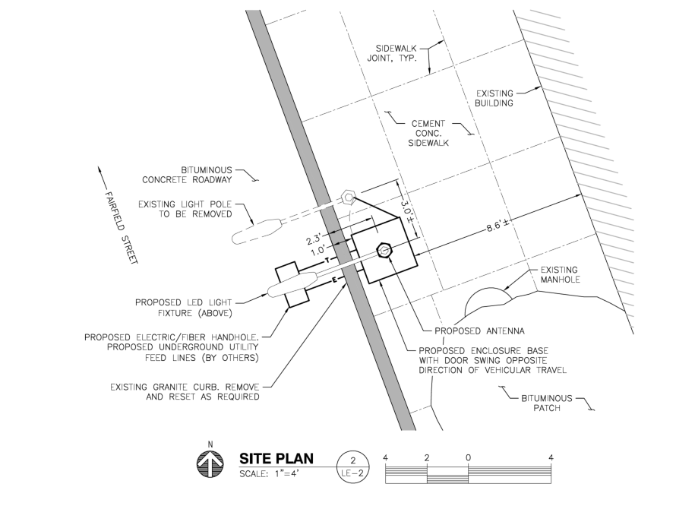

Slide 31
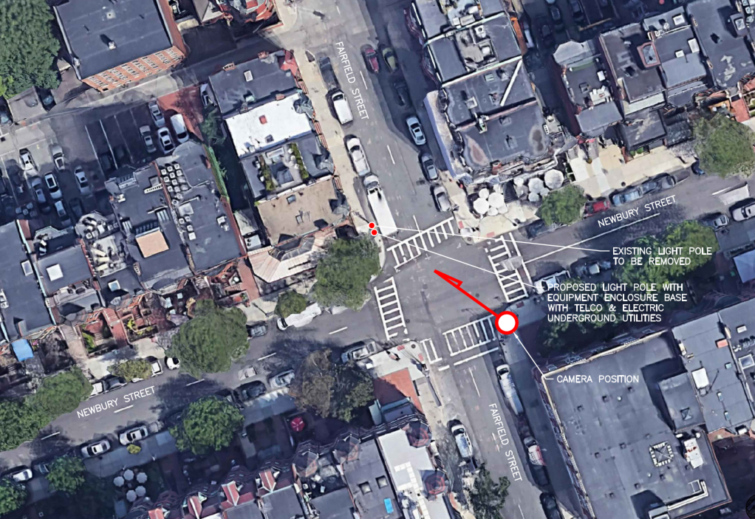
20.230 BB 37 Fairfield Street
BBCOP
032

Slide 32
20.230 BB 37 Fairfield Street
Replace existing concrete lamp post with six-sided metal pole, painted the color of concrete.
An antenna will be located within a concealment shroud on top of the pole, and the remaining antennas will be mounted on the side of the pole below the level of the light fixture.
Top of existing post is 24’ above grade level.
Top of proposed post is 31.2’ above grade level, including antenna.
Decorative base, antennas, and lamp post all to be painted the color of concrete

Slide 33
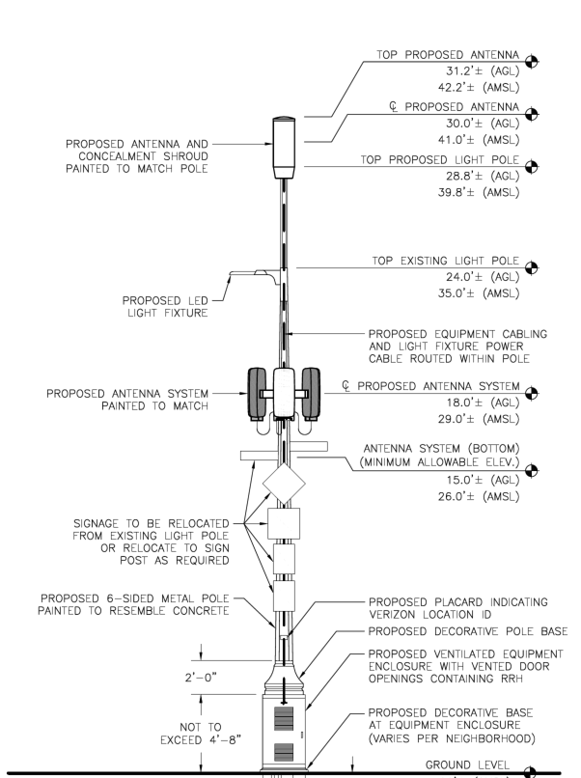

Slide 34
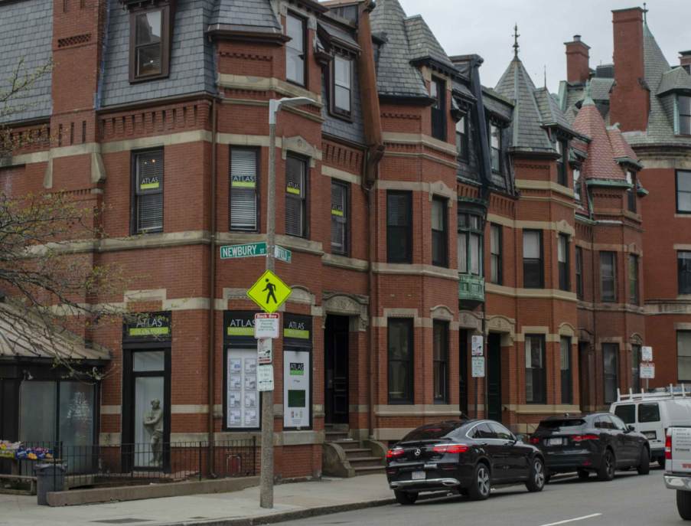
Existing

Slide 35
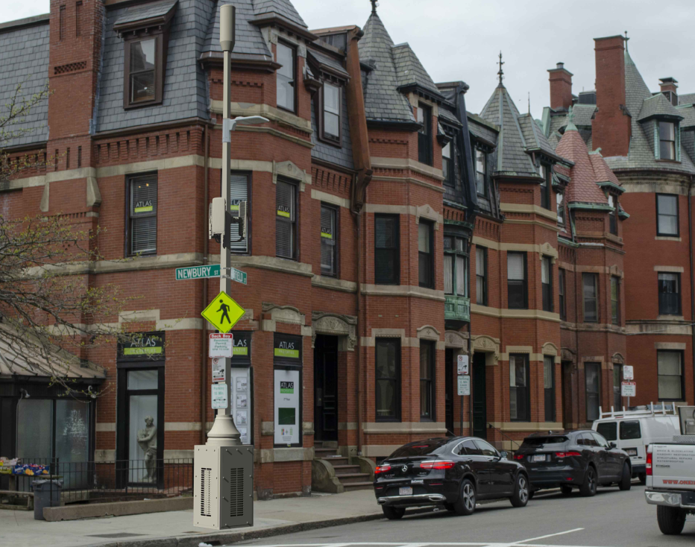
Proposed

Slide 36
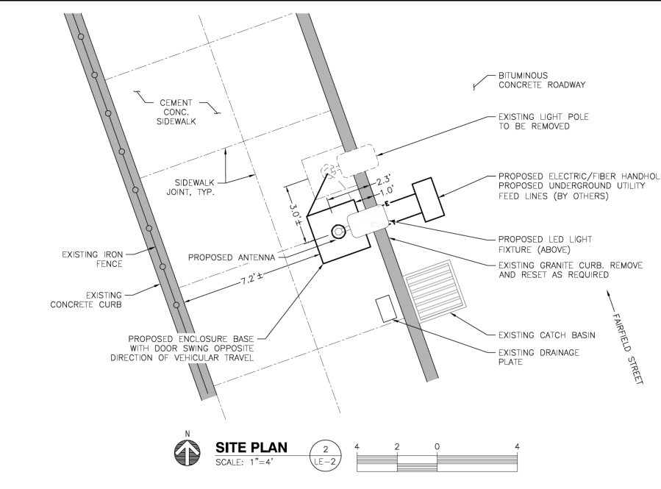

Slide 37
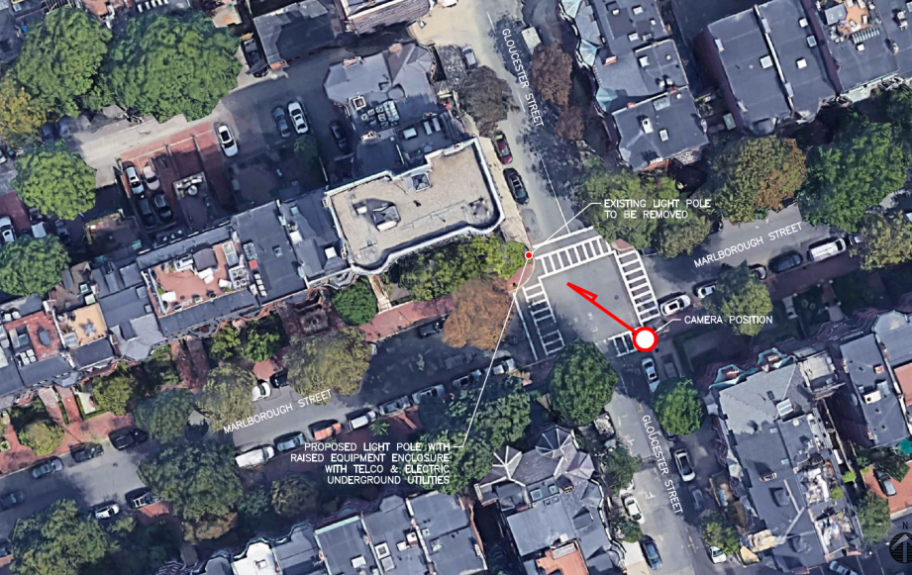
20.231 BB 8 Gloucester Street
BBCOP
034

Slide 38
20.231 BB 8 Gloucester Street
Replace existing concrete lamp post with six-sided metal pole, painted the color of concrete.
An antenna will be located within a concealment shroud on top of the pole, and the remaining antennas will be mounted on the side of the pole below the level of the light fixture.
Top of existing post is 24’ above grade level.
Top of proposed post is 31.2’ above grade level, including antenna.
Equipment cabinet, antennas, and lamp post all to be painted the color of concrete

Slide 39
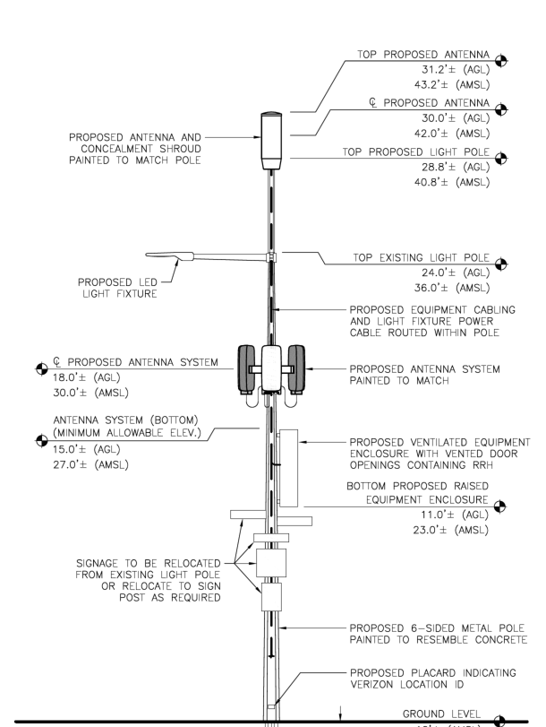

Slide 40
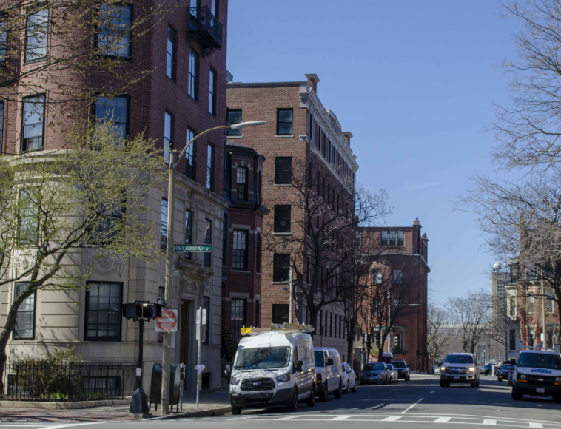
Existing

Slide 41
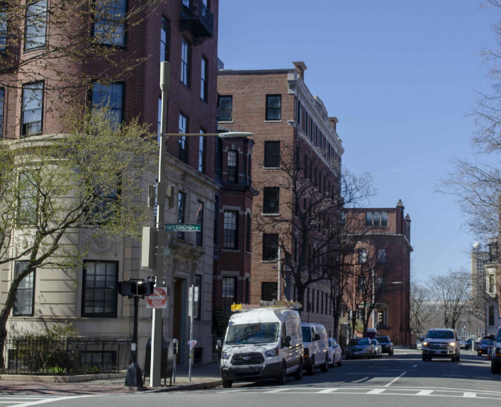
Proposed

Slide 42
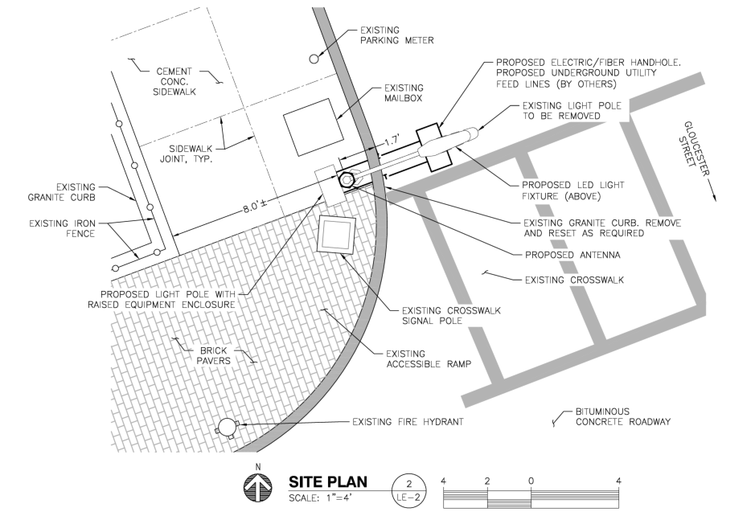

Slide 43
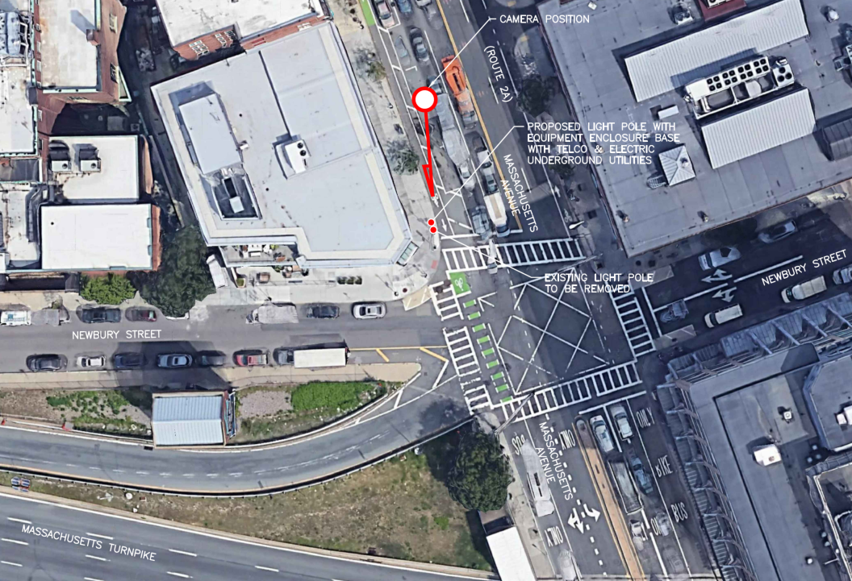
20.233 BB 375 Newbury Street
BBCOP
043

Slide 44
20.233 BB 375 Newbury Street
Replace existing pendant light with six-sided metal pole, painted black.
An antenna will be located within a concealment shroud on top of the pole, and the remaining antennas will be mounted on the side of the pole above the level of the light fixture.
Top of existing post is 25’ above grade level.
Top of proposed post is 32.4’ above grade level, including antenna.
Decorative base, antennas, and lamp post all to be painted black

Slide 45
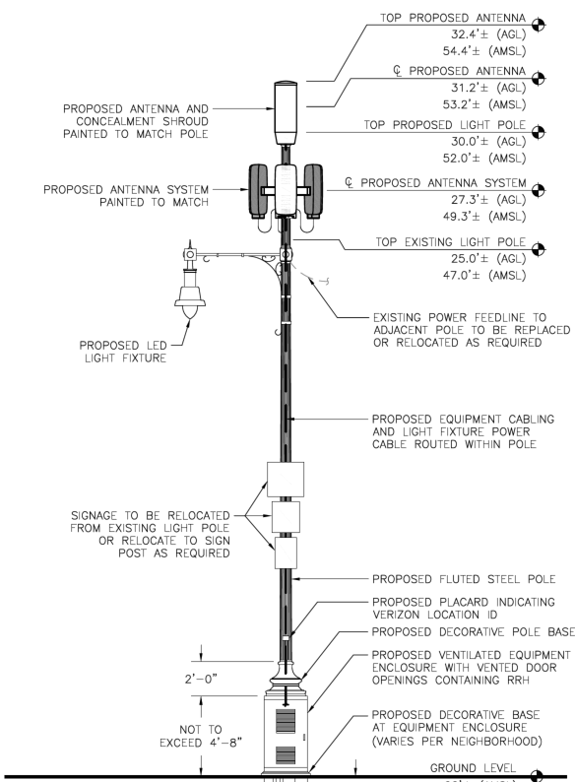

Slide 46
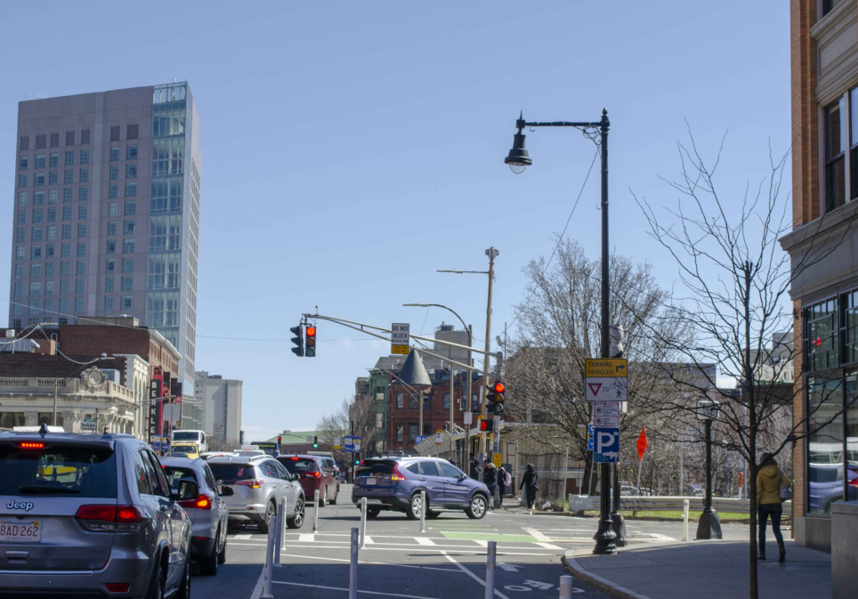
Existing

Slide 47
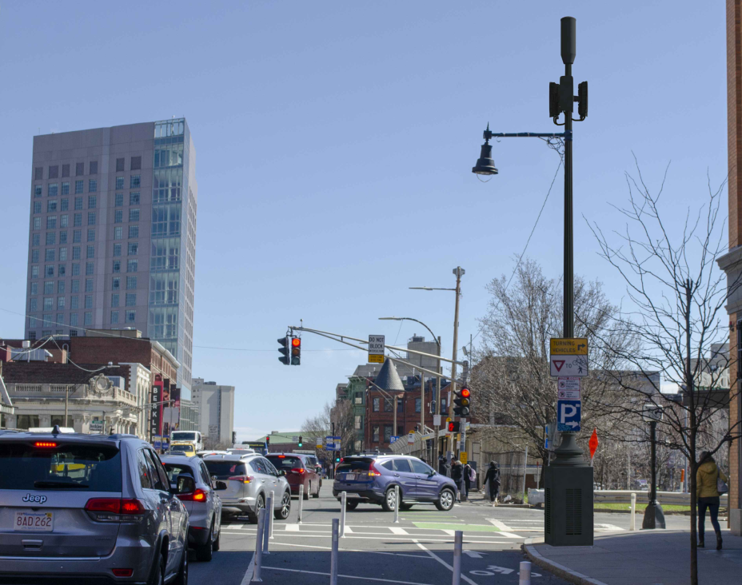
Proposed

Slide 48
