Slide 1
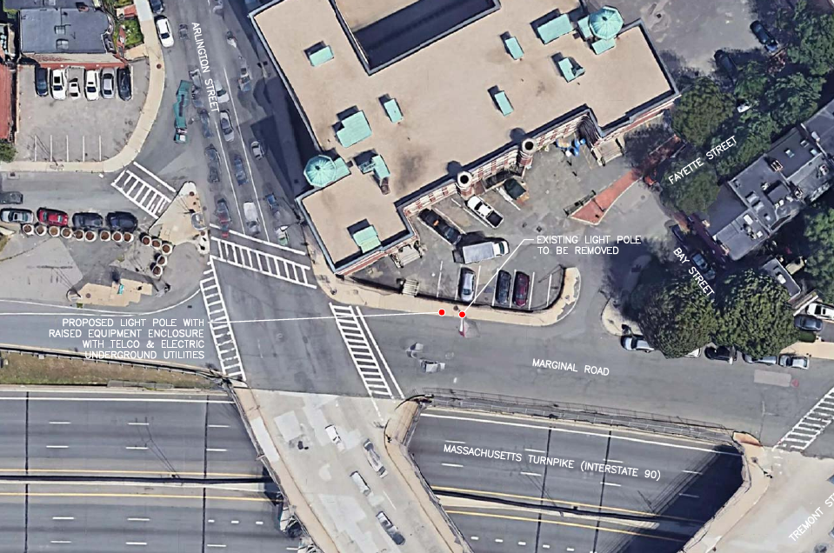
19.1255 BV
Marginal Road Between Arlington Street and Fayette Street
BOS BDT 004

Slide 2
Marginal Road Between Arlington Street and Fayette Street
Replace existing concrete lamp post with six-sided metal pole, painted the color of concrete.
An antenna will be located within a concealment shroud on top of the pole, and the remaining antennas will be mounted on the side of the pole above the level of the light fixture.
Top of existing post is 24’ above grade level.
Top of proposed post is 31.8’ above grade level, including antenna.
Decorative base, antennas, and lamp post all to be painted the color of concrete

Slide 3
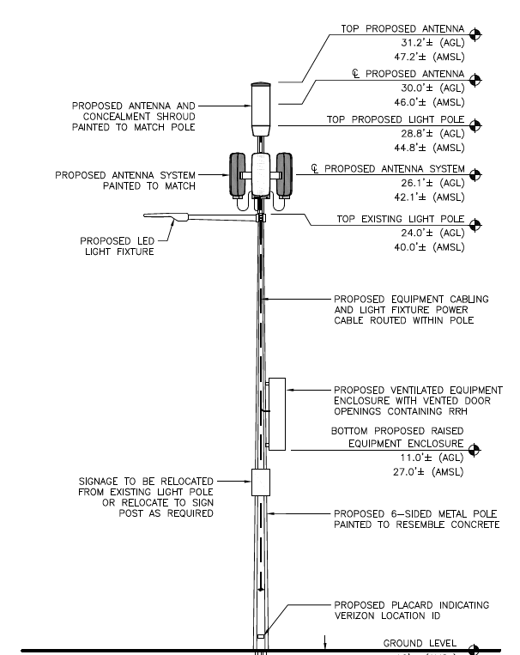

Slide 4
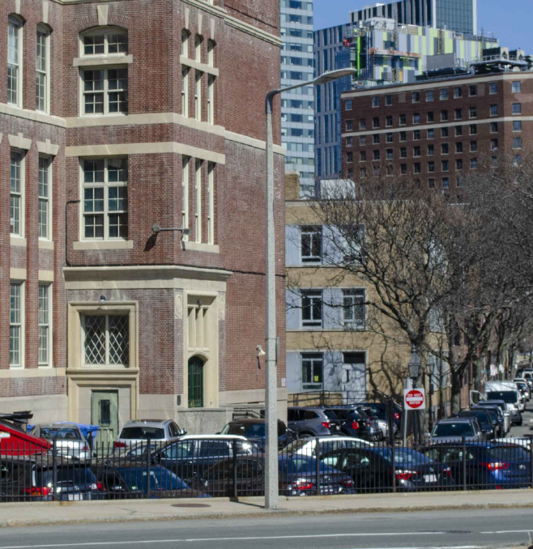
Existing

Slide 5
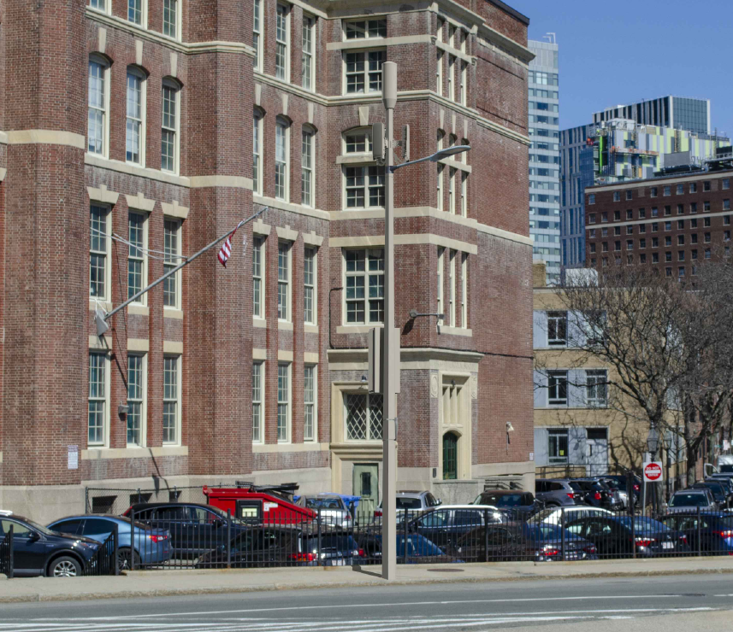
Proposed

Slide 6
