Slide 1
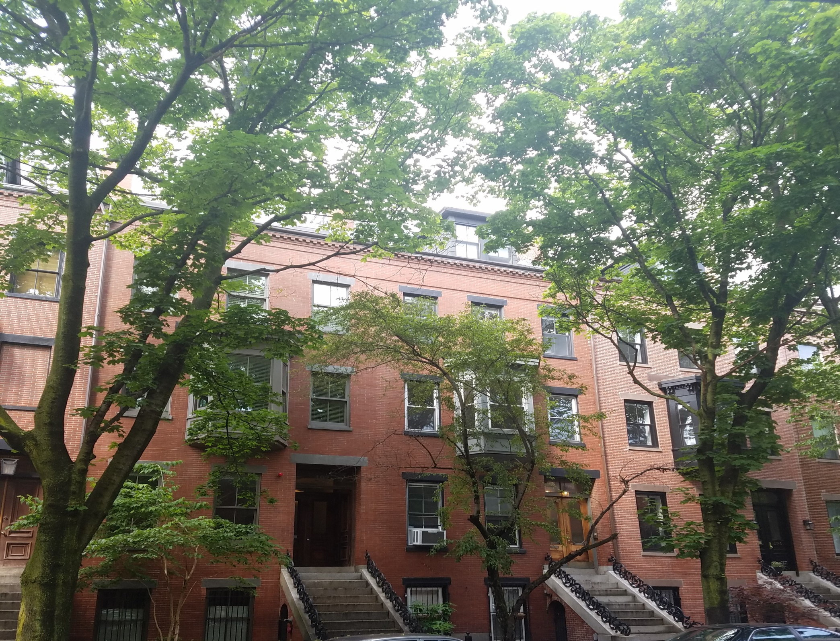
194 W SPRINGFIELD ST
Roof Deck Replacement

Slide 2
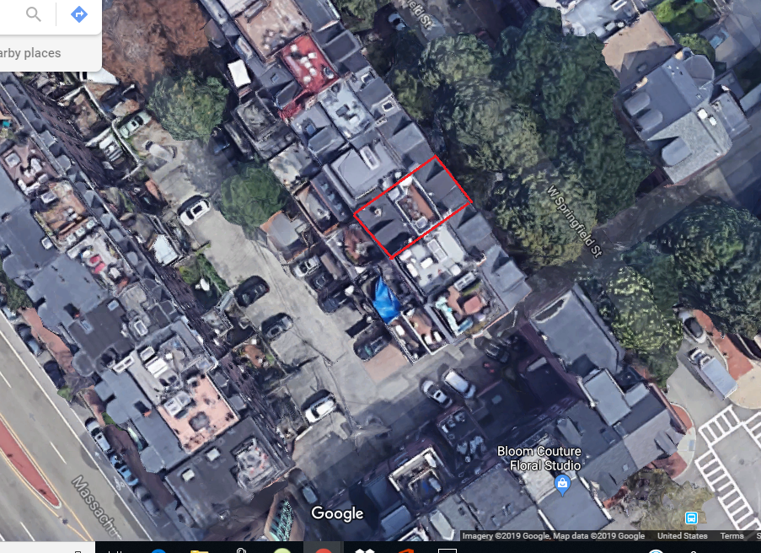
AERIAL VIEW

Slide 3
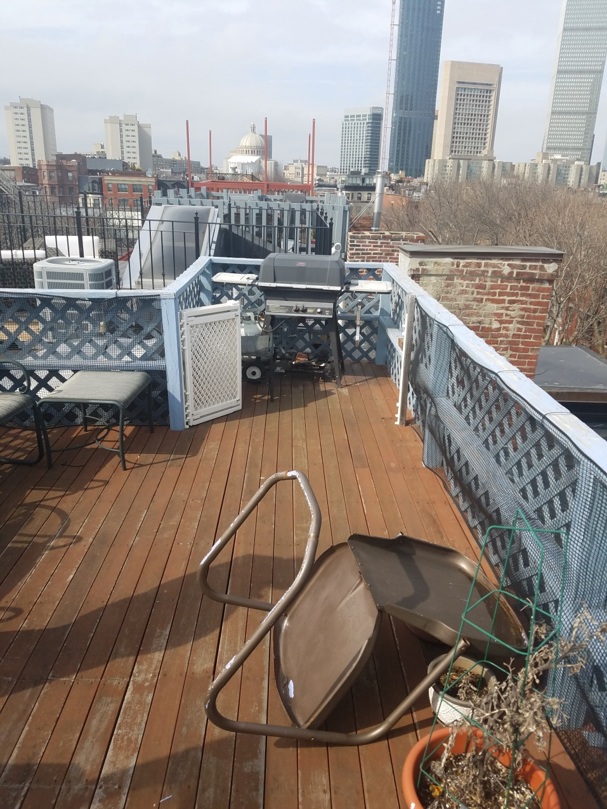
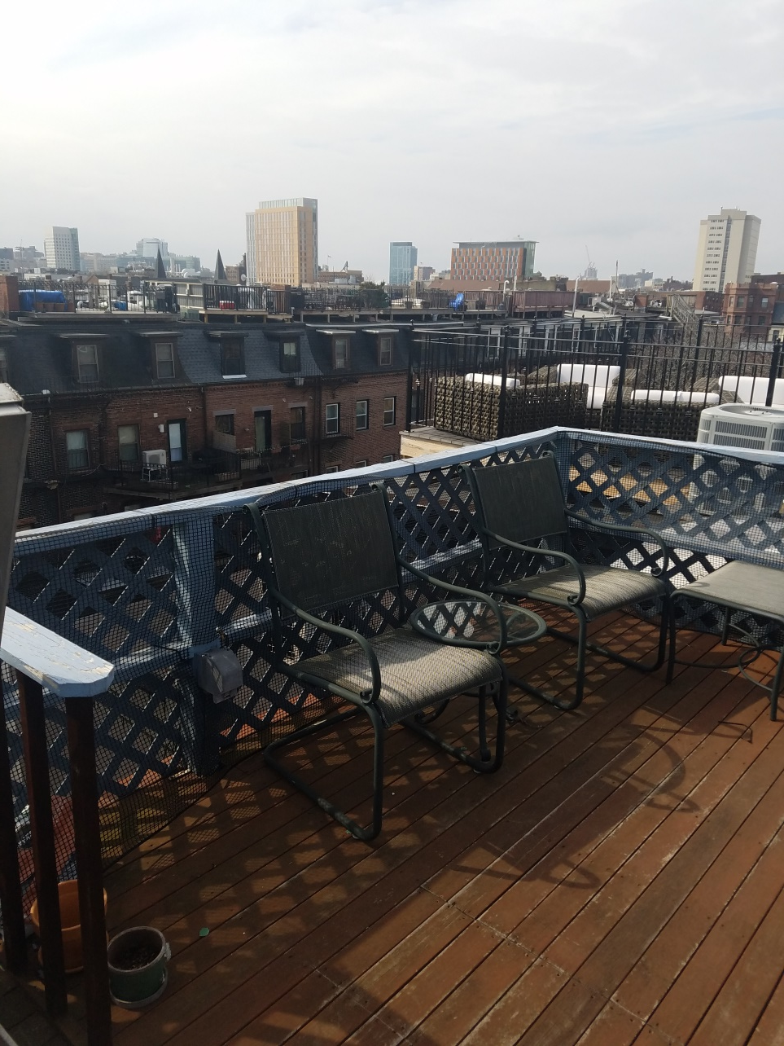
EXISTING DECK

Slide 4
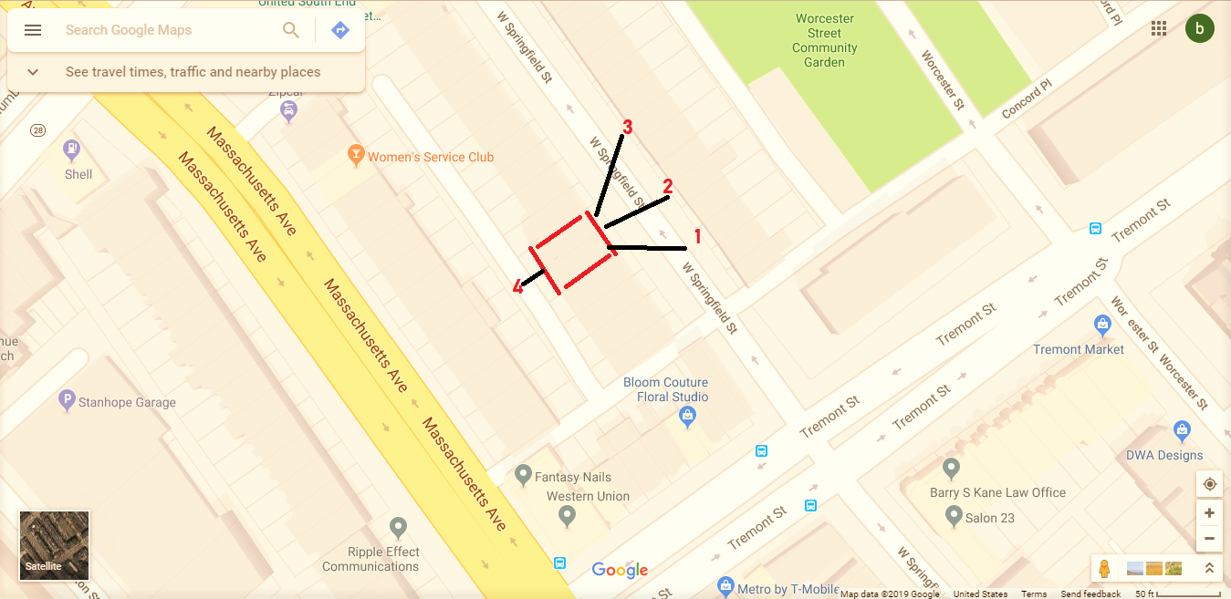
STREET VIEWS

Slide 5
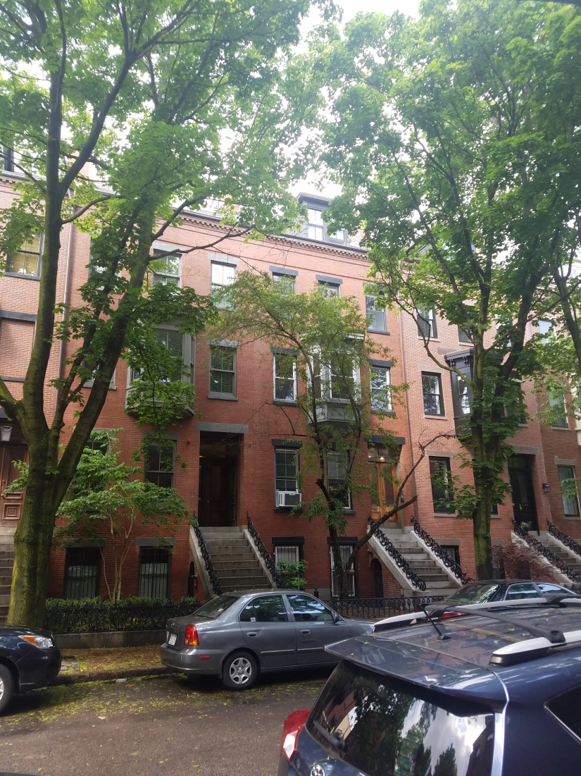
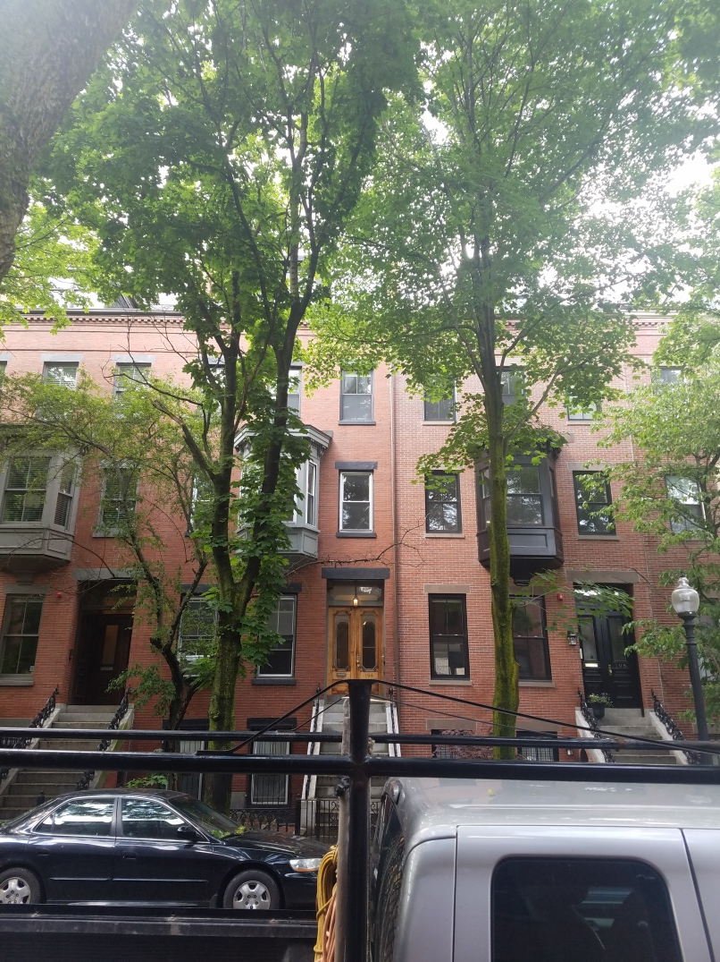
PICTURE VIEW 1 & 2

Slide 6
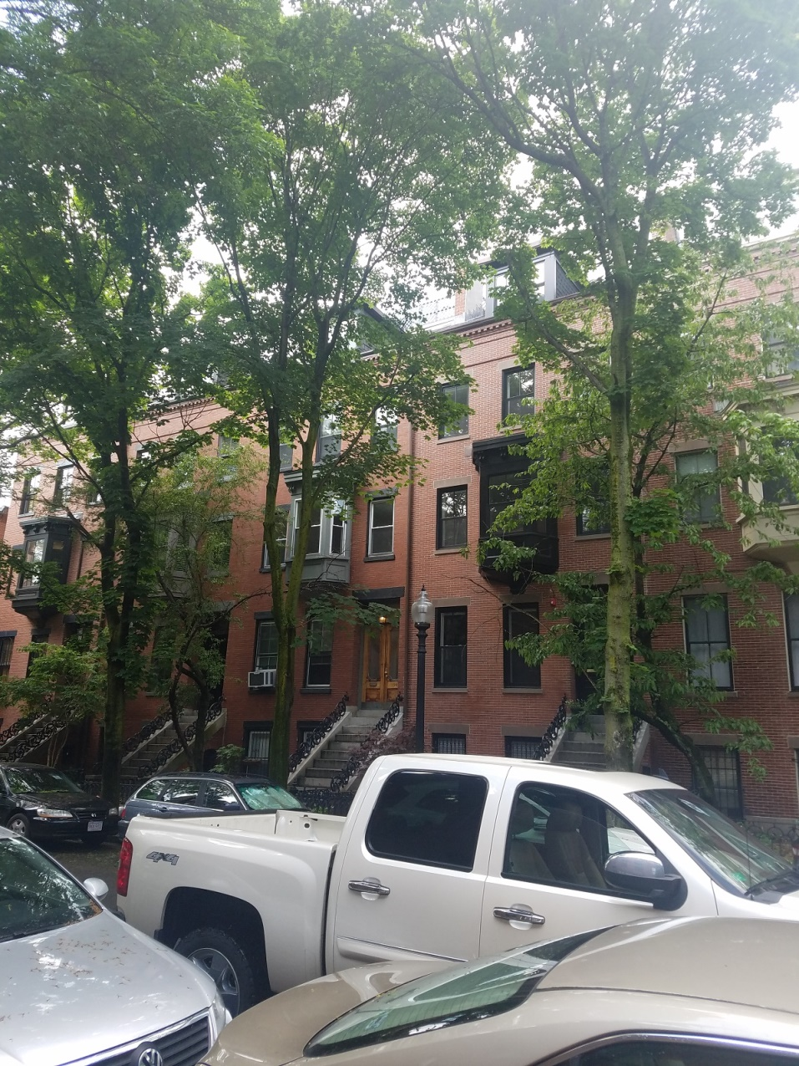
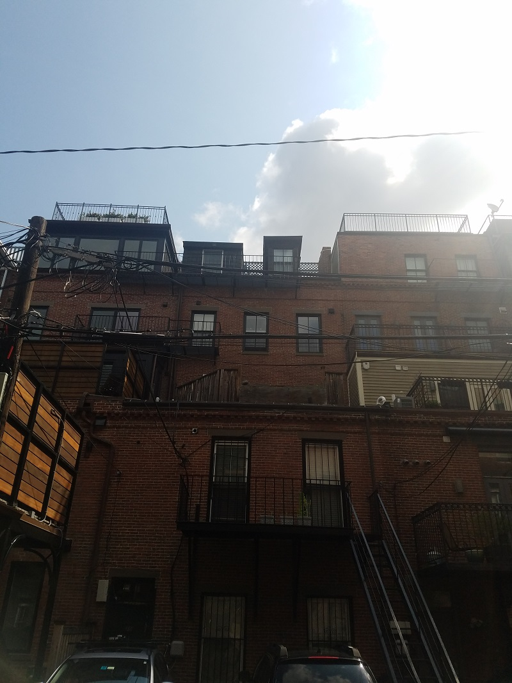
PICTURE VIEW 3 & 4

Slide 7
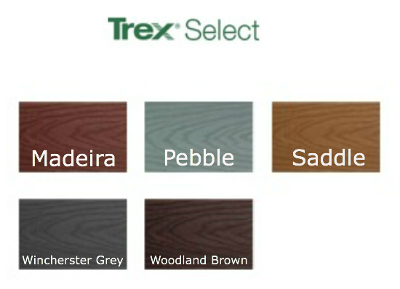
PROPOSED DECKING
THE DECKING ITSELF WILL BE TREX SELECT COMPOSITE DECKING IN PEBBLE GRAY
WITH COLOR MATCHING SCREWS

Slide 8
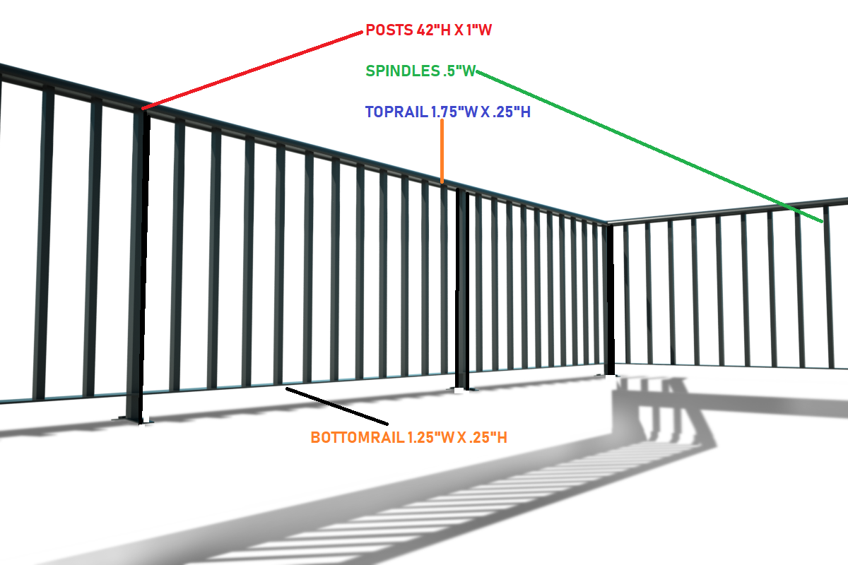
GUARDRAIL
CUSTOM FABRICATED, 42 INCH HIGH, VERTICAL SPINDLE BLACK METAL GUARDRAIL AS SEEN ON NEIGHBORING PROPERTIES AND IN THE PICTURE BELOW

