Slide 1
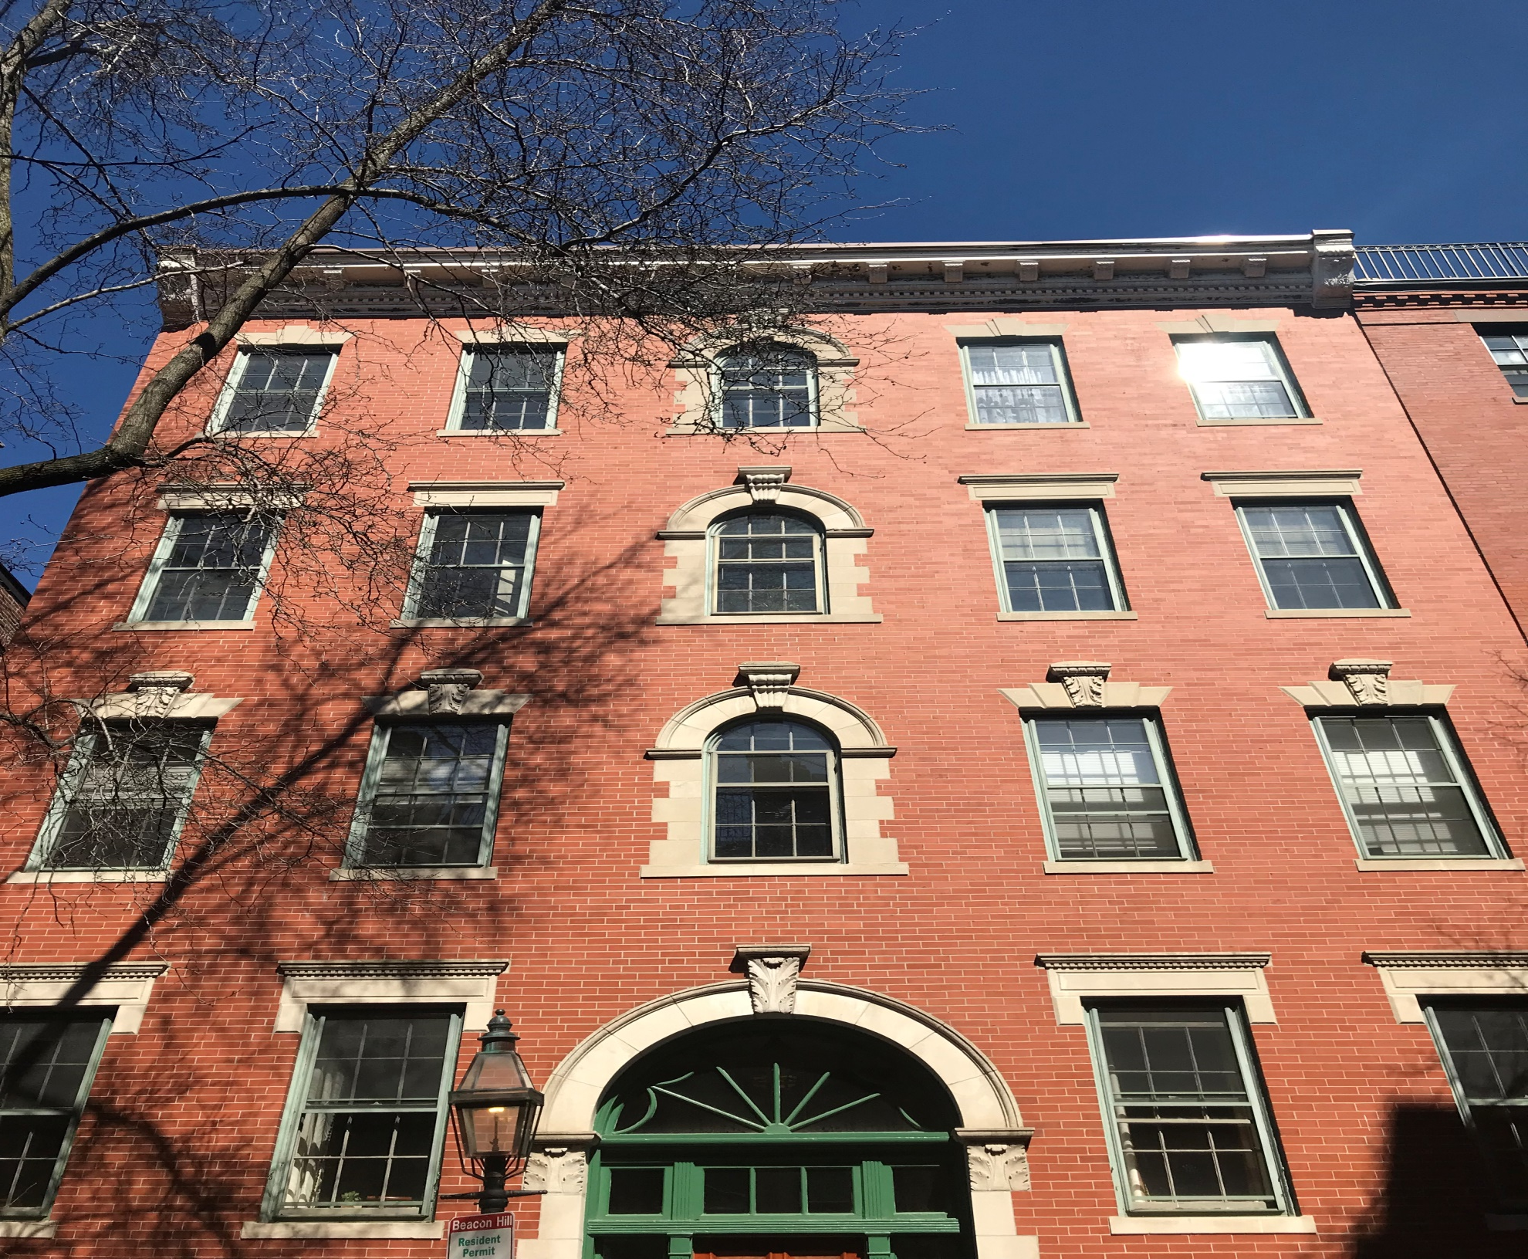
77a Revere Street
Roof Deck Replacement

Slide 2
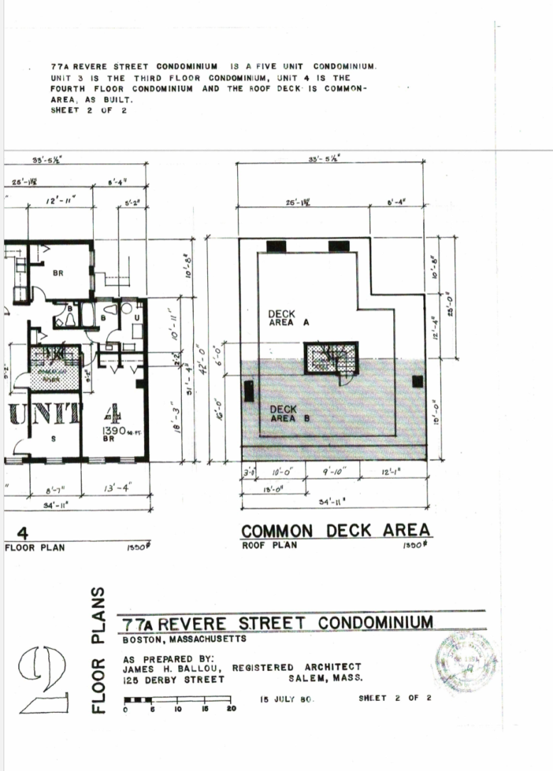
ORIGINAL STAMPED DECK PLAN

Slide 3
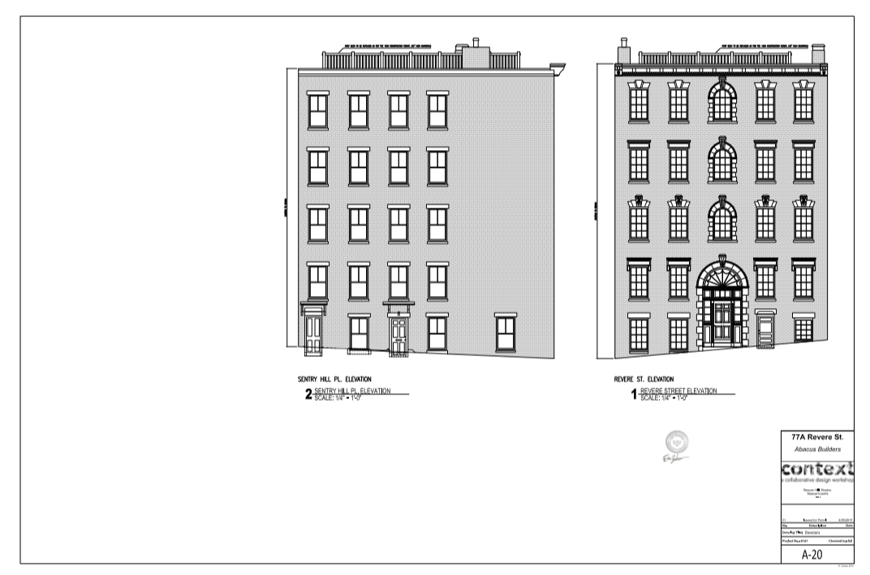
FRONT & SIDE ELEVATION

Slide 4
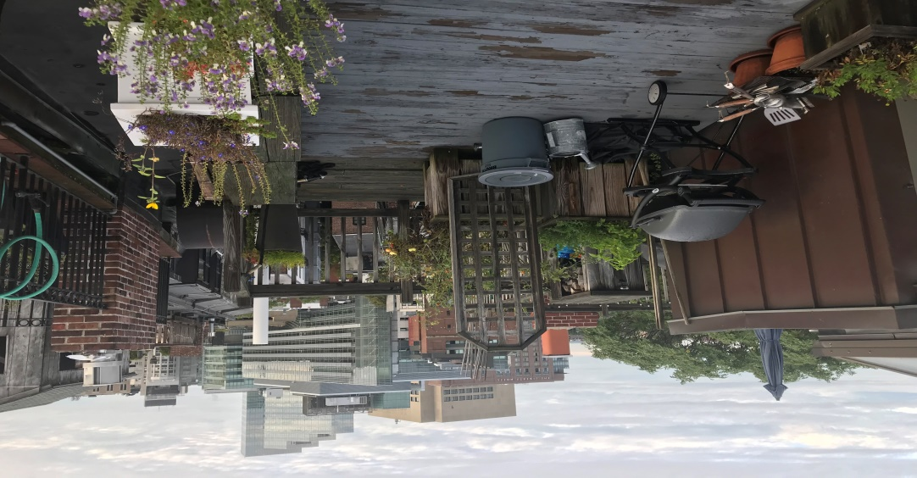
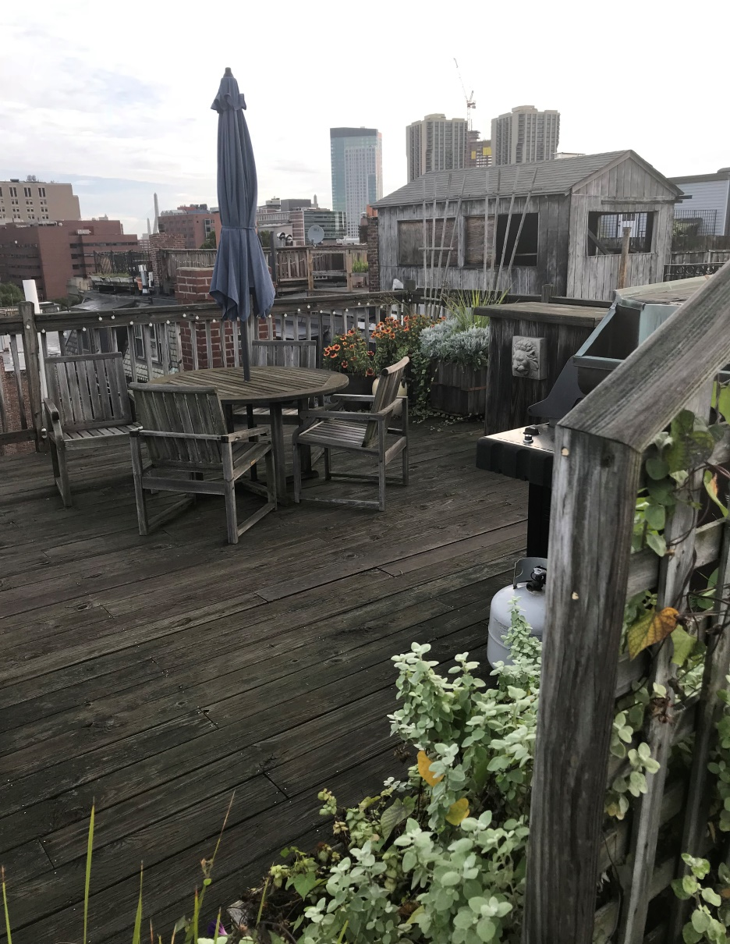
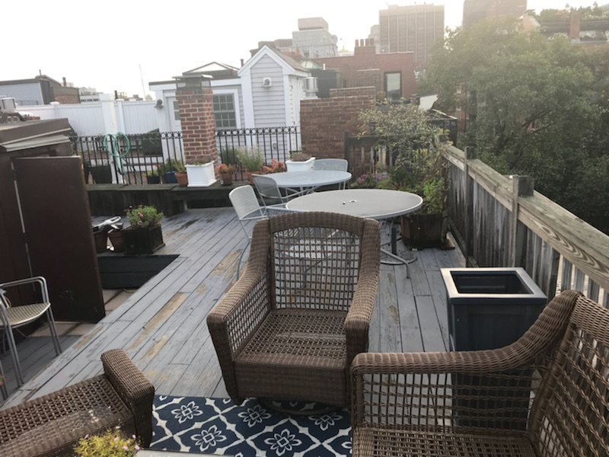
PHOTOS OF ORIGINAL WOODEN DECK

Slide 5
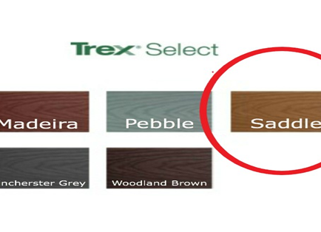
PROPOSED DECKING
THE DECKING ITSELF WILL BE TREX SELECT COMPOSITE DECKING IN SADDLE BROWN WITH COLOR MATCHING SCREWS

Slide 6
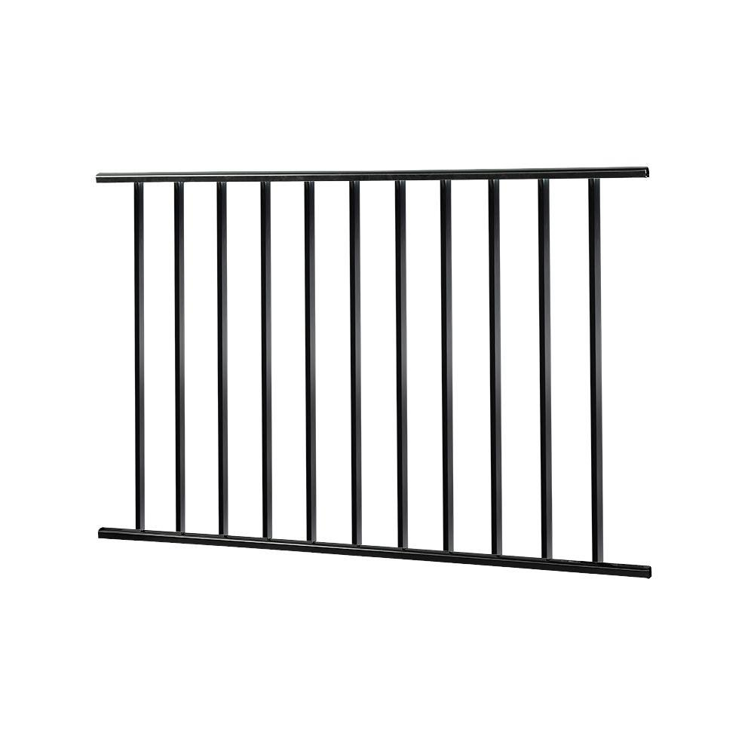
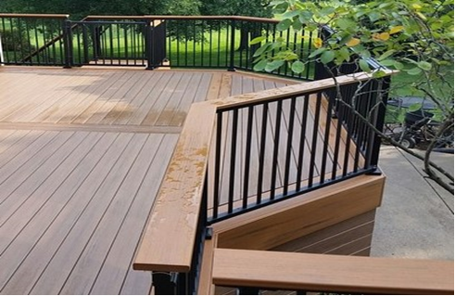
GUARDRAIL
OPTION A – CUSTOM FABRICATED, 42 INCH HIGH, VERTICAL SPINDLE BLACK METAL GUARDRAIL AS SEEN ON NEIGHBORING PROPERTIES AND IN THE PICTURE BELOW
OPTION B (PREFERRED) – OWNERS WOULD LIKE TO ADD A 5.5 INCH MAHOGANY HARDWOOD TOPRAIL SIMILAR IN DESIGN TO THE PICTURE BELOW

Slide 7
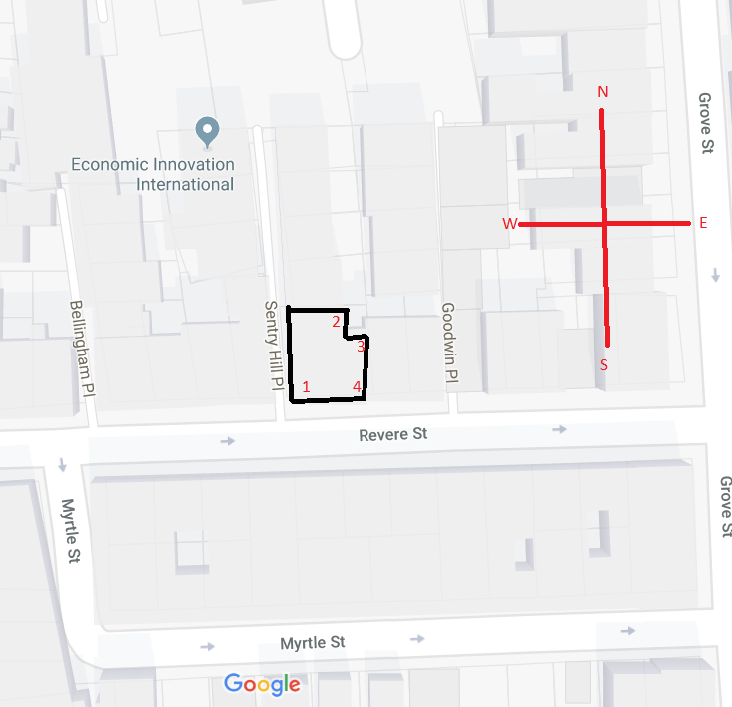
EXISTING ROOF CONDITIONS

Slide 8
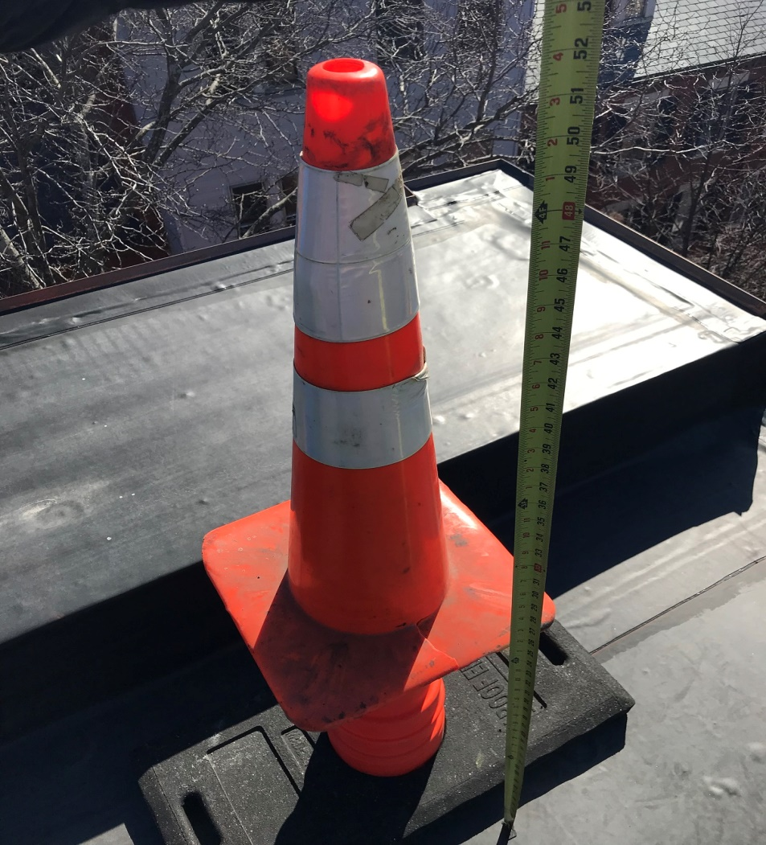
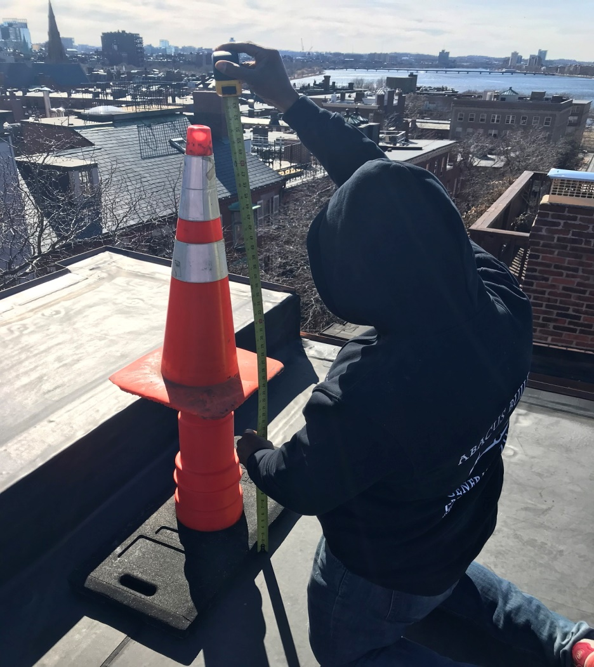
WE SET UP THE PERIMETER USING 52INCH HIGH CONES BEFORE TAKING STREET VIEW PHOTOS:
10 INCH FOR FRAME
42 INCH FOR RAILING HEIGHTH

Slide 9
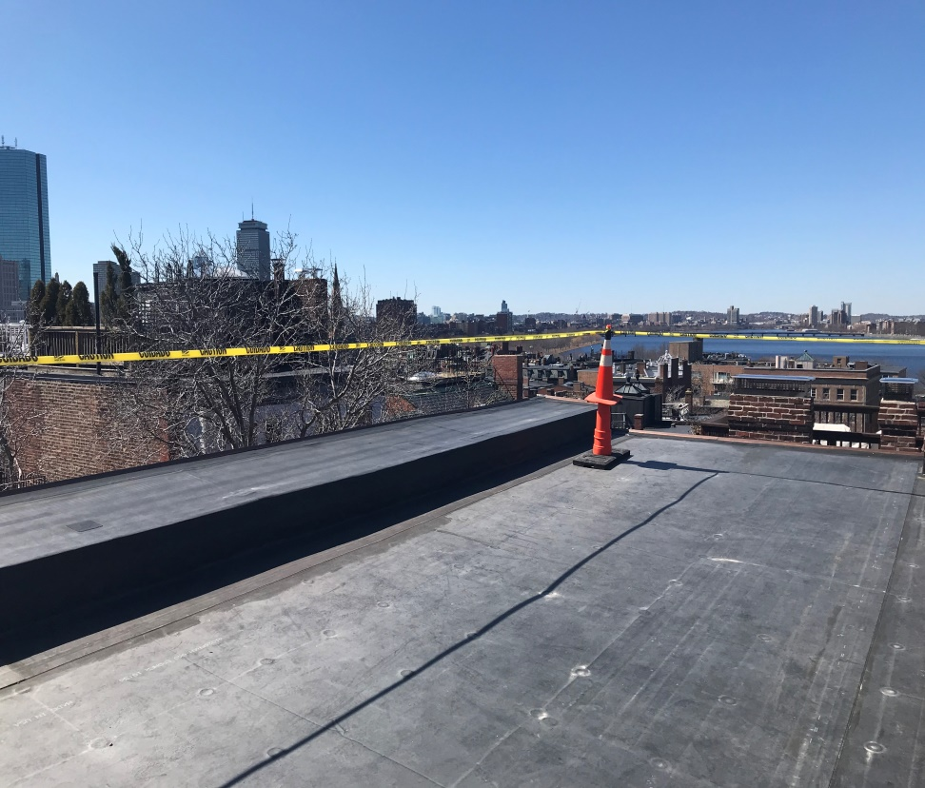
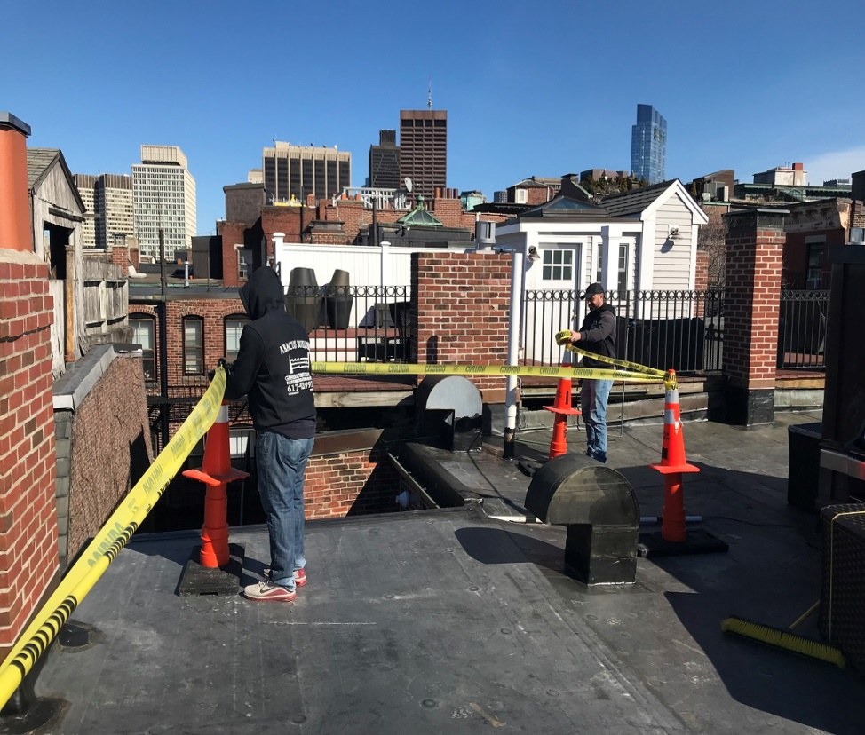
EXISITNG ROOF CONDITIONS
1 SOUTH WEST CORNER
2 NORTH EAST CORNER

Slide 10
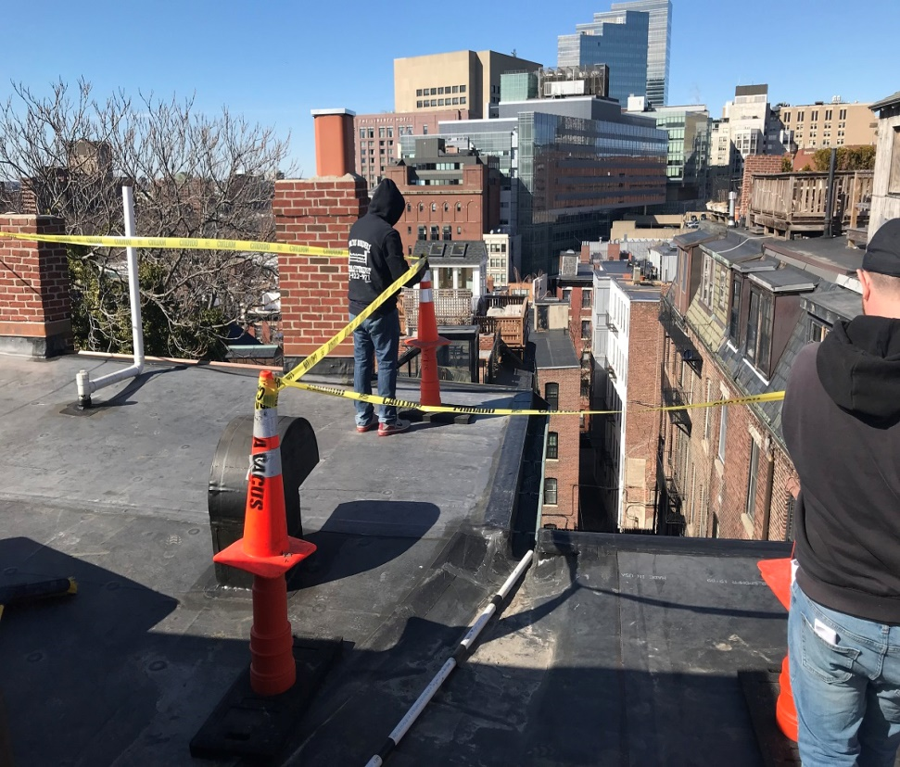
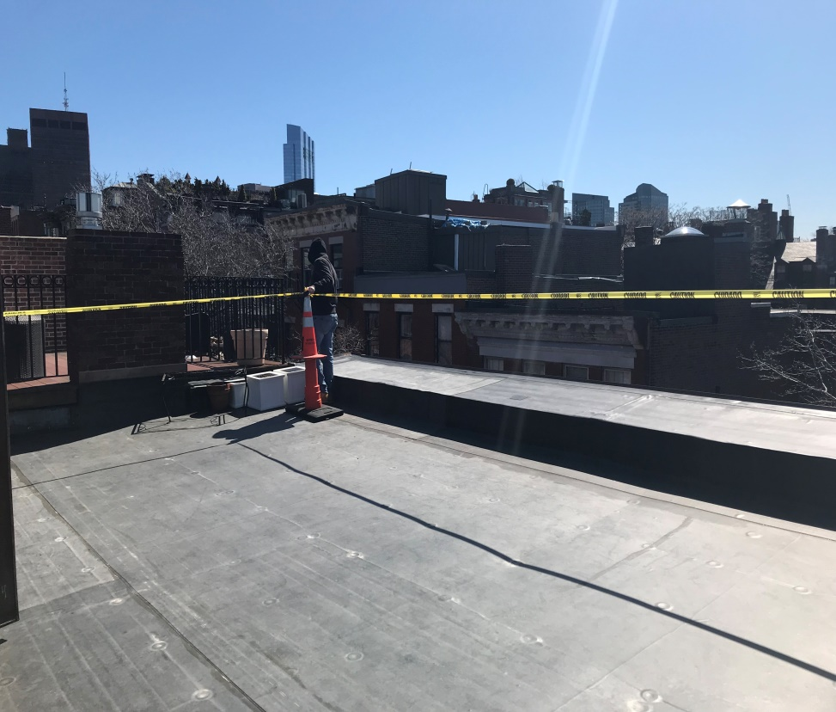
EXISTING ROOF CONDITIONS
4 SOUTH EAST CORNER
3 NE CORNER FACING NORTH

Slide 11
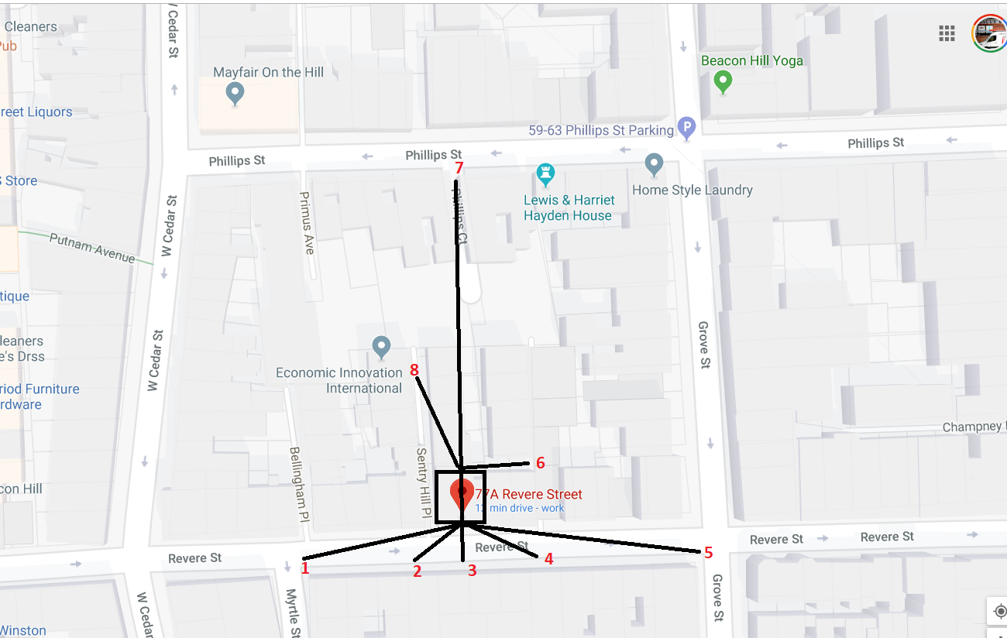
AERIAL STREET VIEW WITH PHOTO LOCATIONS MAPPED OUT

Slide 12
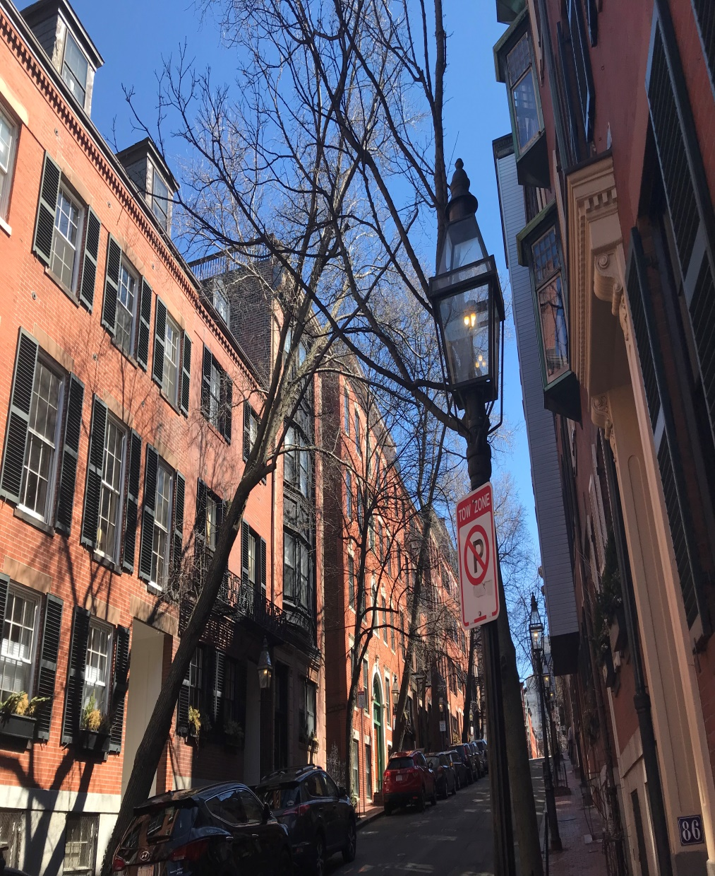
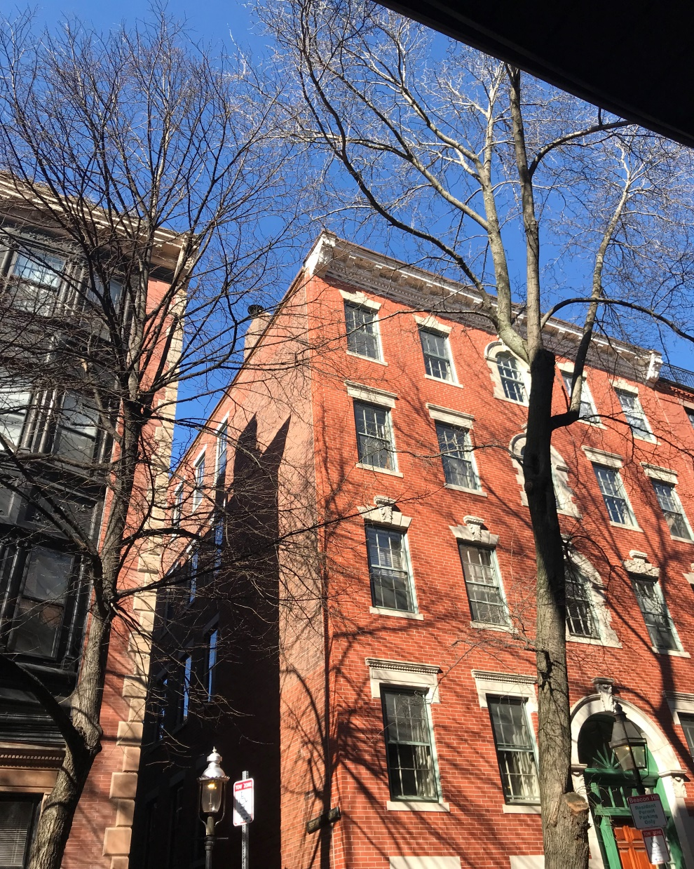
1
2

Slide 13
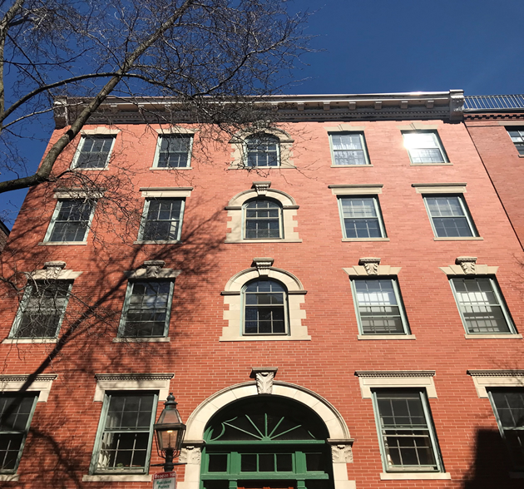
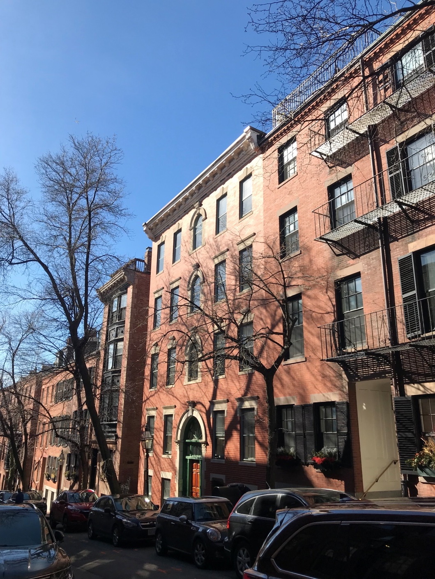
3
4

Slide 14
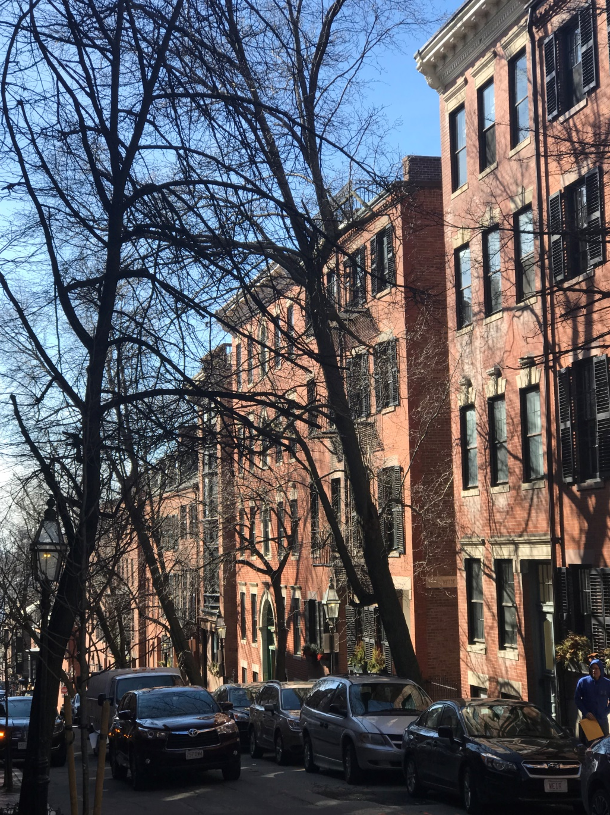
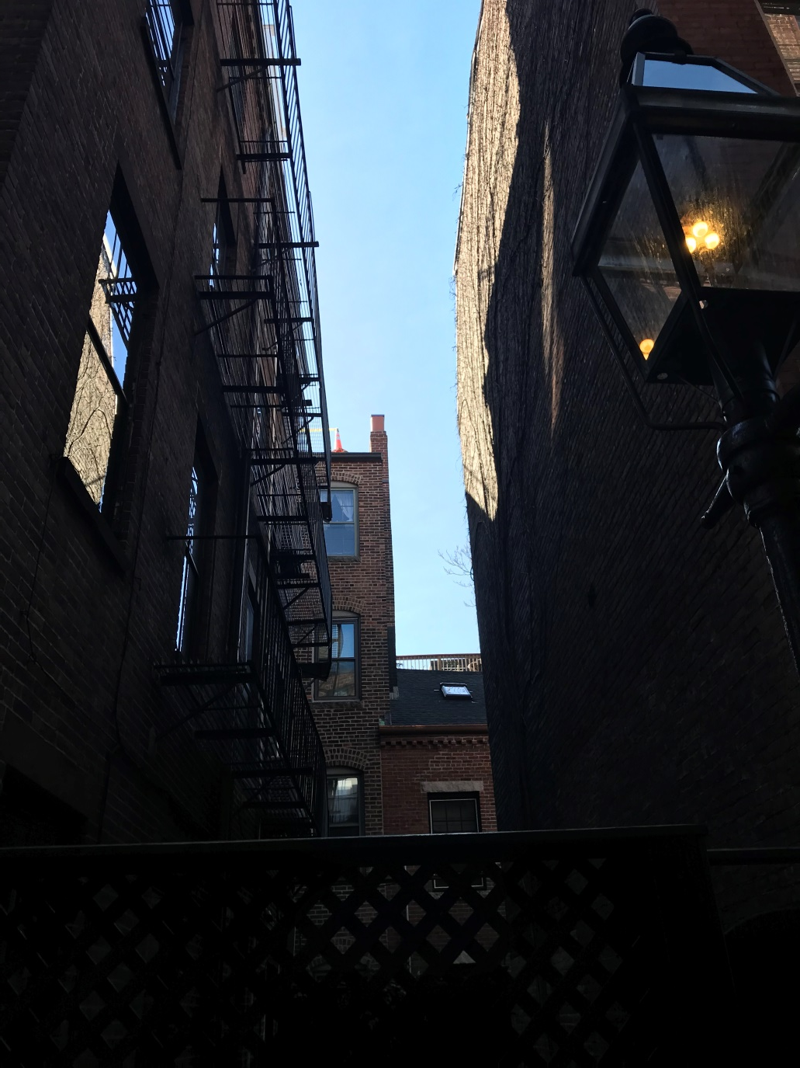
5
6

Slide 15
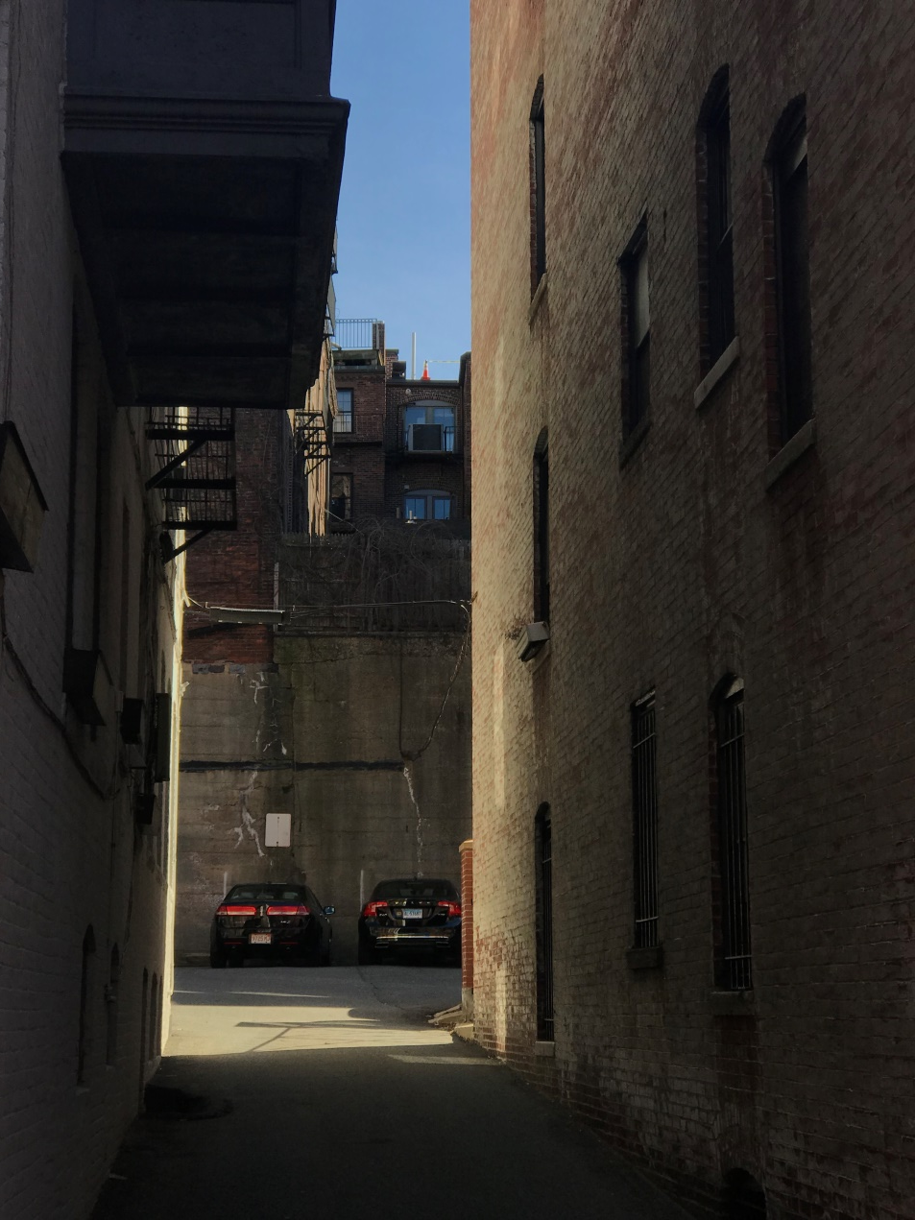
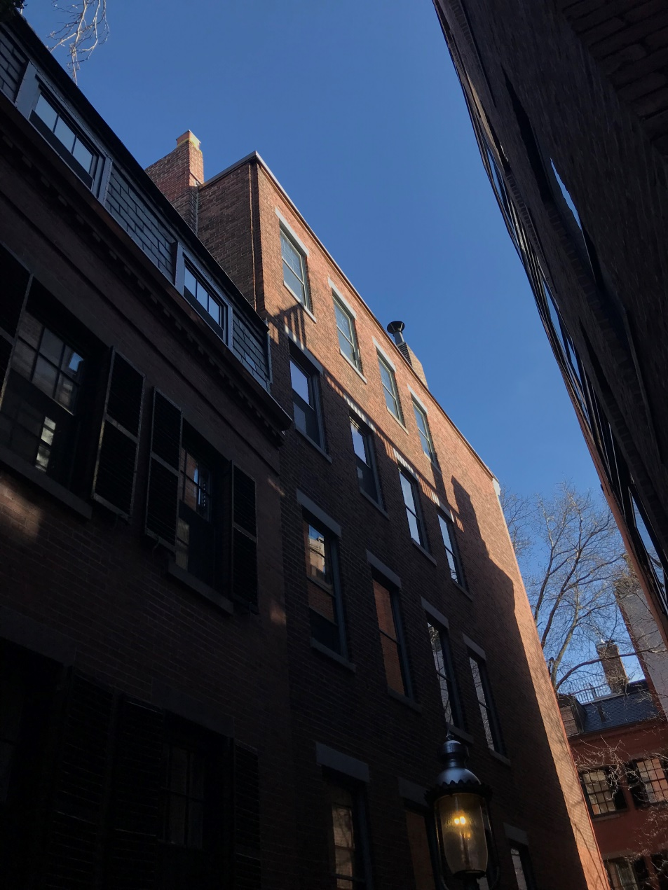
7
8

Slide 16
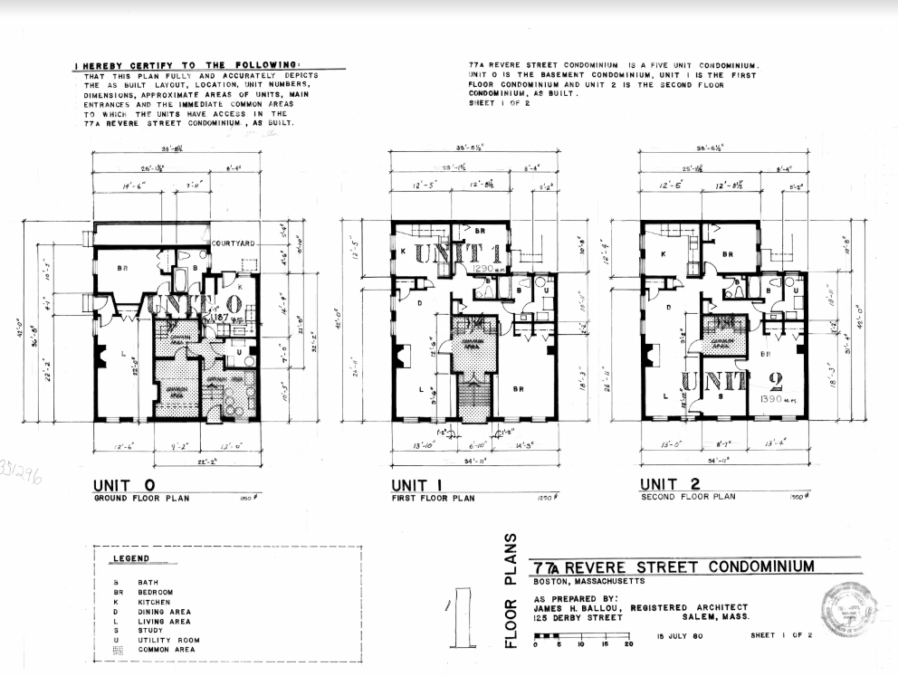
FULL SET OF ORIGINAL PLANS

Slide 17
