Slide 1
545 Boylston Street Public Arts Proposal
Proponent:
John Hancock

Slide 2
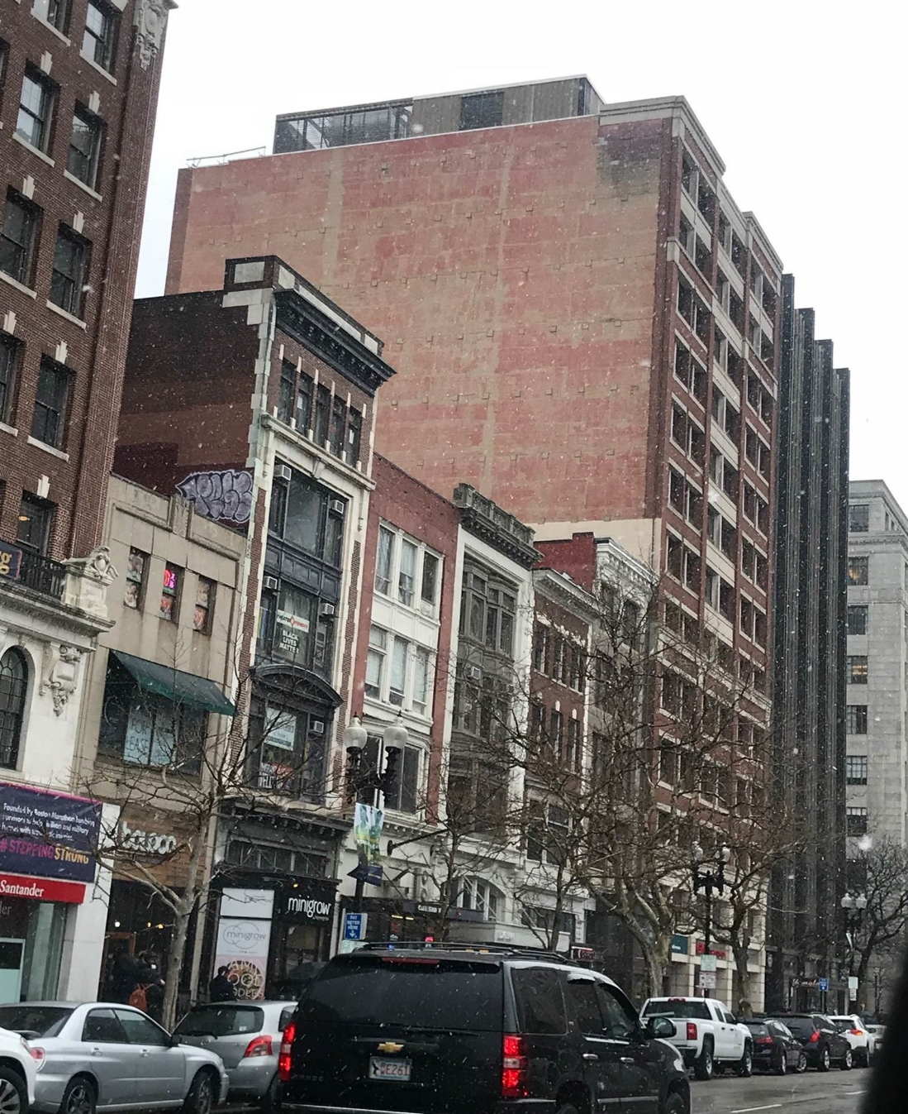
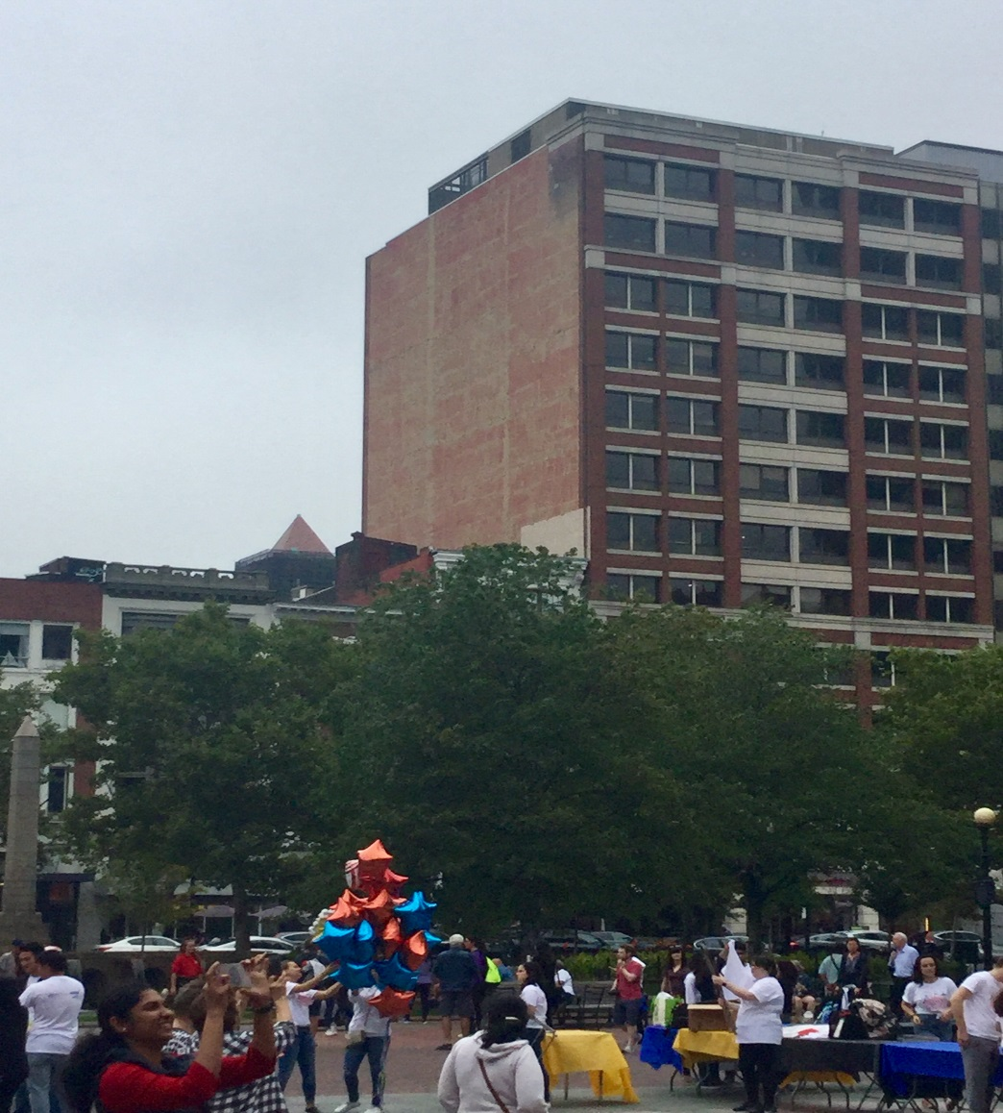
Existing Condition
Notes:
How presentation will benefit audience: Adult learners are more interested in a subject if they know how or why it is important to them.
Presenter’s level of expertise in the subject: Briefly state your credentials in this area, or explain why participants should listen to you.

Slide 3
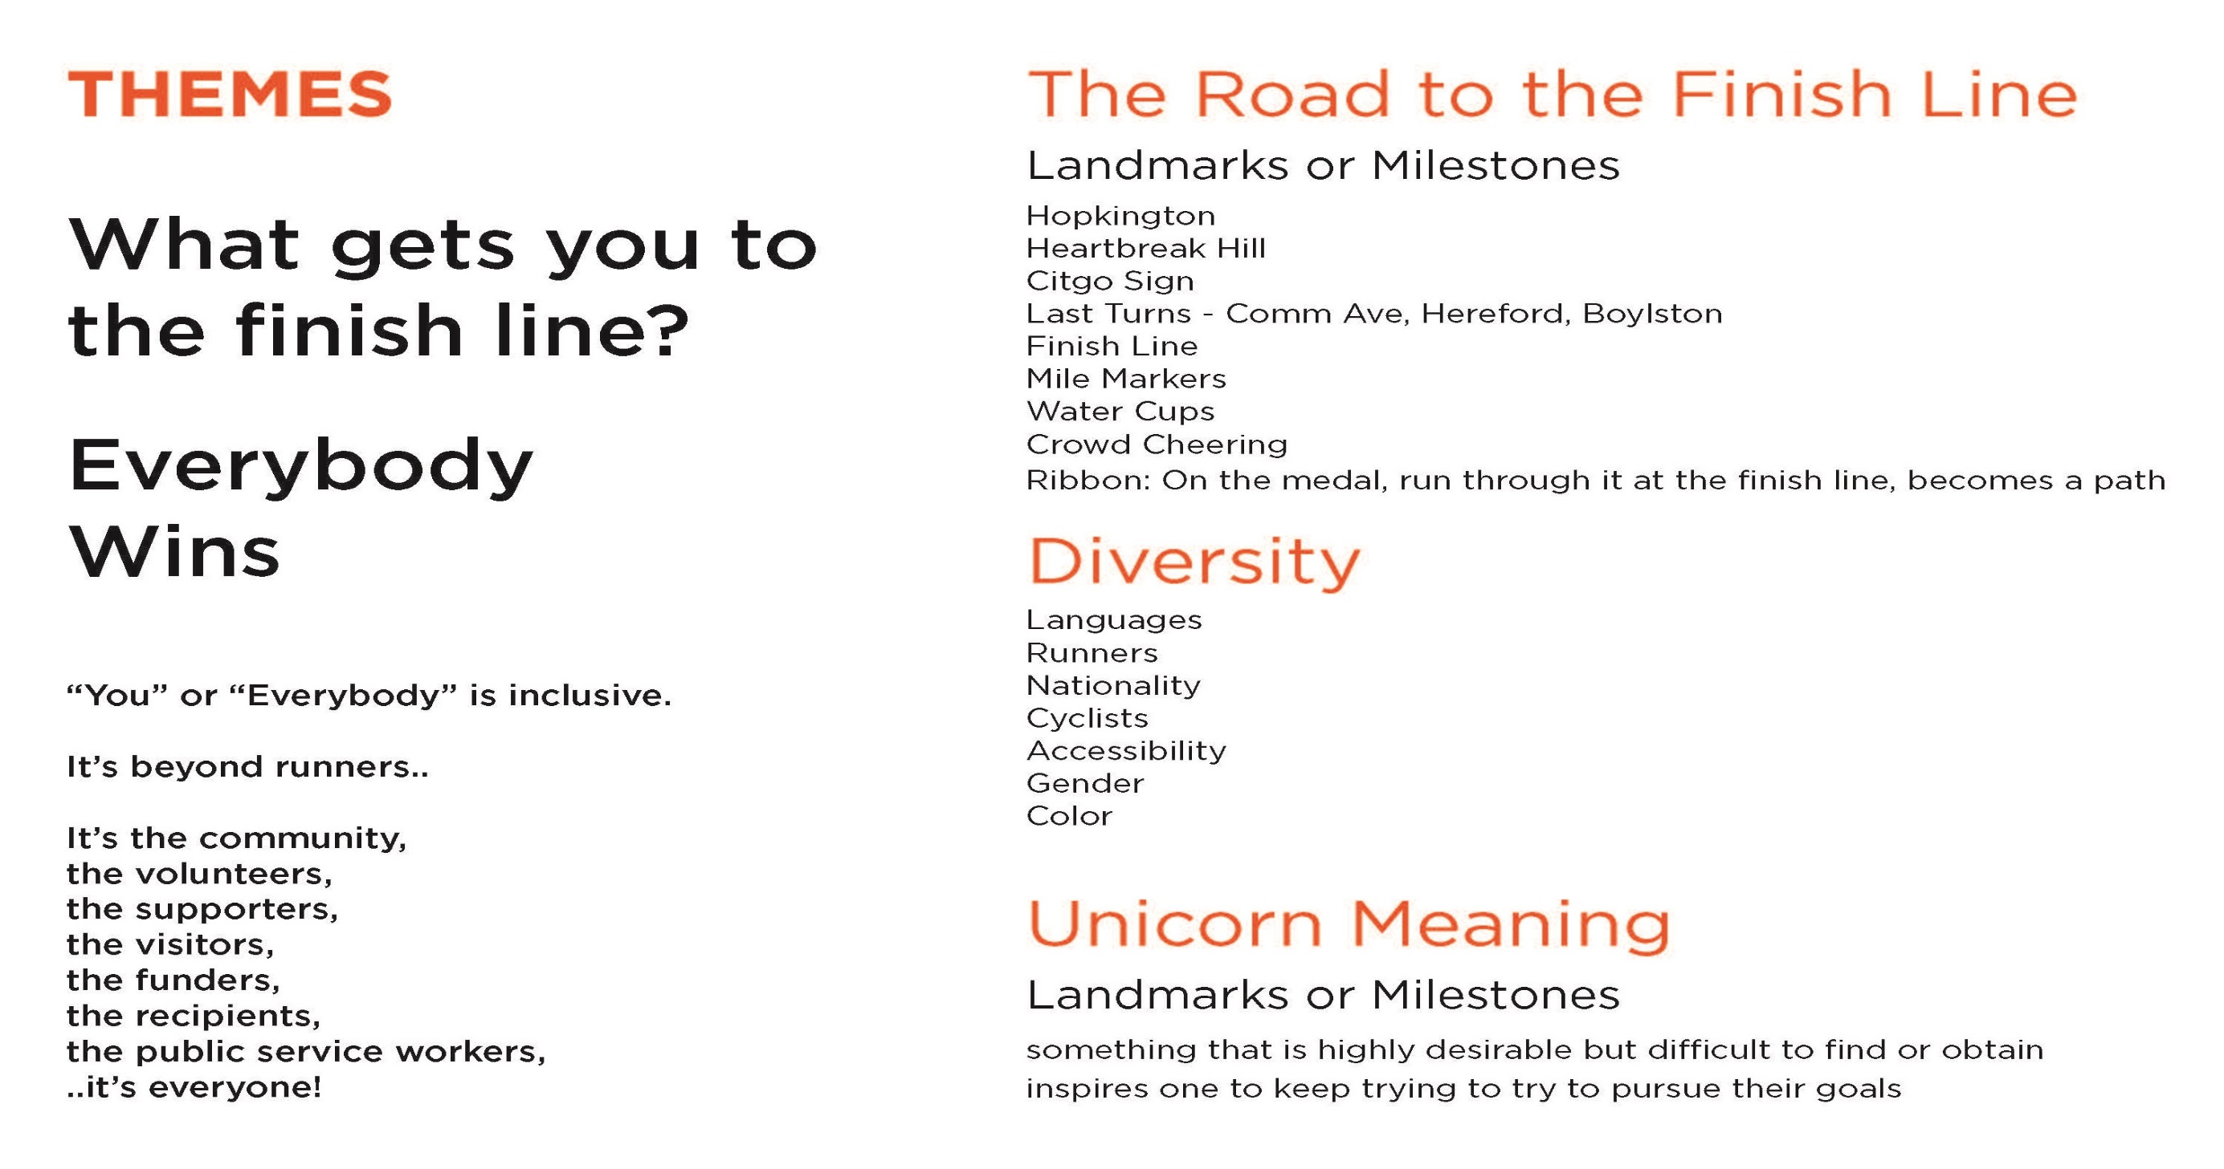
Notes:
Lesson descriptions should be brief.

Slide 4
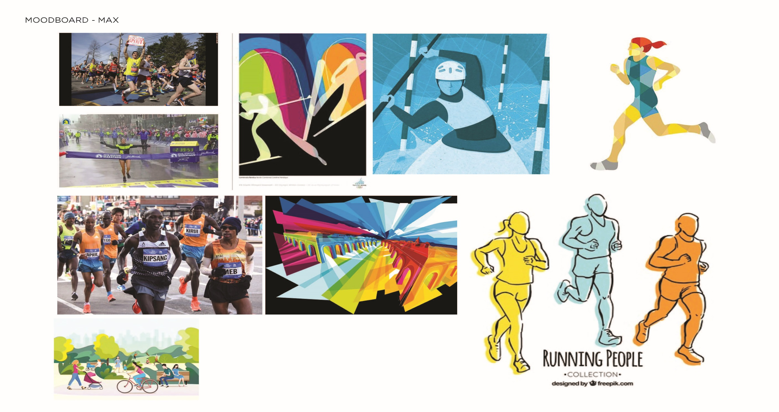
Notes:
Example objectives
At the end of this lesson, you will be able to:
Save files to the team Web server.
Move files to different locations on the team Web server.
Share files on the team Web server.

Slide 5


Slide 6


Slide 7

Final Design

