Slide 1

AT&T Modifications to Existing Wireless Facility
156 Cambridge Street
Presentation to the Beacon Hill Architectural Commission
APP # 19.695BH
February 21, 2019 @ 5:00 p.m.
Boston City Hall – Piemonte Room
Edward D. Pare, Esq.

Slide 2
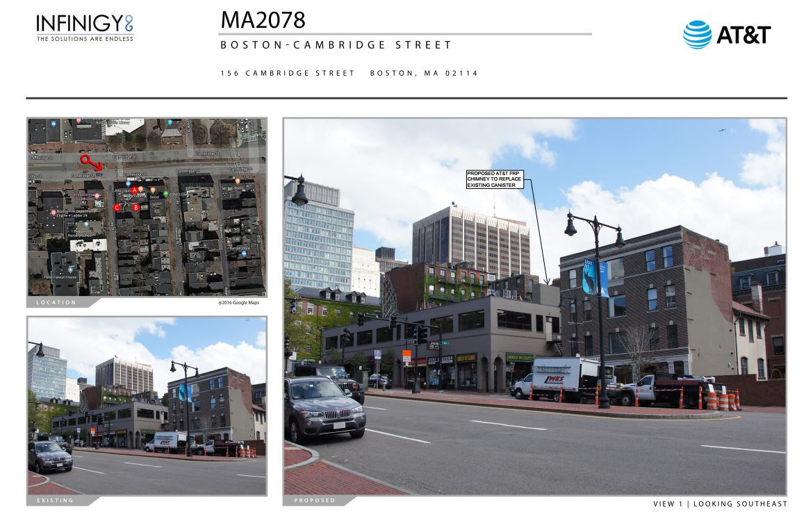

Slide 3
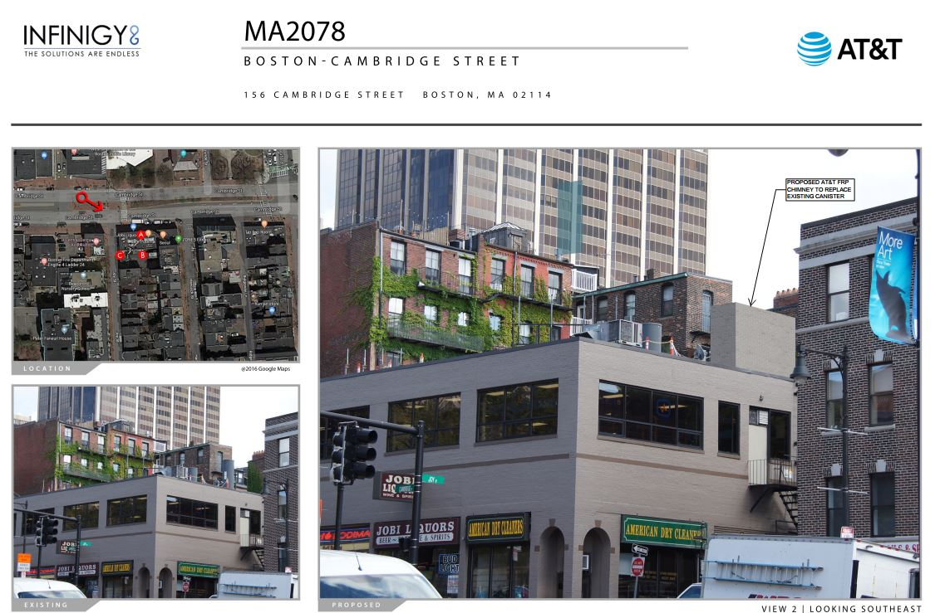

Slide 4
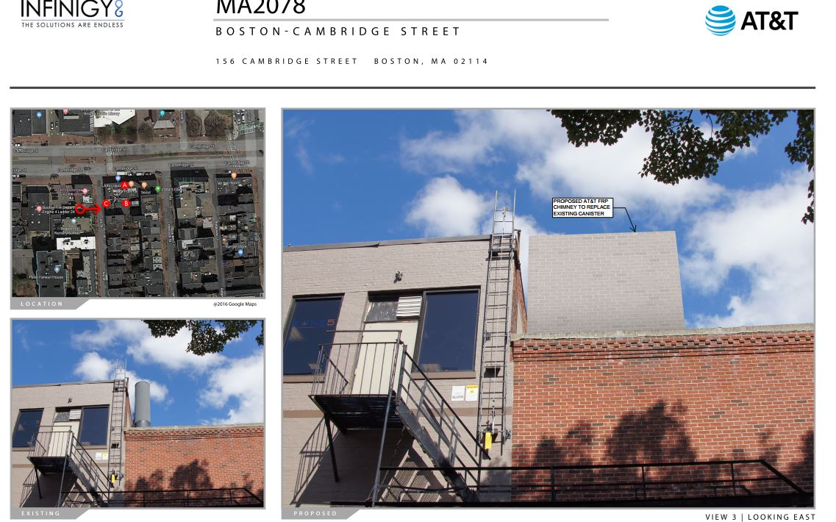

Slide 5
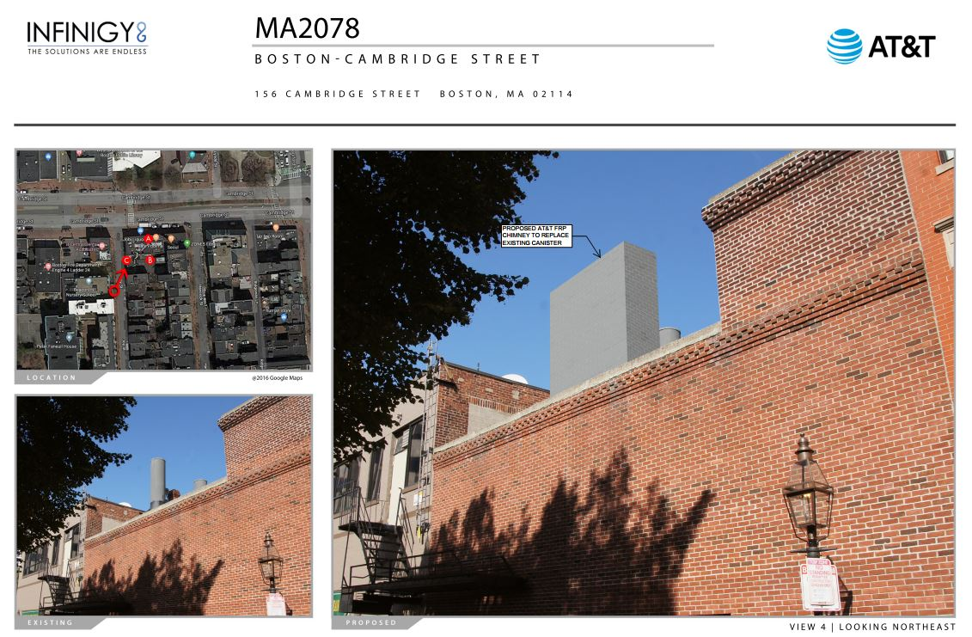

Slide 6
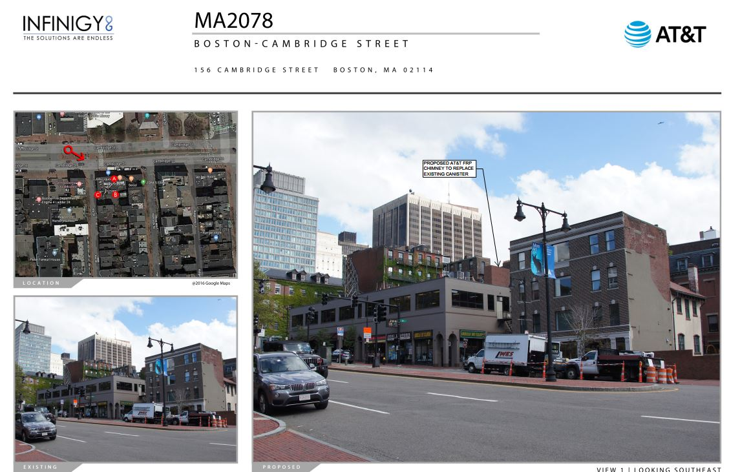

Slide 7
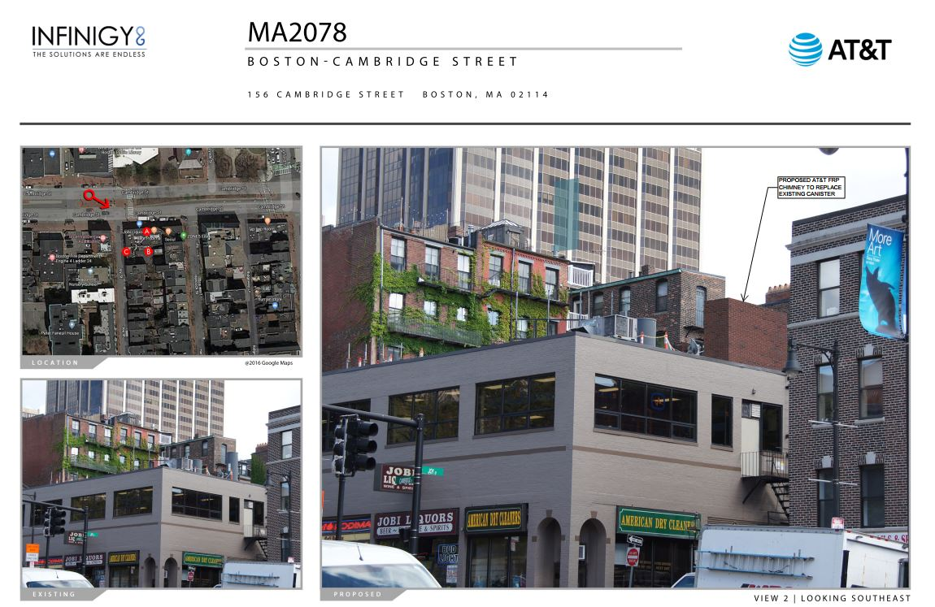

Slide 8
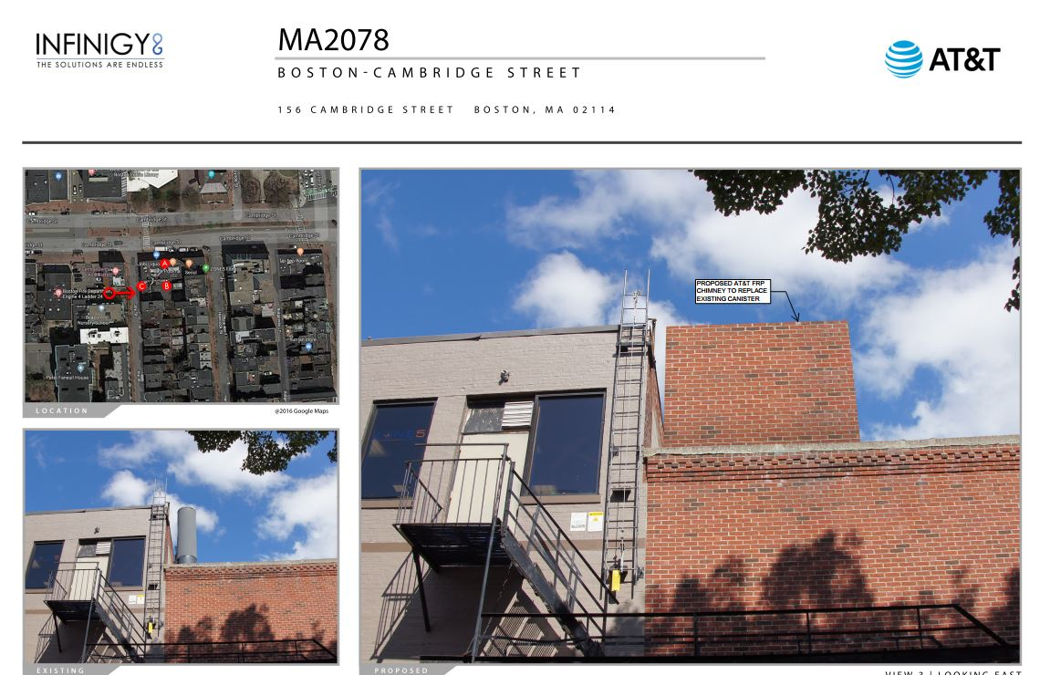

Slide 9
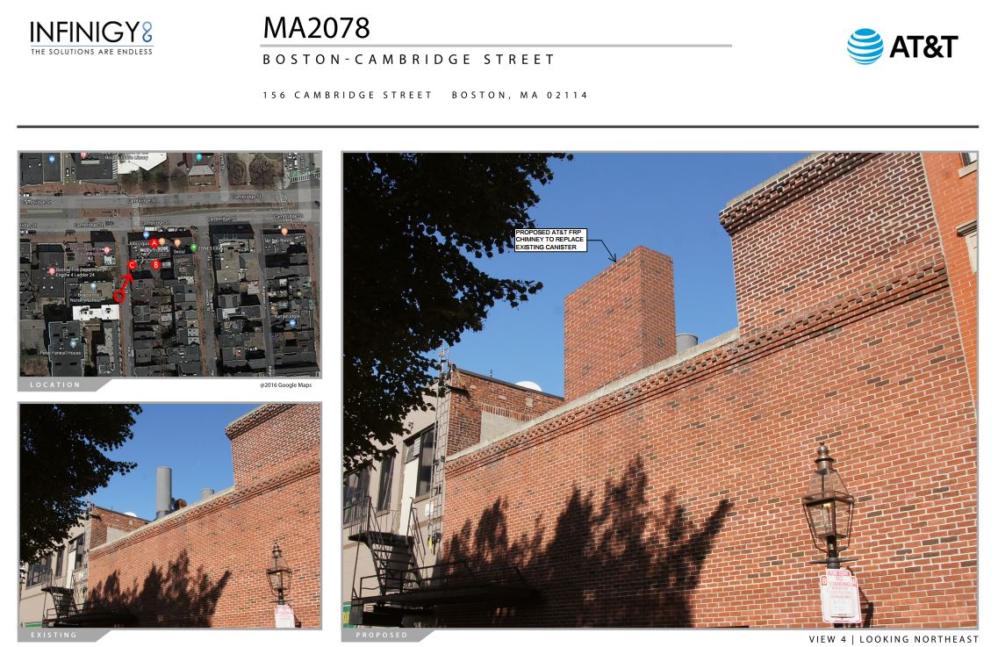

Slide 10
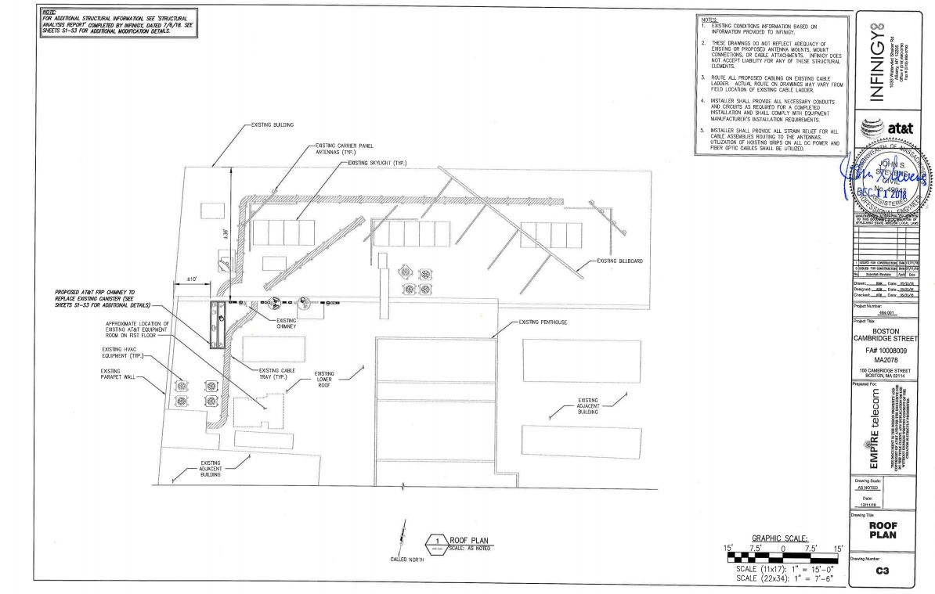

Slide 11
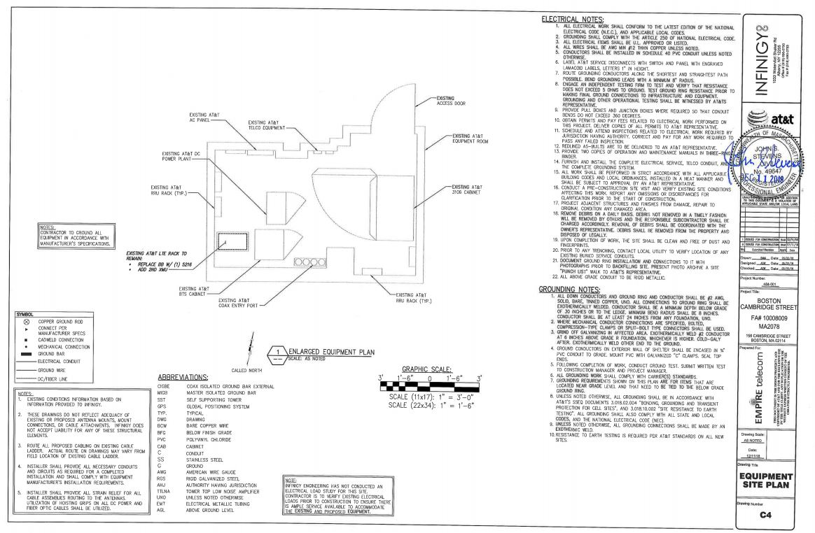

Slide 12
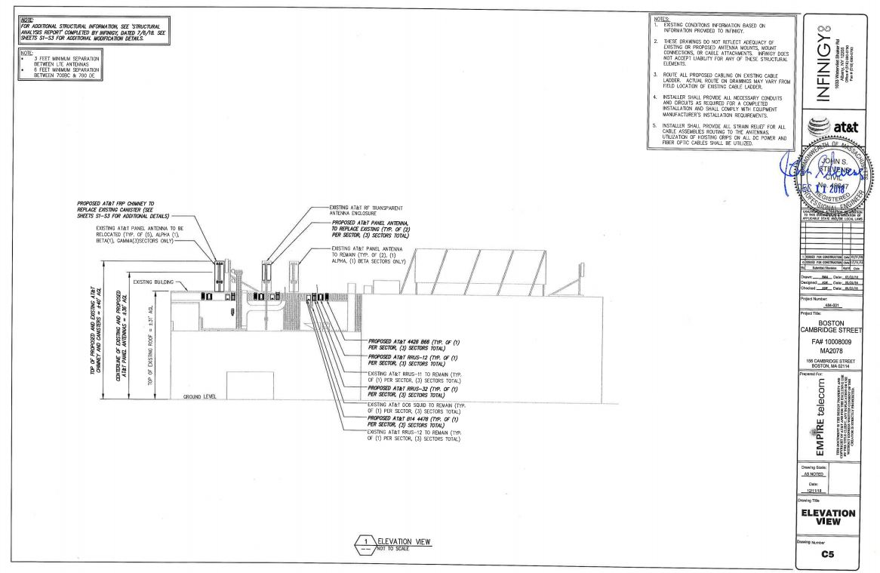

Slide 13
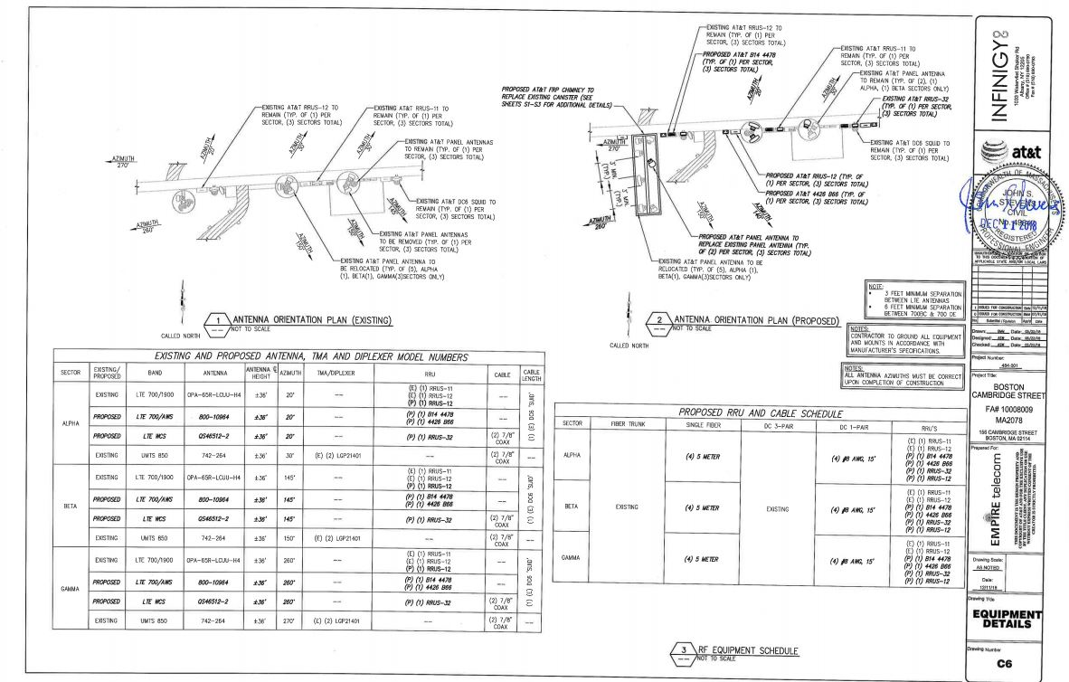

Slide 14
