Slide 1

45 West Newton Street
South End Landmarks Commission
Design Review
January 2, 2019

Slide 2
Input and Support
Homeowners: John Meunier and Jim Flanagan
            30-year South End/Shawmut Avenue residents
            Raised two children in and around Blackstone/Franklin Squares
Architects: Arthur Choo and Associates, David Freed
            Experienced with South End and Landmarks Commission design guidelines
Neighbors: Abutters and neighbors have been consulted
            Condominium owners have reviewed and approved proposed design changes
            Abutters have reviewed and approved proposed design changes
            Randi Lathrop, RG Lathrop Consulting, has assisted with neighborhood outreach and communications
Landmarks: Staff site visit
            Conducted by Nick Armata on December 6, 2018
            Modifications were made to proposal based on staff guidance and input

Slide 3
Why Are We Here Today?
The homeowners are seeking approval from the Commission to:
  Reconfigure the existing rear dormer
    Bring the dormer back an additional two feet from the rear of the building, aligning with adjacent buildings
    raise the edge of the dormer to accommodate desired internal ceiling height
  Relocate roof deck, previously located on the top the building, to the rear dormer
Benefits of the renovation
  A large HVAC mechanical unit that currently sits on the top of the building will be removed. A smaller replacement unit will be relocated and no longer be visible from the street
  Two satellite dishes, currently attached to the existing dormer will be removed
  Replace existing dilapidated dormer and small windows with and new new dormers and fenestration that reflects guidance from Commission staff

Slide 4
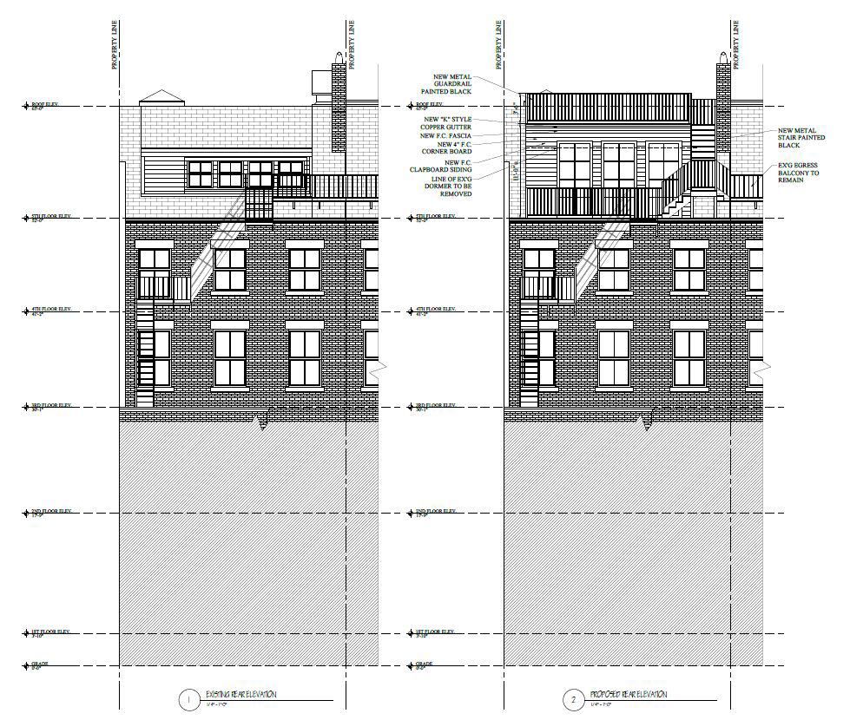
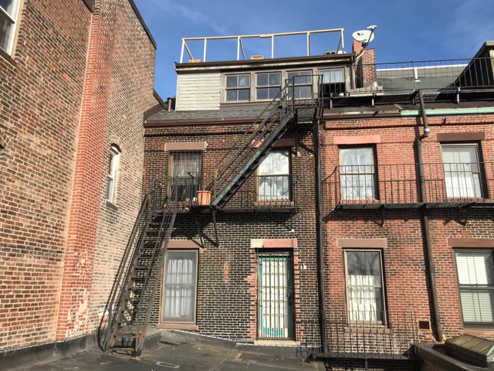
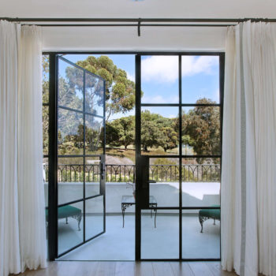
Rear Elevation
Existing
Proposed
Steel doors like those by Euroline

Slide 5
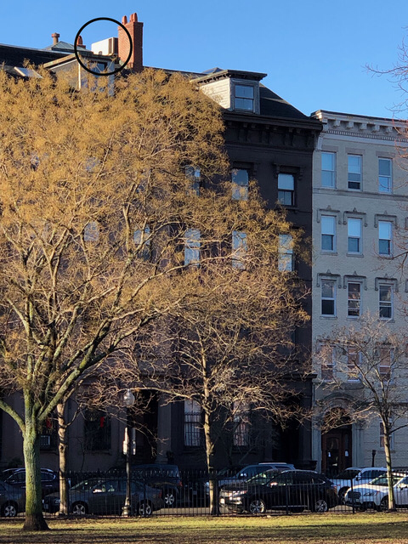
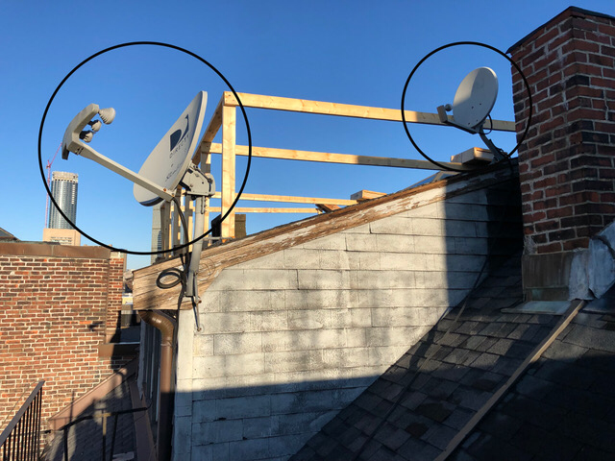
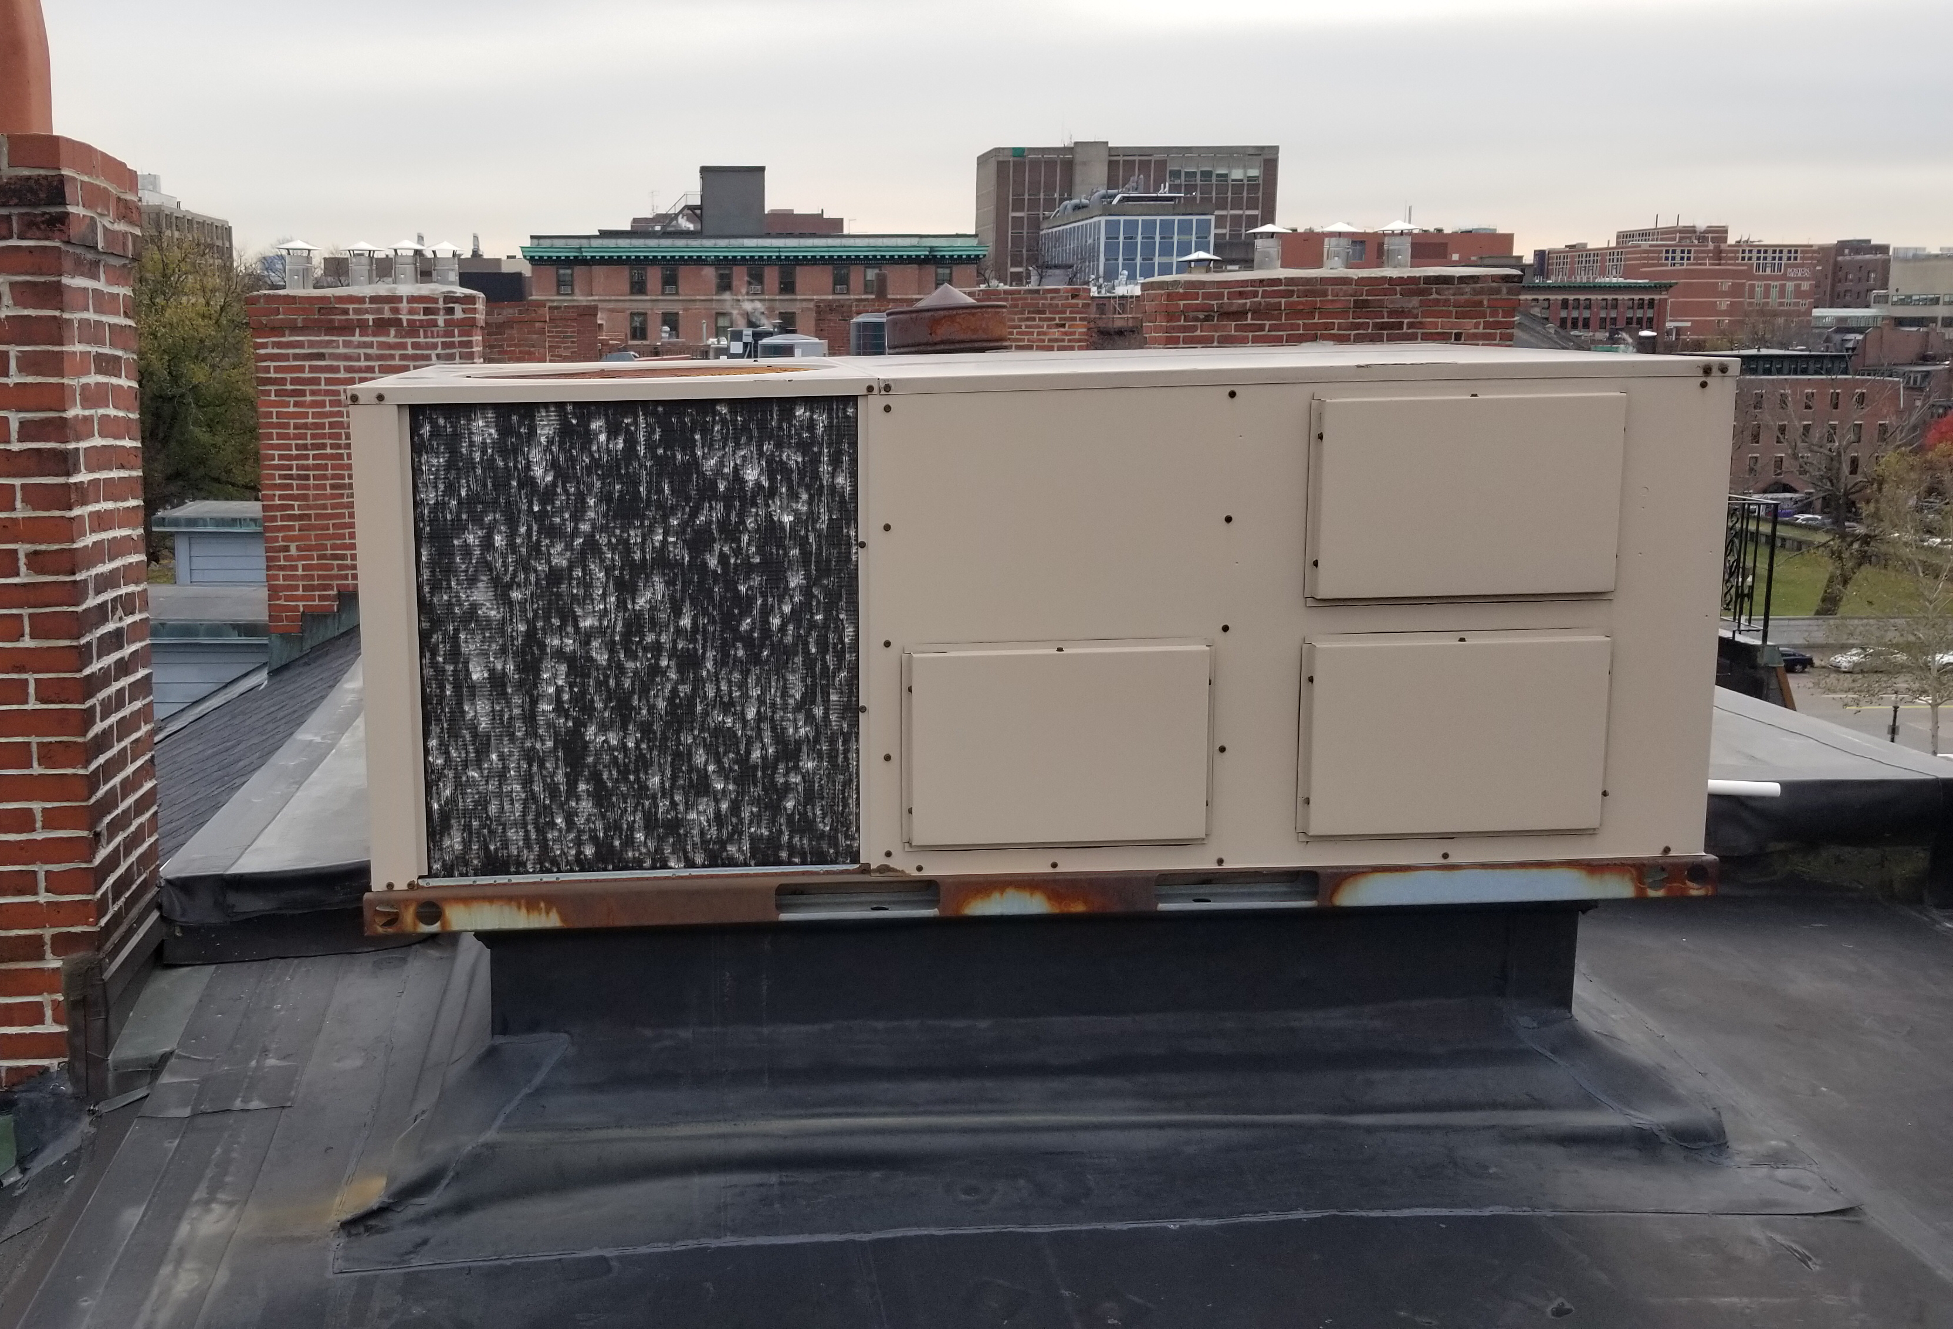
Items to be removed
Front Elevation:
HVAC Mechanicals to be Relocated
Existing Dormer:
Satellite Dishes to be Removed

Slide 6
Local Conditions and Surroundings
A set of existing environmental conditions and factors should be noted by members of the Commission:
  A wide assortment of dormer treatments exist on the rear of West Newton St. today, with the subject property in the worst condition, but also furthest from view
  There are numerous roof decks on the rear and tops of adjacent buildings
  Decorative rooftop ironwork has been a feature of buildings on this block since they were originally constructed in the mid-19th Century

Slide 7
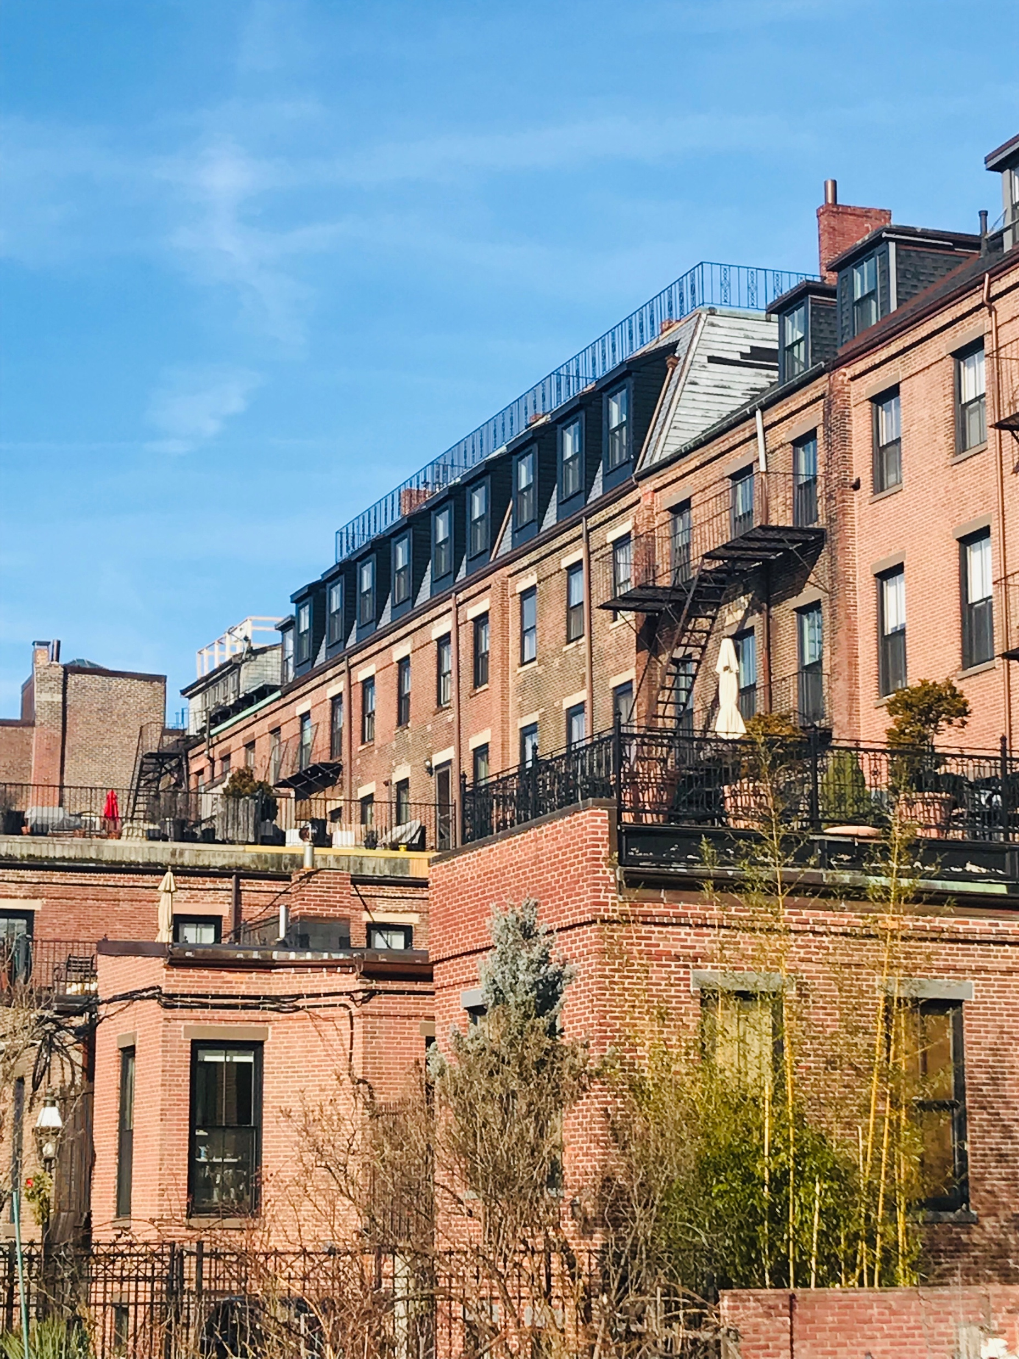
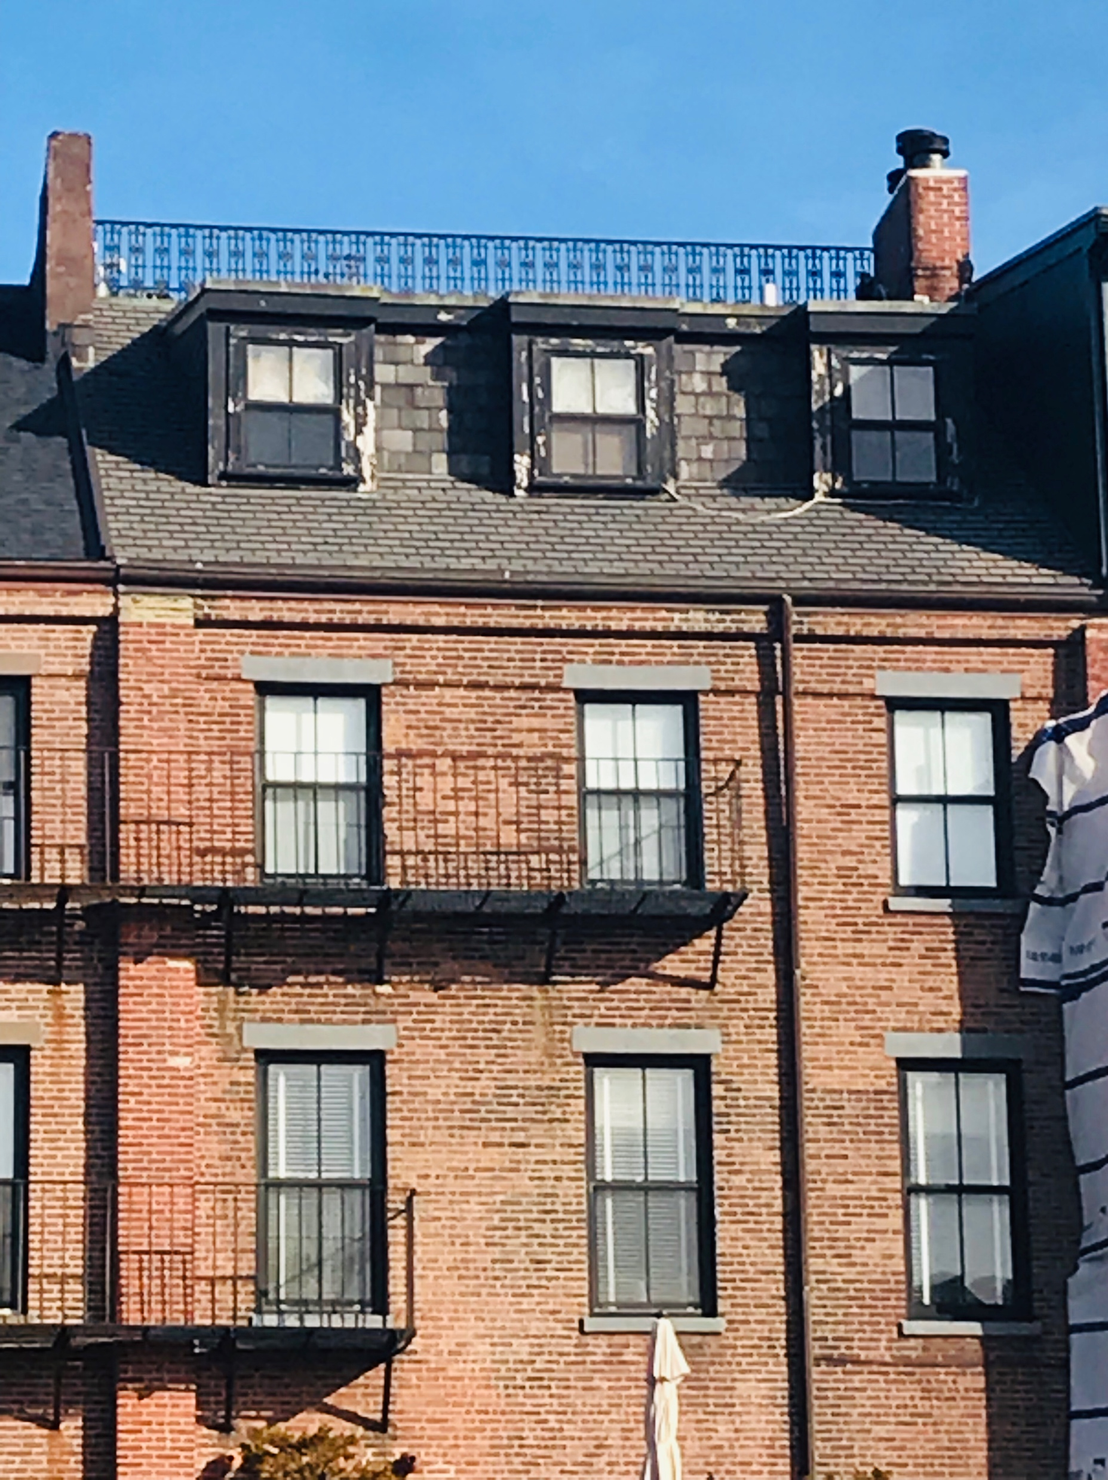
Rear views of West Newton Street

