Slide 1
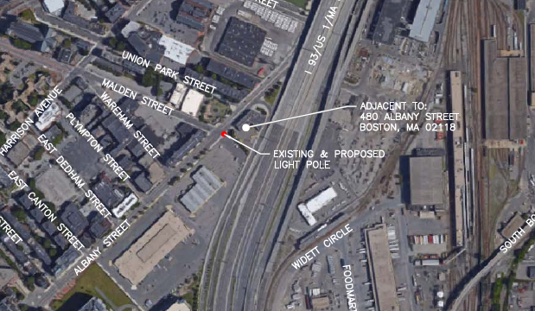
18.596 SE
City ROW at 480 Albany Street

Slide 2
18.596 SE
City ROW at 480 Albany Street
Replace existing standard concrete pole with six-sided decorative metal pole.
Top of existing post is 29’ above grade level.
Top of proposed post is 36.8’ above grade level.
Decorative pole base and lamp post all to be painted to resemble concrete.

Slide 3
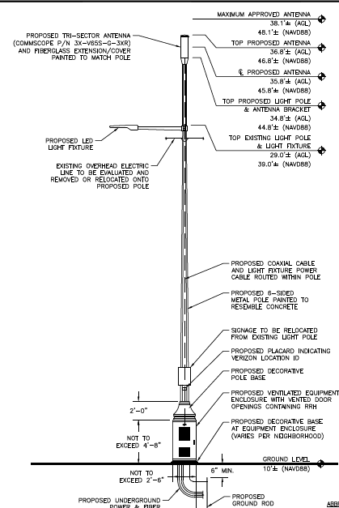

Slide 4
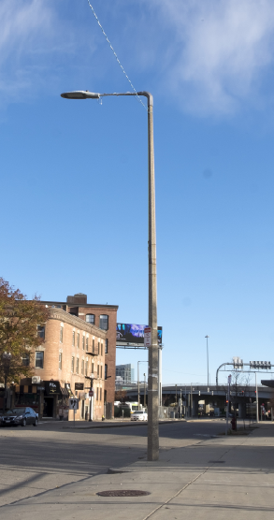
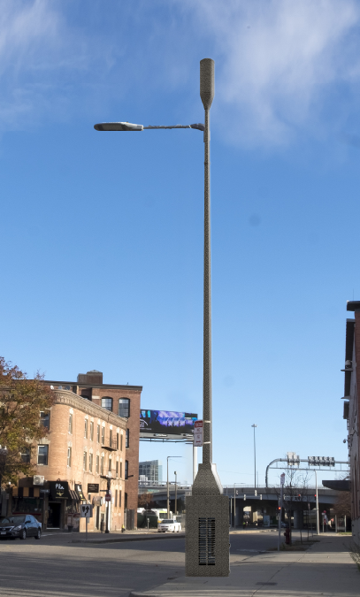

Slide 5
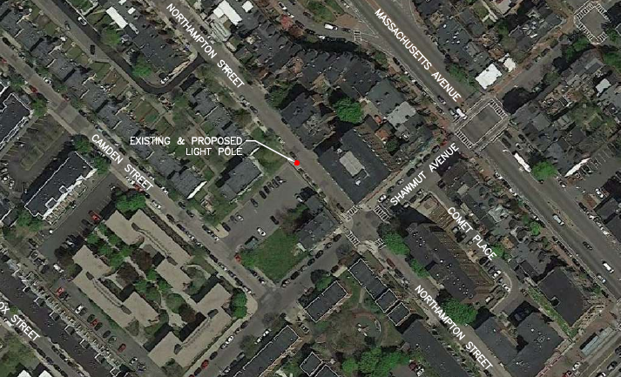
18.592 SE
City ROW at 175 Northampton St.

Slide 6
18.592 SE
City ROW at 175 Northampton St.
Replace existing standard concrete pole with six-sided decorative metal pole.
Top of existing post is 29’ above grade level.
Top of proposed post is 36.8’ above grade level.
Decorative pole base and lamp post all to be painted to resemble concrete.

Slide 7
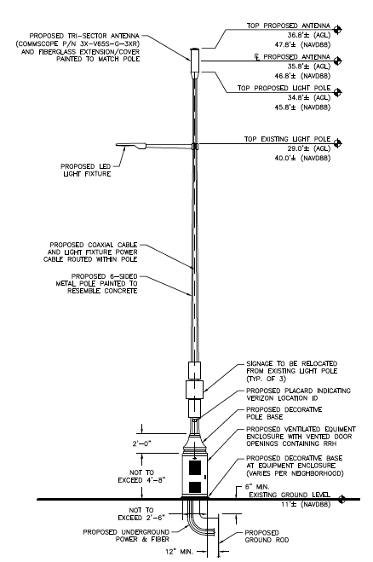

Slide 8
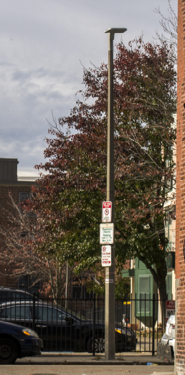
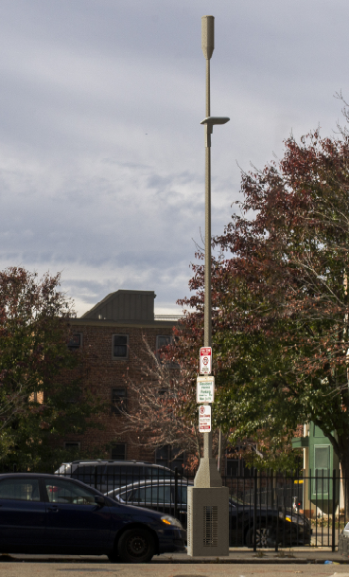

Slide 9
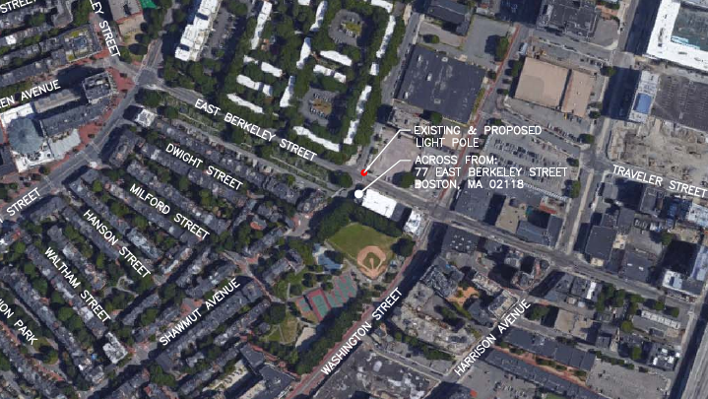
18.594 SE
City ROW at 77 E. Berkeley St.

Slide 10
18.594 SE
City ROW at 77 E. Berkeley St.
Replace existing aeriata concrete pole with six-sided decorative metal pole.
Top of existing post is 24’ above grade level.
Top of proposed post is 30.8’ above grade level.
Decorative pole base and lamp post all to be painted to resemble concrete.

Slide 11
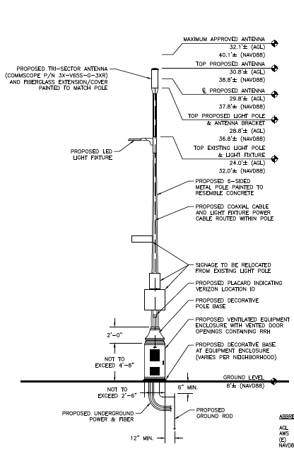

Slide 12
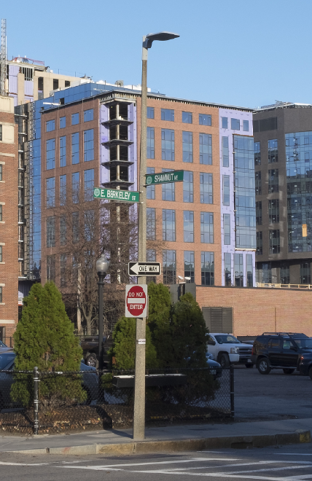
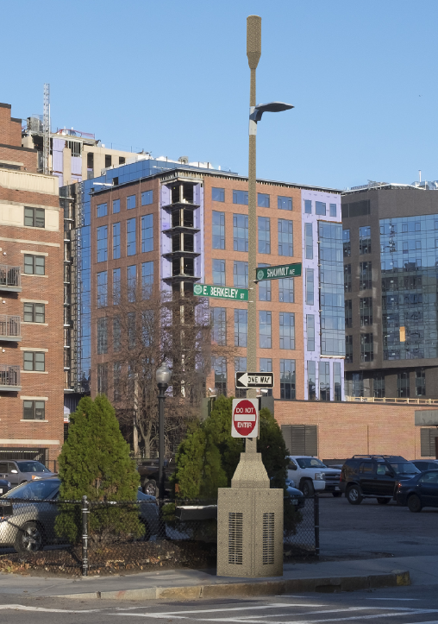

Slide 13
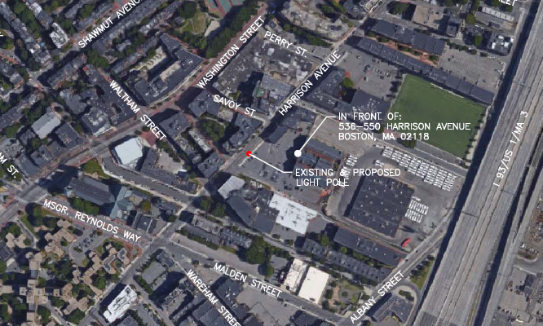
18.595 SE
City ROW at 536-550 Harrison Av.

Slide 14
18.595 SE
City ROW at 536-550 Harrison Av.
Replace existing standard concrete pole with six-sided decorative metal pole.
Top of existing post is 29’ above grade level.
Top of proposed post is 36.8’ above grade level.
Decorative pole base and lamp post all to be painted to resemble concrete.

Slide 15
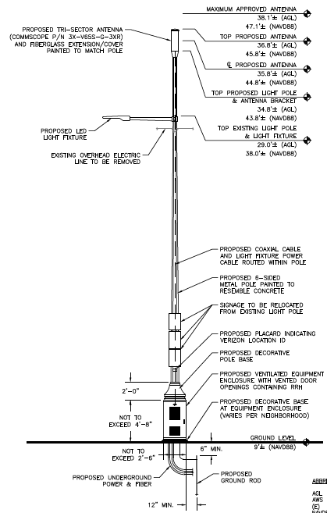

Slide 16
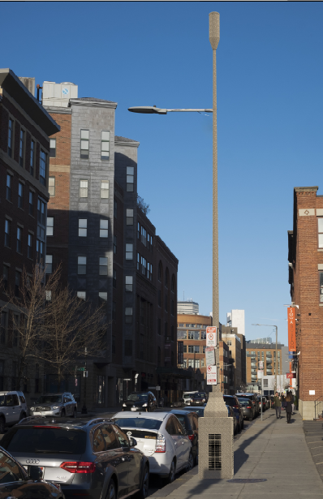
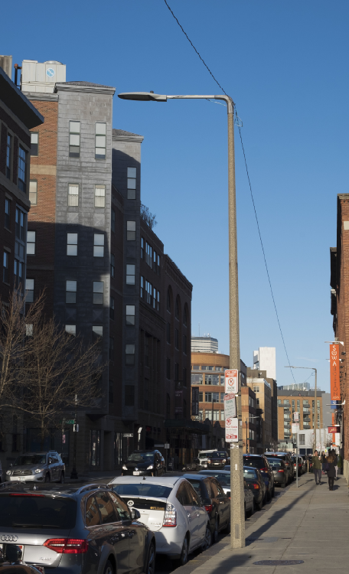

Slide 17
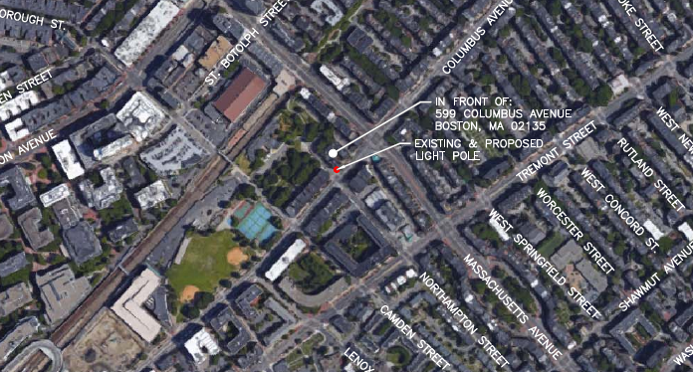
18.593 SE
City ROW at 599 Columbus Av.

Slide 18
18.593 SE
City ROW at 599 Columbus Av.
Replace existing aeriata pole with six-sided decorative metal pole.
Top of existing post is 24’ above grade level.
Top of proposed post is 30.8’ above grade level.
Decorative pole base and lamp post all to be painted black.

Slide 19
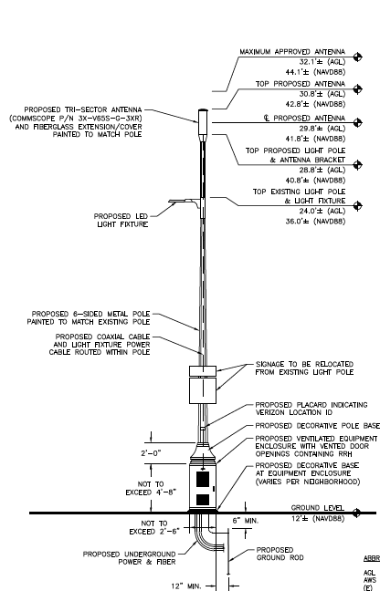

Slide 20
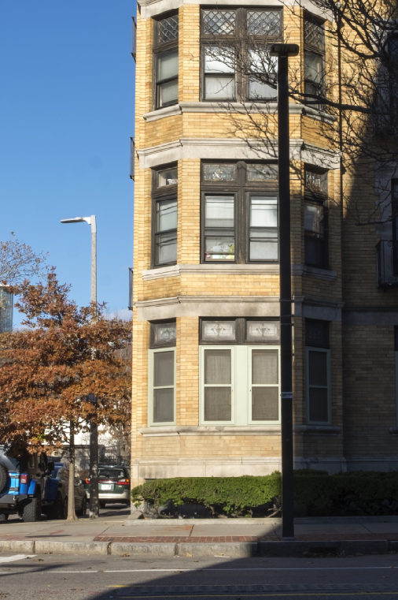
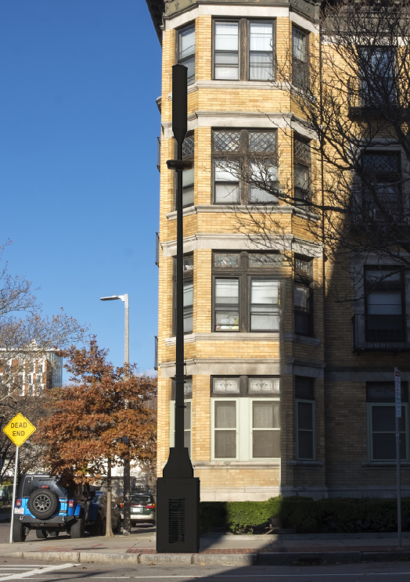

Slide 21
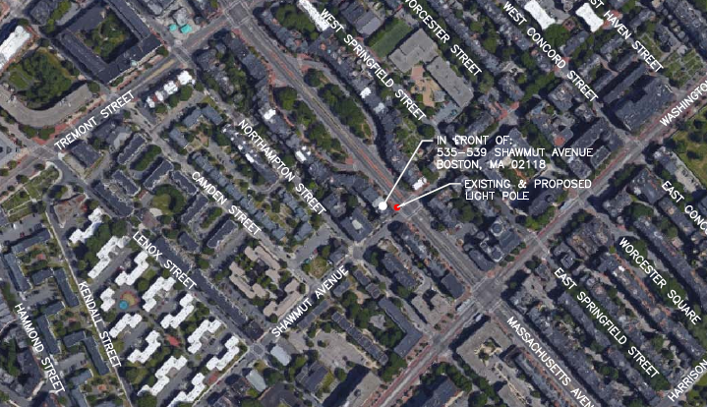
18.591 SE
City ROW at 585 Massachusetts Av.

Slide 22
18.591 SE
City ROW at 585 Massachusetts Av.
Replace existing fluted metal pole with like kind fluted metal pole/pendant light.
Top of existing post is 25’ above grade level.
Top of proposed post is 32’ above grade level.
Decorative pole base and lamp post all to be painted black.

Slide 23
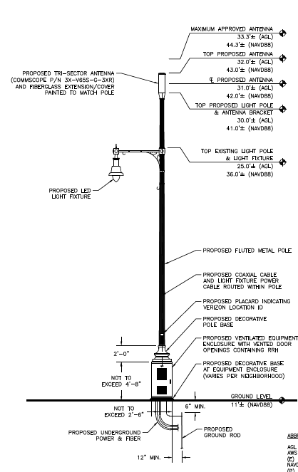

Slide 24
