Slide 1
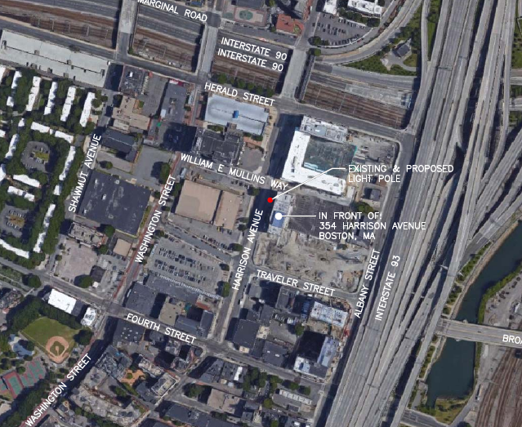
18.022 SE City ROW at 354 Harrison Avenue

Slide 2
18.022 SE City ROW at 354 Harrison Avenue
Replace existing black pendant lamp post with similar fluted black pendant lamp post.
Top of existing post is 25’ above grade level.
Top of proposed post is 32’ above grade level.
Decorative pole base and lamp post all to be painted black

Slide 3
