Slide 1
BBAC Public Hearing
120 Beacon Street Condominium
120/122 Beacon - Brick Wall Proposal
May 10, 2017

Slide 2
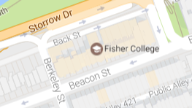
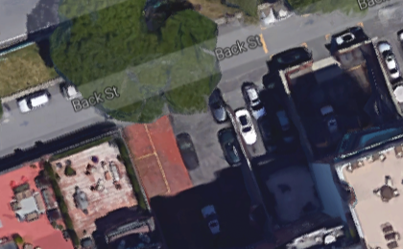
120/122 Beacon Street – aerial view between Arlington Street & Berkeley Street

Slide 3
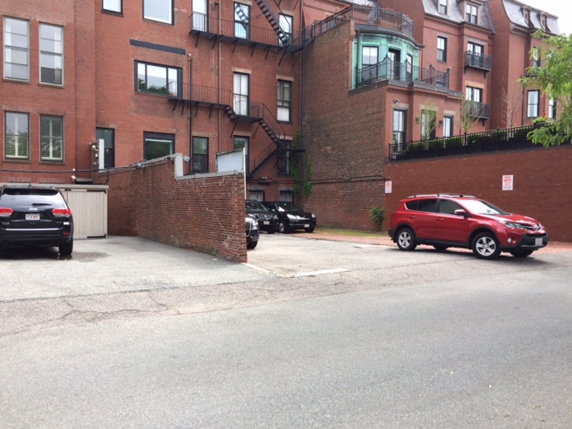
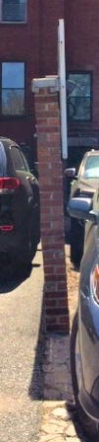
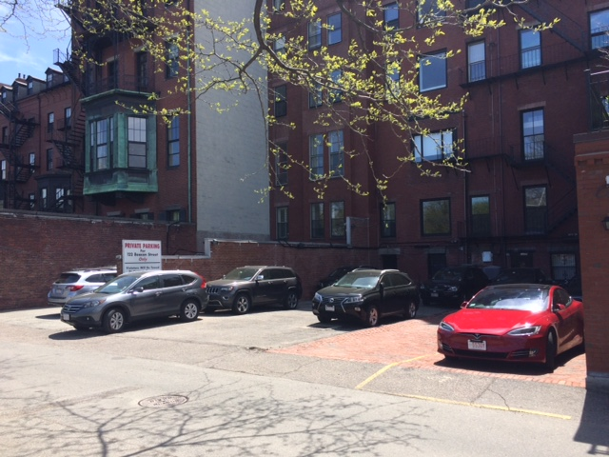
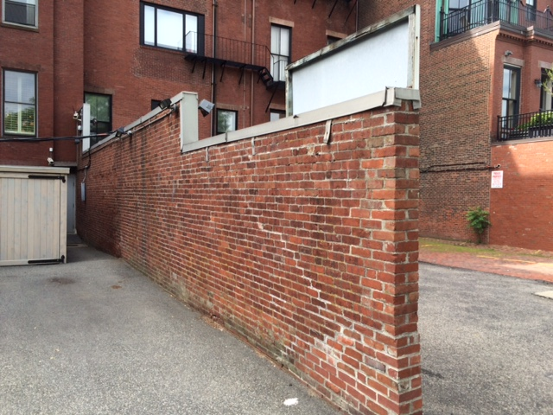
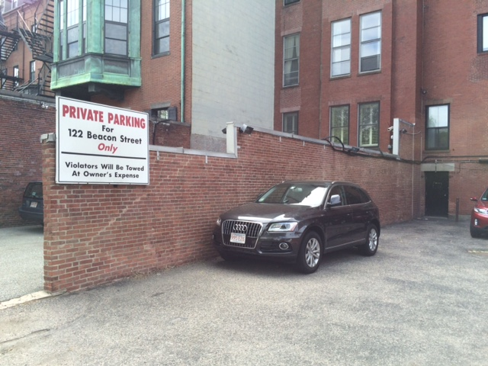
120 Beacon lot (L) & 122/124 Beacon lot (R)
120 Beacon lot (Far L) & 122/124 Beacon lot (R)
120 Beacon lot’s side of brick wall
Leaning wall
122 Beacon lot’s side of brick wall

Slide 4
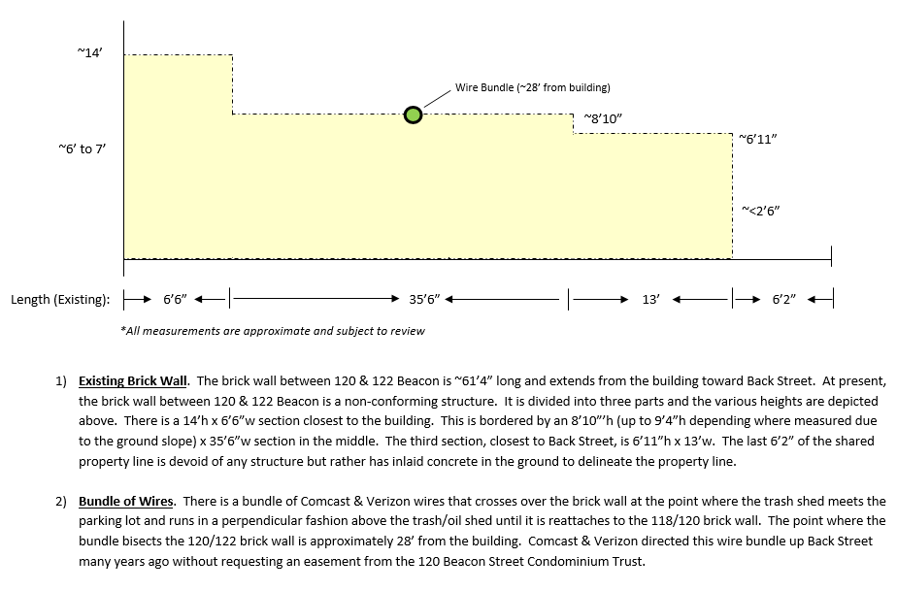
120/122 Beacon Street Brick Wall - Existing

Slide 5
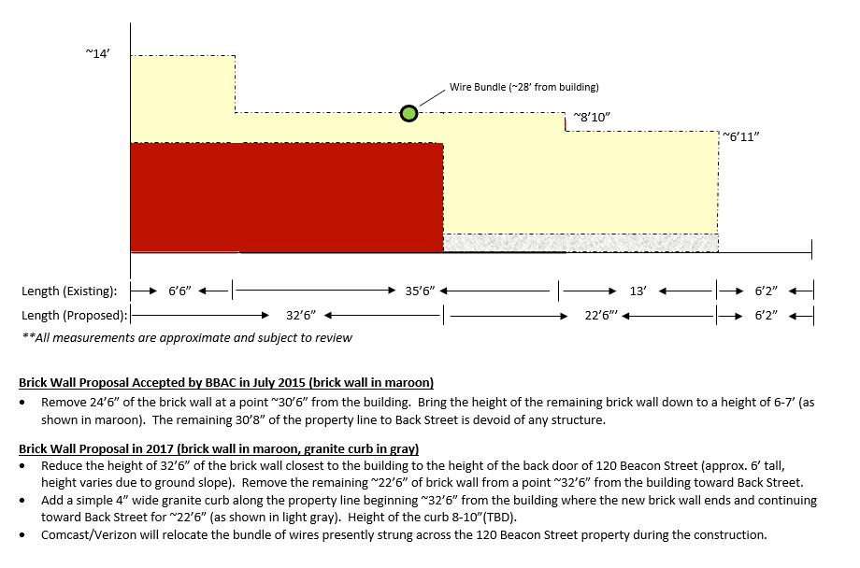
120/122 Beacon Street Brick Wall - Proposed

Slide 6
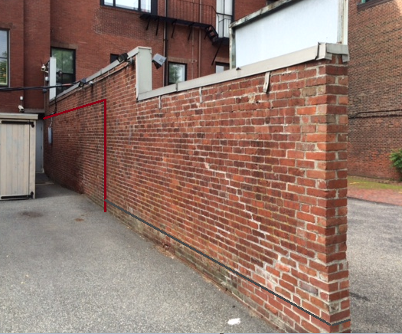
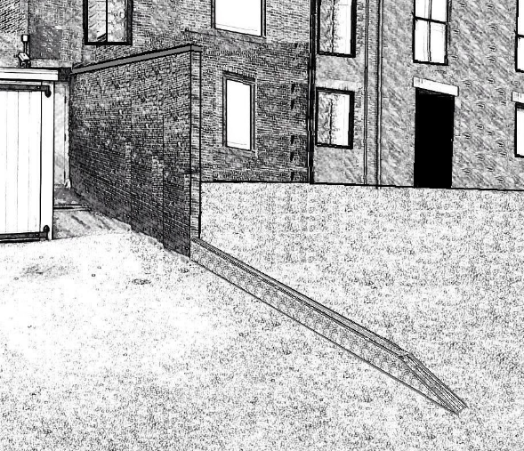
120/122 Beacon Street Brick Wall - Proposed
Existing wall with outline of new brick wall (red line) and granite curb (gray line at bottom)
Rendering of new wall and curb

Slide 7
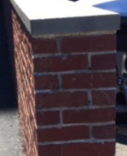
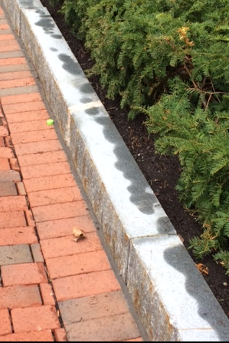

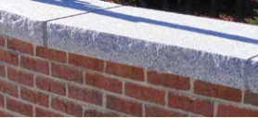
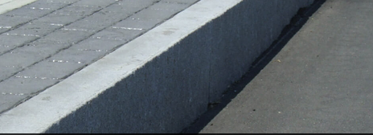
120/122 Beacon Street Brick Wall – Examples & Materials
Gray Granite

