Slide 1
Welcome to the Conversation!
Thursday June 6, 2019 Community Meeting
Regarding Parcels on Hollander and Holworthy

Slide 2
Meeting Agenda
1. General Introduction
2. Introduction to the Department of Neighborhood Development
3. Introduction of Parcels
4. Introduction of Past Neighborhood Home Imitative Projects
5. Discussion of Best Use of Parcels
6. Next Steps

Slide 3
Department of Neighborhood Development
1. Neighborhood Housing Development
2. Office of Housing Stability
3. Real Estate Management Services
4. The Boston Home Center
5. Housing Innovation Lab

Slide 4
List of Parcels
Number | Parcel ID | Address | Sq. Footage
1 | 1203306000 | 80 HOLWORTHY ST | 3,334 sq ft
2 | 1203307000 | 78 HOLWORTHY ST | 3,333 sq ft
3 | 1203308000 | 76 HOLWORTHY ST | 3,333 sq ft
4 | 1203309000 | 74 HOLWORTHY ST | 3,333 sq ft
5 | 1203310000 | UNNUMBERED HOLWORTHY ST | 38,767 sq ft
6 | 1203326000 | 59 HOLLANDER ST | 3,250 sq ft
7 | 1203325001 | 57 HOLLANDER ST | 3,250 sq ft
8 | 1203320000 | 31 HOLLANDER ST | 3,300 sq ft
9 | 1203319000 | 29 HOLLANDER ST | 3,300 sq ft
10 | 120333500 | 73 HOLWORTHY ST | 3,333 sq ft
11 | 1203334000 | 71 HOLWORTHY ST | 3,333 sq ft
Total Sq. ft. |  |  | 71,866

Slide 5
Parcel Map

Slide 6
Aerial View

Slide 7
Bird’s Eye View

Slide 8
Holworthy Street View

Slide 9
Holworthy Street View

Slide 10
Hollander Street View

Slide 11
Hollander Street View

Slide 12
Past Neighborhood Home Intiative Projects

Slide 14
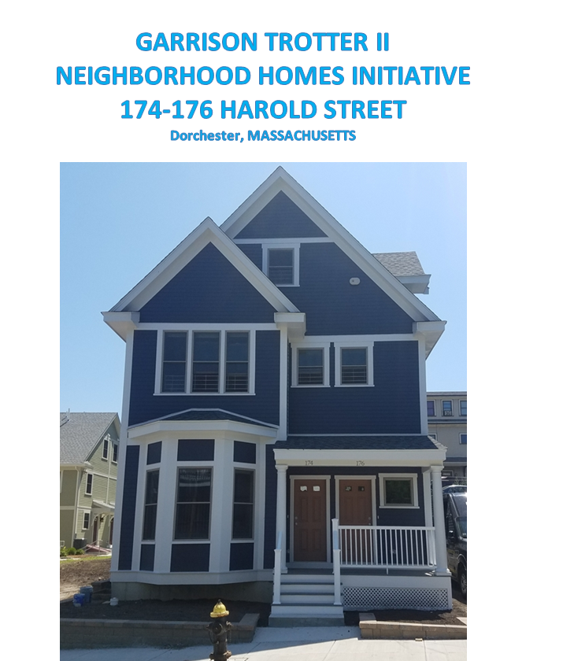

Slide 15
91 Waumbeck

Slide 16
93 Waumbeck

Slide 17
95-97 Waumbeck Street

Slide 18
109 Waumbeck Street

Slide 19
113 Waumbeck Street

Slide 20
Next Steps
COMMUNITY MEETING JUNE 6
COMMUNITY MEETING
TO DISCUSS HOME TYPES
RFP AVAILABLE
Initial community meeting to discuss site use.
Community Meeting to introduce schematic designs of housing

Slide 21
Questions?
Please Contact:
Jonathan Spillane, Development Officer, 617-635-0248, jonathan.spillane@boston.gove
John Feuerbach, Senior Development Officer,
617-635-0353, john.feuerbach@boston.gov

