Slide 1
632 Morton Street
Community Meeting
October 8, 2020

Slide 2

What is the Grassroots Program?
632 Morton Street

Slide 3
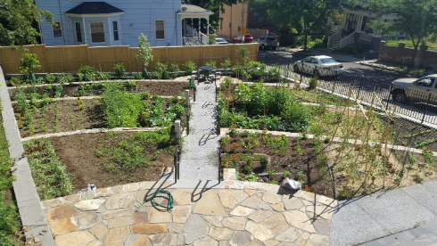
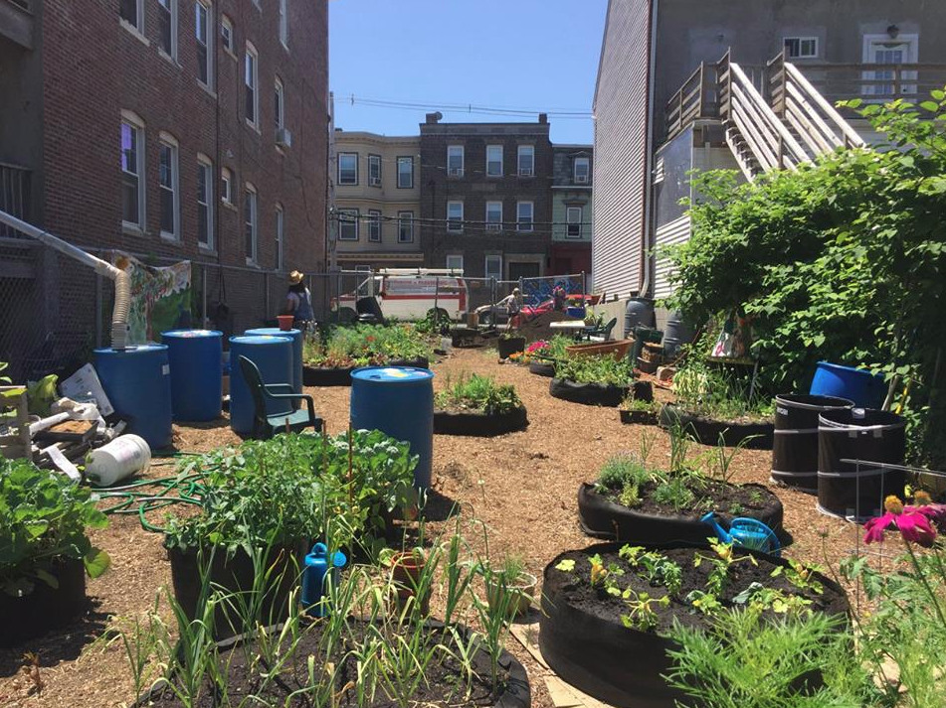
What is the Grassroots Program?
Supports the development of community gardens & other open spaces
Provides grant funds, City-owned land, and technical assistance to neighborhood groups and non-profits
Windermere Road Garden, Dorchester
Eastie Farm, East Boston

Slide 4
Site
632 Morton Street

Slide 5
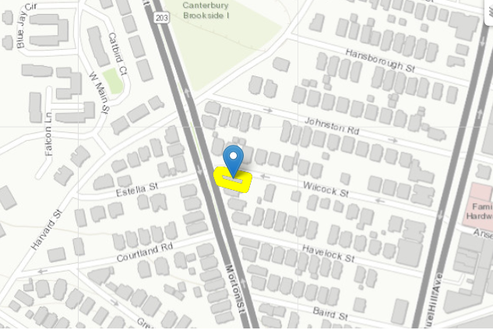
632 Morton Street - Map

Slide 6
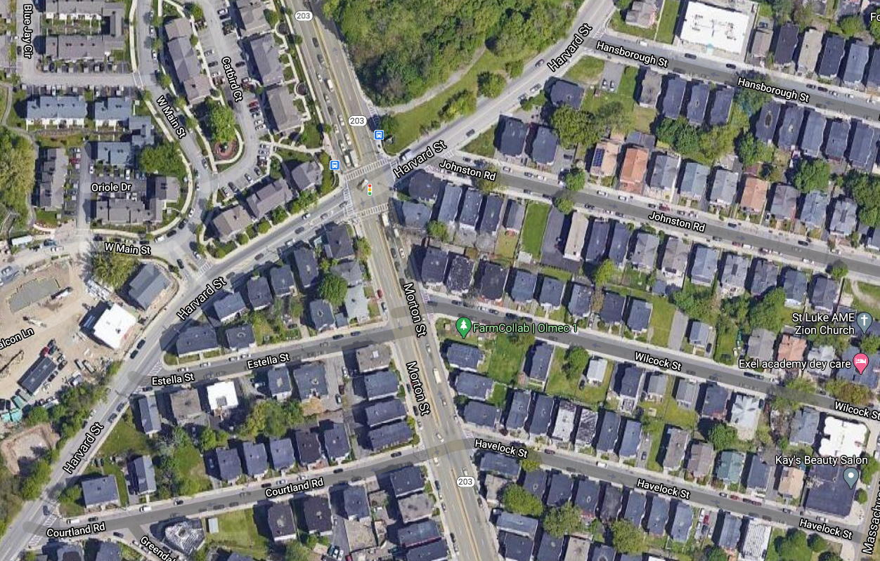
632 Morton Street - Satellite View
LOREM

Slide 7
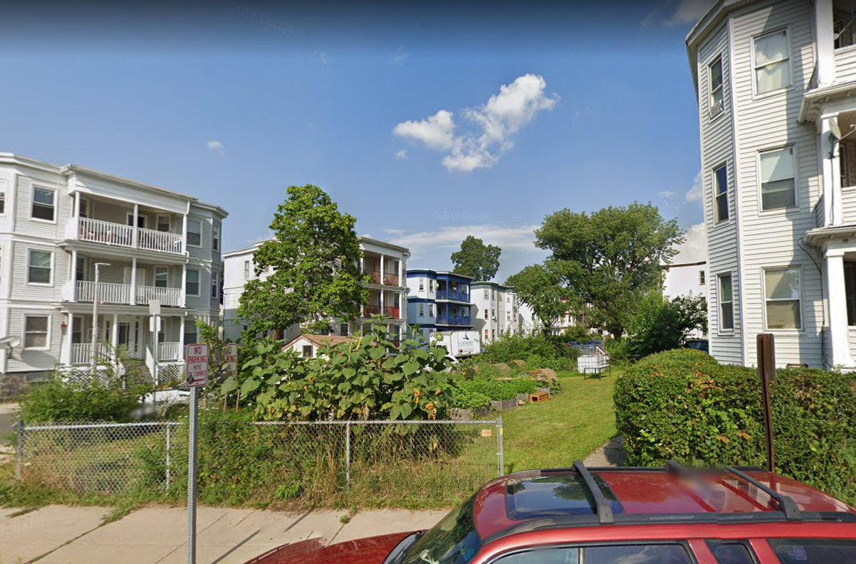
632 Morton Street - Street View

Slide 8
Discussion: Comments and Questions
632 Morton Street

Slide 9
PROPOSED FUTURE USE
Community open space
Open year-round for public use
Raised garden beds for community use
Possible food forest – fruit trees and bushes for free community food access
Possible greenhouse for community use
Permanently protected as open space

Slide 10
WE WANT TO HEAR FROM YOU!
Do you have any questions or concerns regarding the permanent use of this site as open space for community use including a food forest and greenhouse?
Do you want to see this space be preserved as public open space into the future?
Is there anything you would NOT want to see on this site?
Any other comments, questions, or concerns?

Slide 11
Next Steps
632 Morton Street

Slide 12
THANK YOU!
Shani Fletcher / Development Officer
(617) 635-0466 / shani.fletcher@boston.gov

